Slide 1
Unit – 2
Introduction to Arduino and Sensors

Slide 2
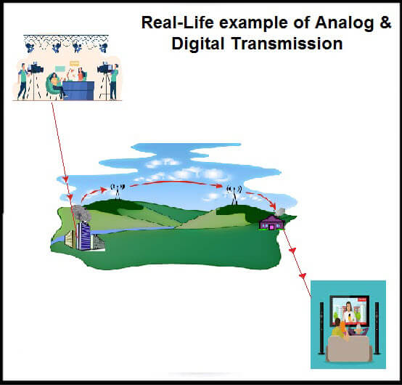
Analog and Digital Signals

Slide 3
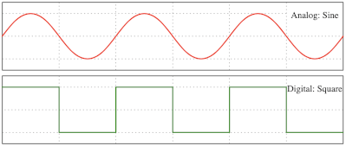
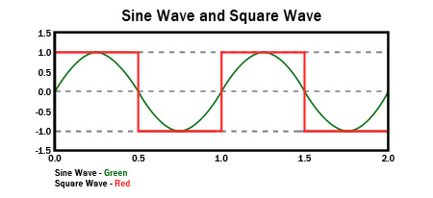
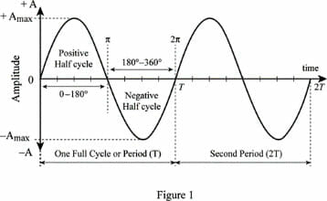
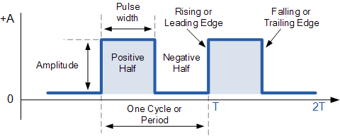
What are Analog and Digital Signals

Slide 4
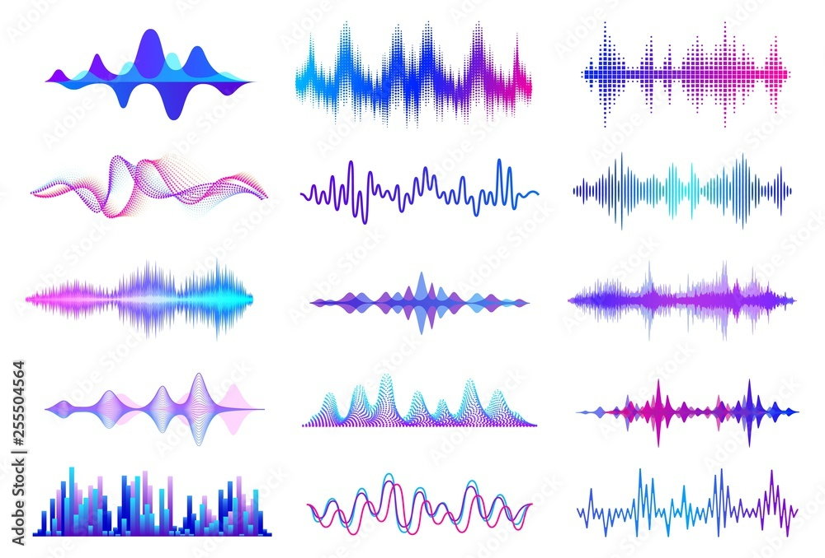
Analog Signals
Temperature Reading
Audio Waveform
Can Take Infinite Values
Continues in Time and Amplitude

Slide 5
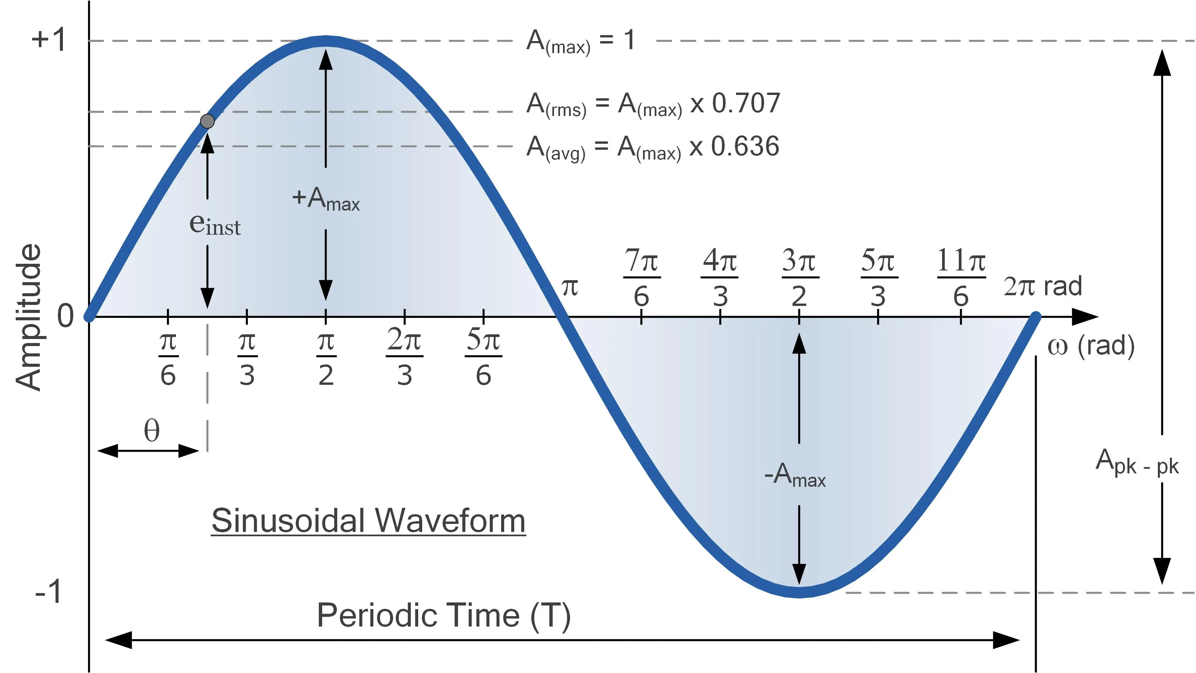
What are Signals?
Signals carry information in the form of variations in physical quantities
Instantaneous Value ?
Frequency ?
Average Value ?
Time Period ?
Peak Value ?
Amplitude ?
RMS Value ?

Slide 6
Solve
Determine the average value and RMS value of sinusoidal current of peak value 40A.
Notes:
Rms =28.28, avg = 25.56

Slide 7
Solve
Write the instantaneous value for a 50Hz sinusoidal voltage supply for domestic purposes at 230V.
Notes:
V = 325 sin 314 t

Slide 8
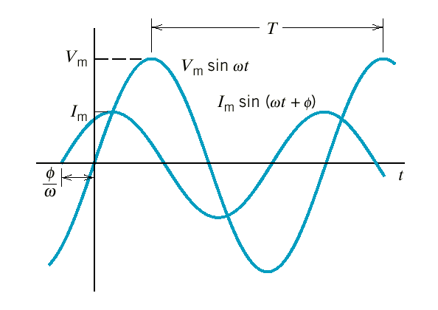
Lags vs Leads
cosθ = sin ⎛θ + ^{π ⎞}
⎜ ₂ ⎟
⎝
⎠
sinθ = cos⎛θ − ^{π ⎞}
⎜ ₂ ⎟
⎝ ⎠
The current leads the voltage by φ radians.
OR
The voltage lags the current by φ radians.

Slide 9
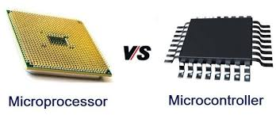

Slide 10
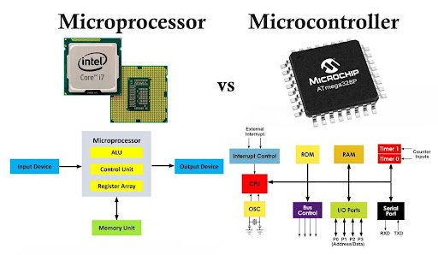

Slide 11
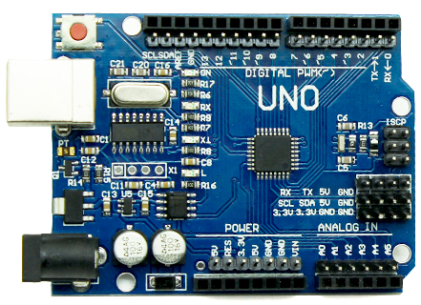
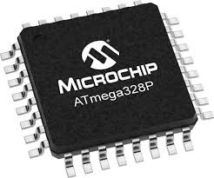
Micro-Controller vs Arduino

Slide 12
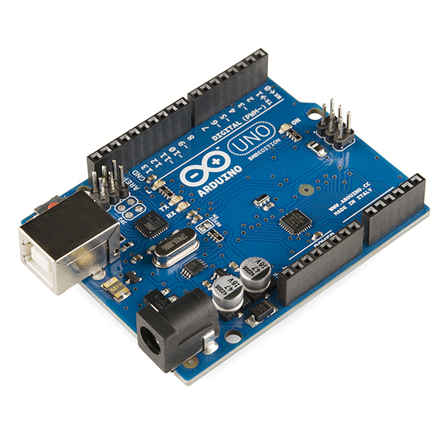
What is Arduino ?
Created in 2005 by Two Italian engineers
“Uno" means one in Italian and is named to mark the version, Arduino 1.0
A microcontroller board, contains
David Cuartielles and Massimo Banzi
on-board power supply
USB port to communicate with PC
Atmel microcontroller chip
standard board that can be programmed
Open source hardware
any one can get the details of its design & modify it or make his own one himself
connected to the system without any sophisticated PCB design and implementation

Slide 13
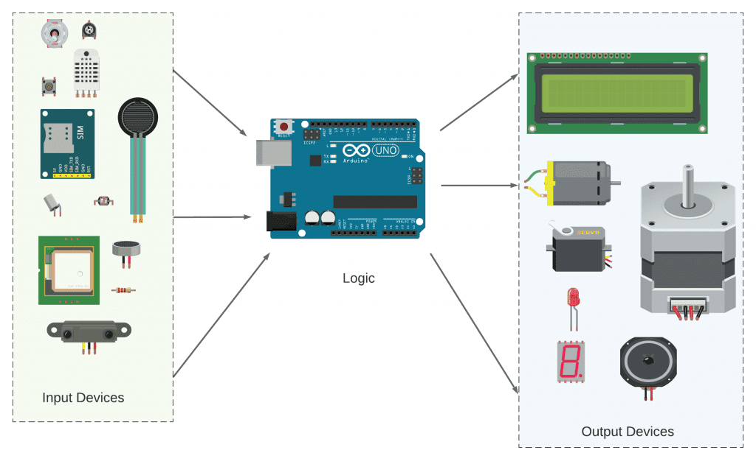
What can you do?
Sensors (to sense Stuff)
Buttons
Variable Resistance
Actuators (To do Stuff)
Lights
Motors
Push Buttons
Touch Pads
Tilt Switch
Volume Knobs
Sliders
Photoresistors
Thermistors
Ultrasound
IR sensor
LEDs
Speakers
Display (LCDs)

Slide 14
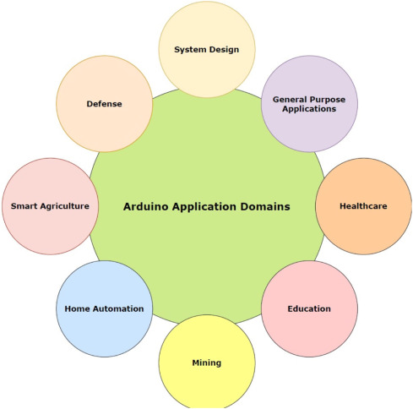
Why Arduino ?

