Slide 1
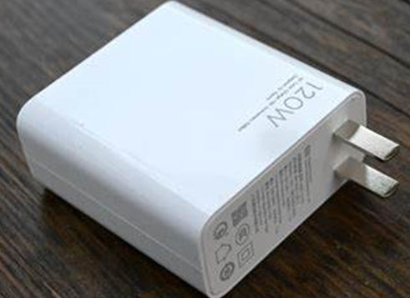
Semiconductor Diode
Working of semiconductor diode in no bias, forward bias conditions & reverse bias condition

Slide 2
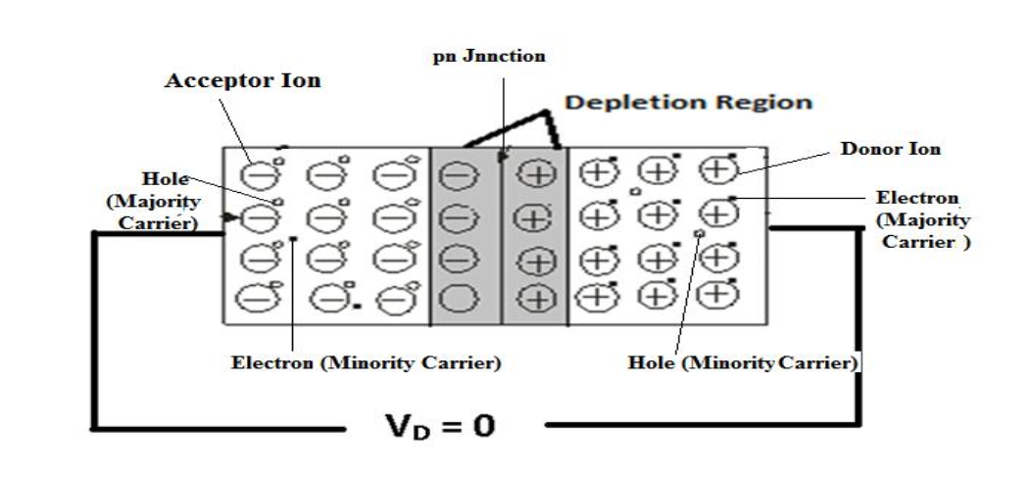
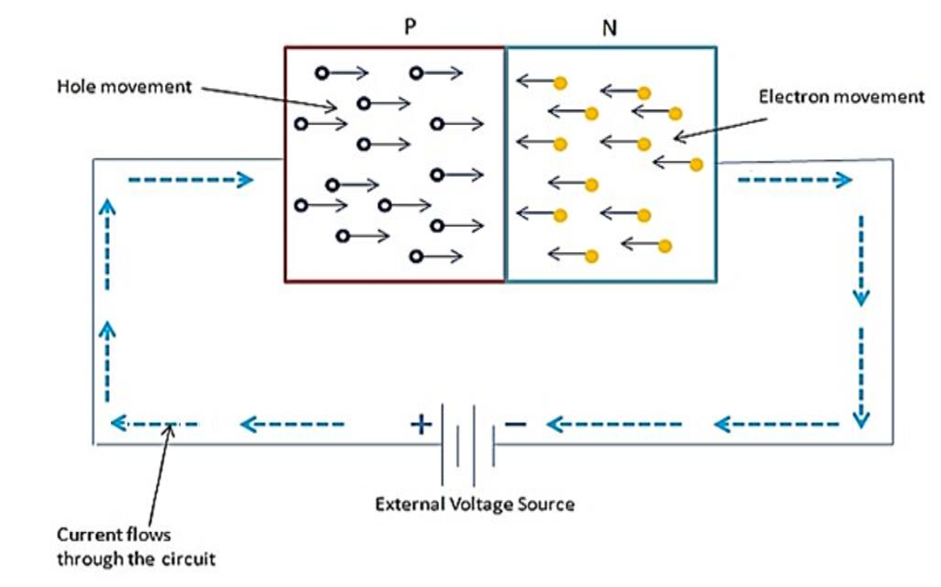
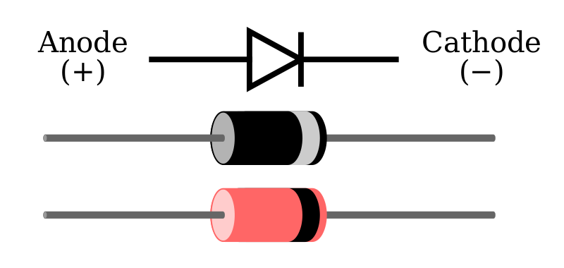
PN Junction Diode ( No Biased and Forward Bias)
Diode, semiconductor material, such as silicon, in which half is doped as p-region and half is doped as n-region with a PN-junction in between.
The p region is called anode and n type region is called cathode.
It conducts current in one direction and offers high (ideally infinite) resistance in other direction.
Notes:
Random topics just for revising some concepts.

Slide 3
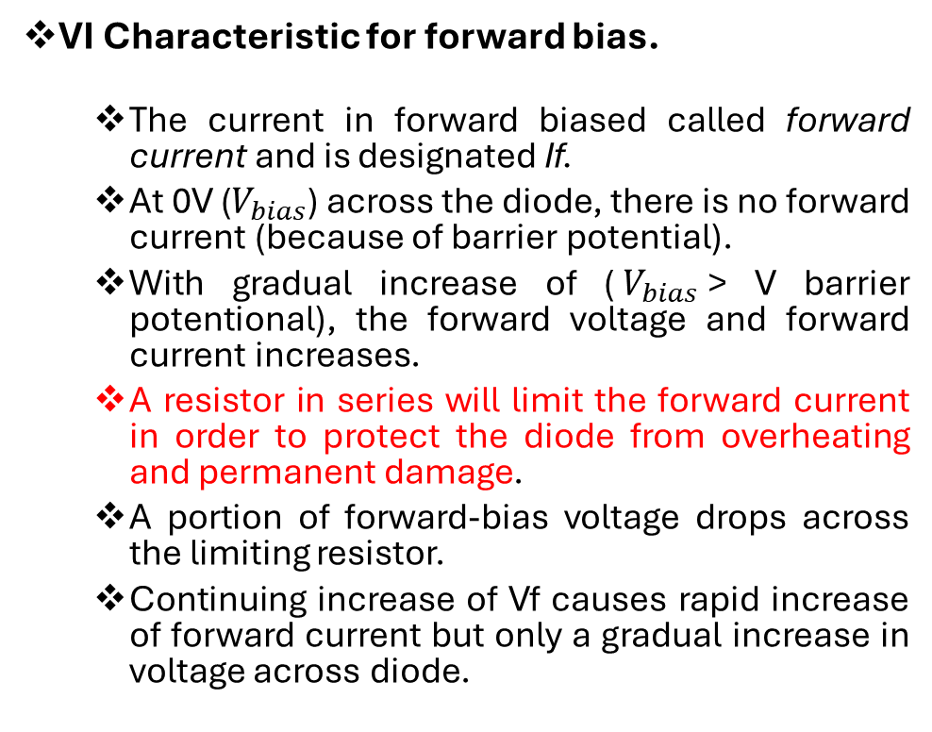
VI Characteristics of Diode for Forward Bias
VI Characteristic for forward bias.
The current in forward biased called forward current and is designated If.
At 0V ($V_{bias}$) across the diode, there is no forward current (because of barrier potential).
With gradual increase of ($V_{bias}$> V barrier potentional), the forward voltage and forward current increases.
A resistor in series will limit the forward current in order to protect the diode from overheating and permanent damage.
A portion of forward-bias voltage drops across the limiting resistor.
Continuing increase of Vf causes rapid increase of forward current but only a gradual increase in voltage across diode.
Function of R ?
IF= (Vbias-VF)/R
Notes:
Random topics just for revising some concepts.

Slide 4
QUICK QUIZ (POLL)
A diode has forward resistance of the order of ……………
kΩ
Ω
MΩ
none of the above

Slide 5
QUICK QUIZ (POLL)
The knee voltage of a crystal diode is approximately equal to ………….
A) applied voltage
B) breakdown voltage
C) forward voltage
D) barrier potential

Slide 6
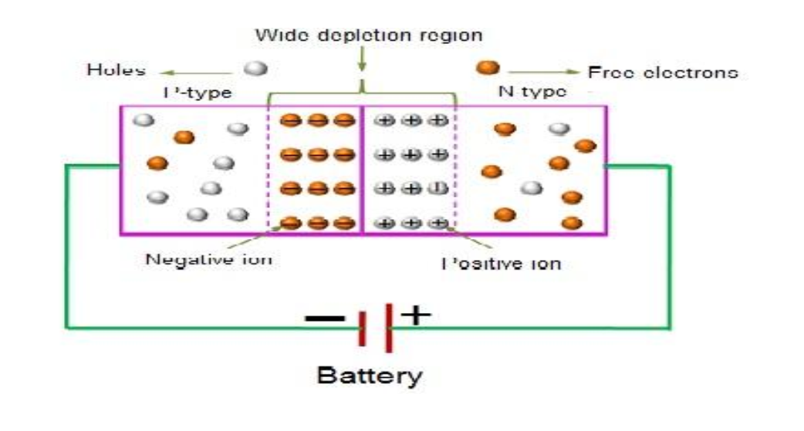
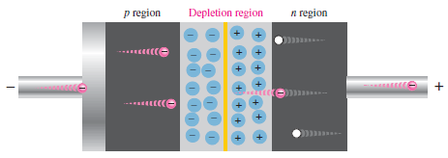
PN Junction Diode (Reverse Bias)
Depletion region get wider
Effective resistance increases (high in K ohm).
A high potential barrier is created across the junction thus preventing current from flowing through the semiconductor material.
Act as open switch (ideal , R=Infinite)
A small amount current is generated due to the minority carriers in p and n regions called leakage current or reverse saturation current
Notes:
Random topics just for revising some concepts.

Slide 7
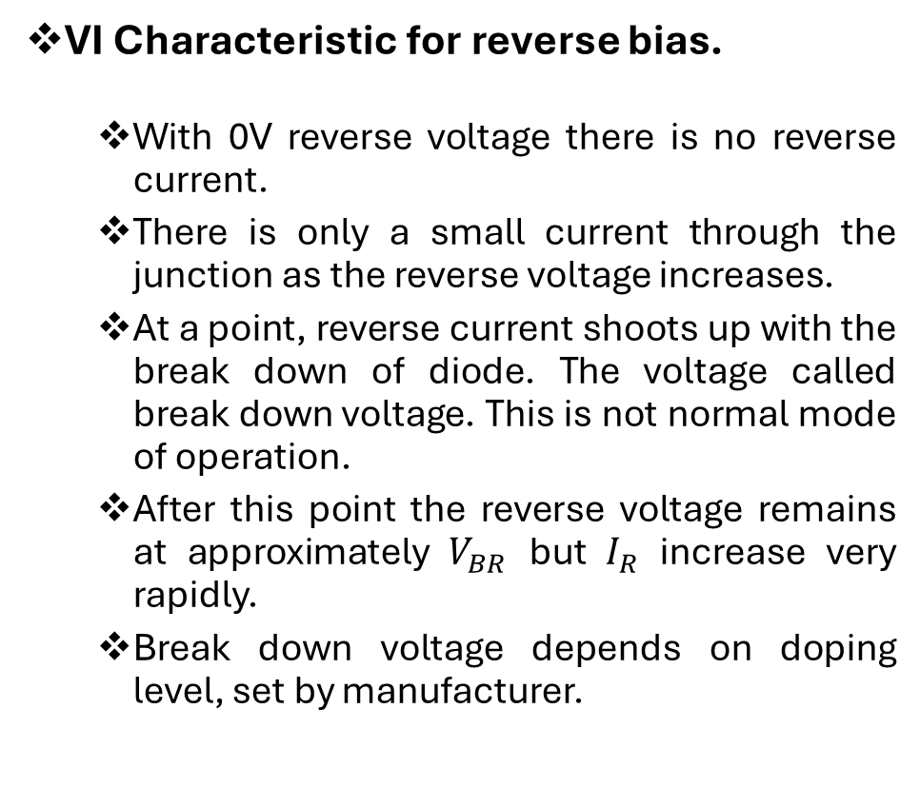
VI Characteristics of Diode for Reverse Bias
VI Characteristic for reverse bias.
With 0V reverse voltage there is no reverse current.
There is only a small current through the junction as the reverse voltage increases.
At a point, reverse current shoots up with the break down of diode. The voltage called break down voltage. This is not normal mode of operation.
After this point the reverse voltage remains at approximately $V_{BR}$ but $I_{R}$ increase very rapidly.
Break down voltage depends on doping level, set by manufacturer.
Notes:
Random topics just for revising some concepts.

Slide 8
QUICK QUIZ (POLL)
A silicon diode has an external bias voltage is 12V with an external resistor of 150 ohm. What is the total forward current
a) 150mA
b) 100mA
c) 75mA
d) 12mA

Slide 9
QUICK QUIZ (POLL)
In a PN junction when the applied voltage overcomes the ........ potential, the diode current is large, which is known as .............
A) Depletion, negative bias
B) Reverse, reverse bias
C) Resistance, reverse bias
D) Barrier, forward bias

Slide 10
Avalanche breakdown
The reverse bias increases the electrical field across the depletion region. When the high electric field exists across the depletion, the velocity of minority charge carrier crossing the depletion region increases. These carriers collide with the atoms of the crystal. Because of the violent collision, the charge carrier takes out the electrons from the atom.
The collision increases the electron-hole pair. As the electron-hole induces in the high electric field, they are quickly separated and collide with the other atoms of the crystals. The process is continuous, and the electric field becomes so much higher then the reverse current starts flowing in the PN junction. The process is known as the Avalanche breakdown. After the breakdown, the junction cannot regain its original position because the diode is completely burnt off.

Slide 11
Avalanche Breakdown Phenomenon:
After certain reverse voltage across the junction, the minority carriers get sufficient kinetic energy due to reverse voltage and the strong electric field.
Free electrons with sufficient kinetic energy collide with stationary ions of the depletion layer and knock out more free electrons.
These newly created free electrons also get sufficient kinetic energy due to the same electric field, and they create more free electrons by collision cumulatively.
As a result, very soon, huge number of free electrons get created in the depletion layer, and the entire diode will become conductive.
This type of breakdown of the depletion layer is known as avalanche breakdown.

Slide 12
Reverse Breakdown in the Reverse Bias
If the external bias voltage is increased to a value call breakdown voltage the reverse current can increase drastically.
Free minority electrons get enough energy to knock valance electron into the conduction band.
The newly released electron can further strike with other atoms.
Notes:
Random topics just for revising some concepts.

Slide 13
QUICK QUIZ (POLL)
During reverse bias, a small current develops known as a) Forward current b) Reverse current c) Reverse saturation current d) Active current
(In pico ampere)

Slide 14
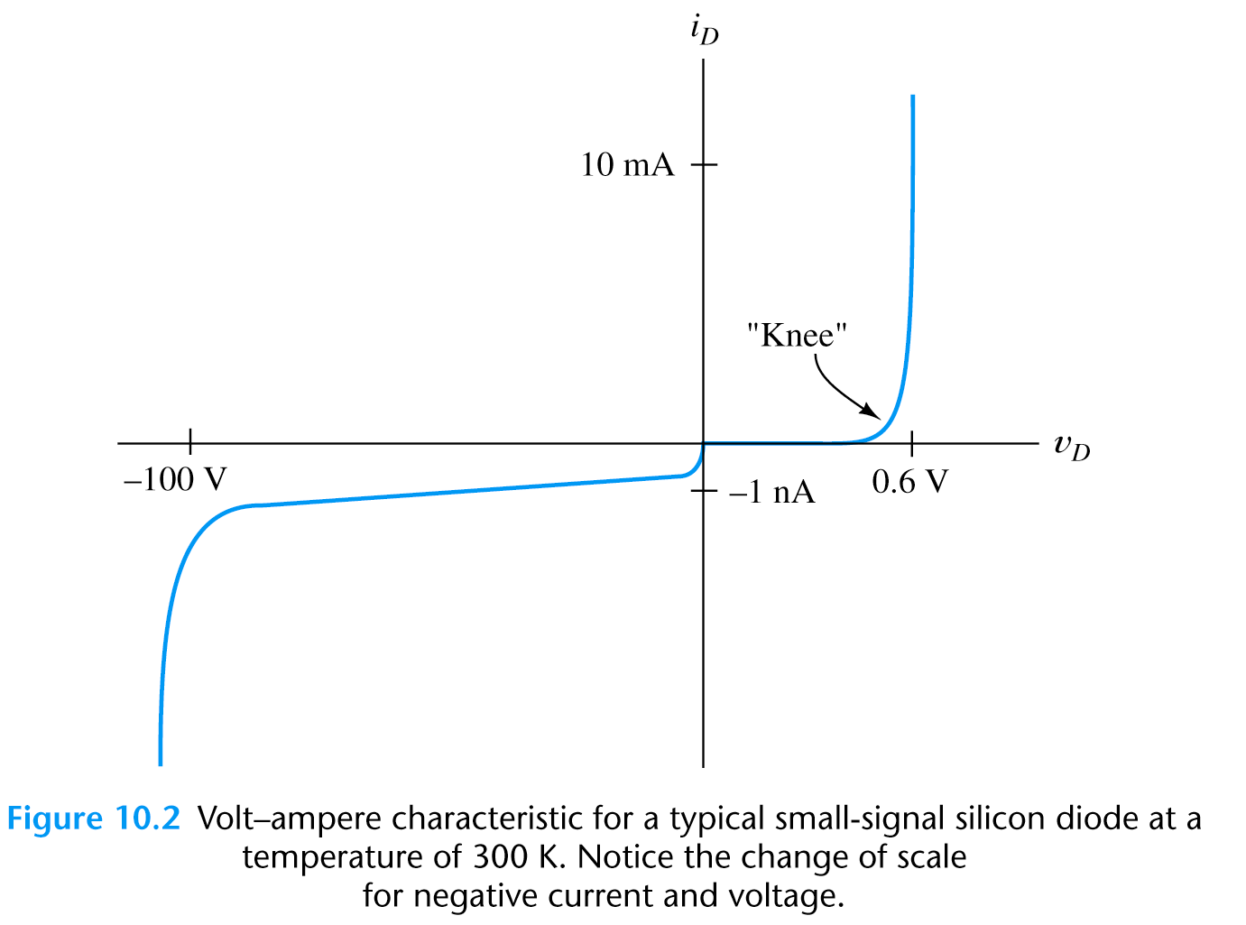
Shockley Equation
* The Shockley equation is a theoretical result under certain simplification:

Slide 15
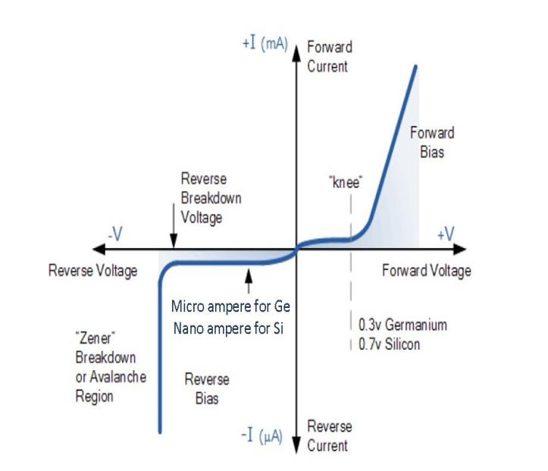
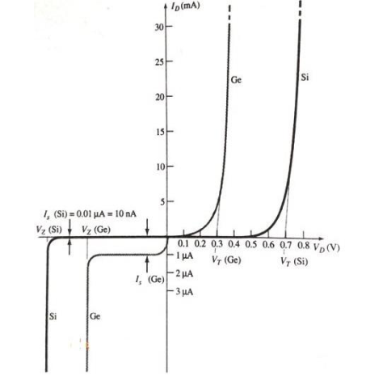
Complete VI Characteristics of Diode

Slide 16
QUICK QUIZ (POLL)
An ideal crystal diode is one which behaves as a perfect ……….. when forward biased.
conductor
insulator
resistance material
none of the above

Slide 17
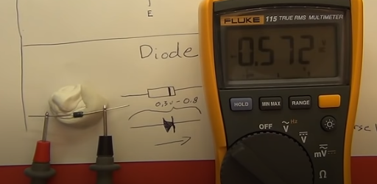
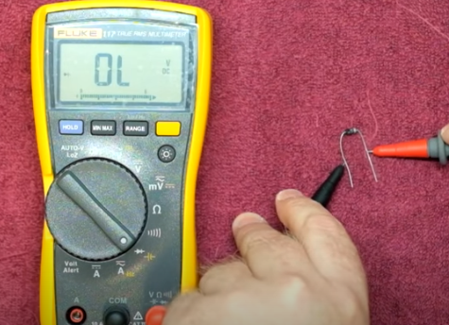
Testing of diode
https://www.youtube.com/watch?v=8LGD5LdOzEM

Slide 18
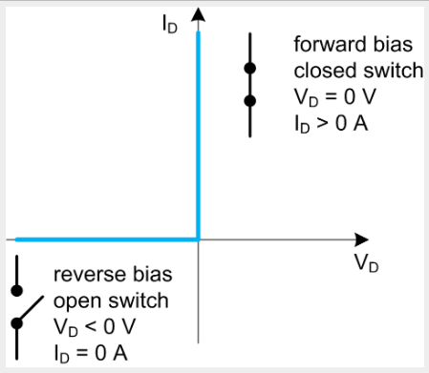
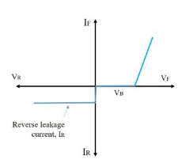
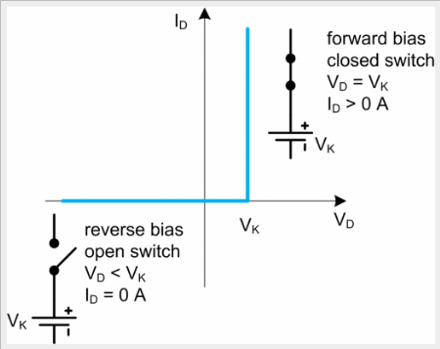
Diode Model
Ideal Diode
Practical Diode

Slide 19
Applications of a Diode
Rectifiers
Half Wave Rectifier
Full Wave Rectifier
Clipper
Clamper

Slide 20
The knee voltage of a diode approximately is equal to the
A.Breakdown voltage
B.Barrier potential
C.Applied voltage
D.Forward voltage

Slide 21
The turn-on voltage of a Ge junction diode is
A.1.0 V
B.0.3 V
C.0.7 V
D.0.1 V

Slide 22
In reverse biased diode, as the reverse voltage decreases the depletion region
A.Remains same
B.Decreases
C.Increases
D.Depends on doping

Slide 23
The forward region of a semiconductor diode characteristic curve is where diode appears as
A.An OFF switch
B.A capacitor
C.A constant current source
D.An ON switch

Slide 24
Application of forward bias to a junction diode
A.Reduces forward current
B.Reduces minority carrier current
C.Reduces potential barrier height
D.All of the above

Slide 25
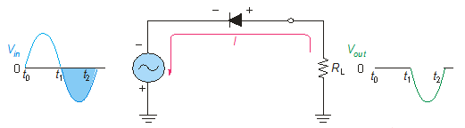
Diode as Rectifiers
Reversing diode.
Average value of Half wave output voltage:
VAVG = VP / pi
VAVG is approx 31.8% of Vp
PIV: Peak Inverse Voltage = Vp

Slide 26
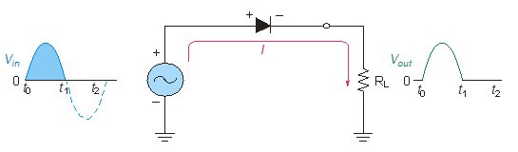
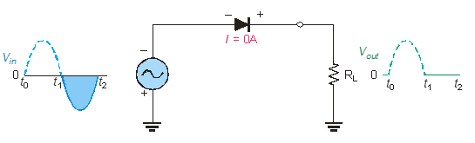
Half wave Rectifiers
As diodes conduct current in one direction and block in other.
When connected with ac voltage, diode only allows half cycle passing through it and hence convert ac into dc.
As the half of the wave get rectified, the process called half wave rectification.
A diode is connected to an ac source and a load resistor forming a half wave rectifier.
Positive half cycle causes current through diode, that causes voltage drop across resistor.
Notes:
Random topics just for revising some concepts.

Slide 27
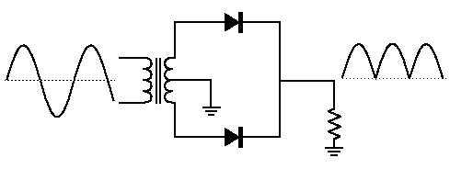
Full wave rectifiers
A full wave rectifier allows unidirectional current through the load during the entire 360 degree of input cycle.
The output voltage have twice the input frequency.
VAVG is 63.7% of Vp
Full Wave Rectifier
VAVG = 2VP / pi
Notes:
Random topics just for revising some concepts.

Slide 28
The Center-Tapped Full wave rectifiers
A center-tapped transformer is used with two diodes that conduct on alternating half-cycles.
During the positive half-cycle, the upper diode is forward-biased and the lower diode is reverse-biased.
During the negative half-cycle, the lower diode is forward-biased and the upper diode is reverse-biased.
Notes:
Random topics just for revising some concepts.

Slide 29
The Bridge Full-wave rectifiers
The Bridge Full-Wave rectifier uses four diodes connected across the entire secondary as shown.
Conduction path for the positive half-cycle.
Conduction path for the negative half-cycle.
Notes:
Random topics just for revising some concepts.

Slide 30

The Bridge Full-Wave Rectifier
Example:
Determine the peak output voltage and current in the 3.3 kΩ load resistor if V_{sec} = 24 V_{rms}. Use the practical diode model.
Solution:
The peak output voltage is:
= 32.5 V
Applying Ohm’s law,
I_{p(out)} = 9.8 mA

Slide 31
Application of forward bias to a junction diode
A.Reduces forward current
B.Reduces minority carrier current
C.Reduces potential barrier height
D.All of the above

Slide 32
Homework
Draw the forward and reverse characteristics of a diode and explain which type of current flows during conduction.
What are applications of a Diode? Explain the working of diode as a rectifier with a diagram.

Slide 33
