Slide 1


Slide 2


Slide 3
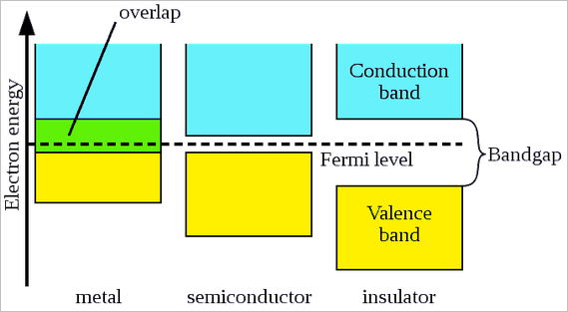
Semiconductors (An Introduction)
In terms of electrical properties, material can be categorized into three parts.
Energy band gap?
Temperature Coefficient of resistance?

Slide 4
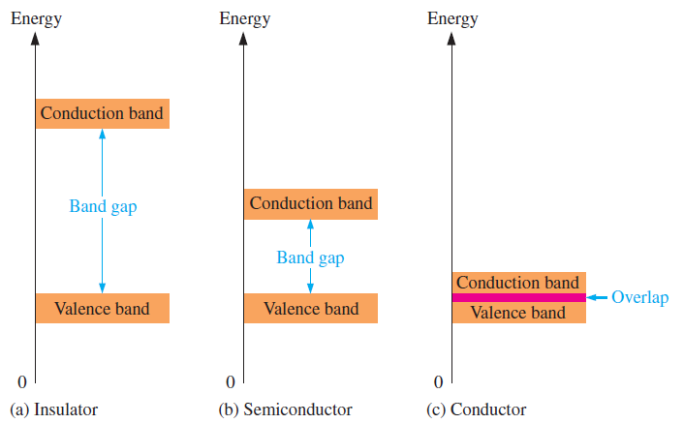
  Conductor and Insulators.
  Atomic Model
the gap can be crossed
only when breakdown
conditions occur
the gap is smaller
and can be crossed
when a photon
is absorbed
the conduction band
and valence band
overlap, so there is no gap

Slide 5
Poll
What effect does temperature have on the conductivity of a semiconductor?
A) Conductivity decreases with an increase in temperature
B) Conductivity remains constant with temperature changes
C) Conductivity increases with an increase in temperature
D) Conductivity initially increases and then decreases with temperature

Slide 6
Semiconductors
Advantages
Small size, so circuits involving devices are very compact.
No heating is required- set into operation after the circuit is switched on.
occupy less space on any PCB board.
require low voltage operation.
Low power consumption.

Slide 7
Semiconductors
Disadvantages
Conductivity changes with variations in the temperature.
Extra components required for stabilization.
Easily damaged (by exceeding power limit).

Slide 8
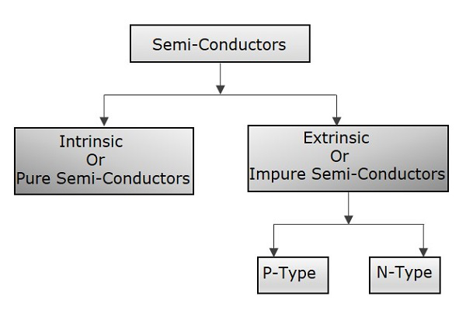
Types of Semiconductors

Slide 9
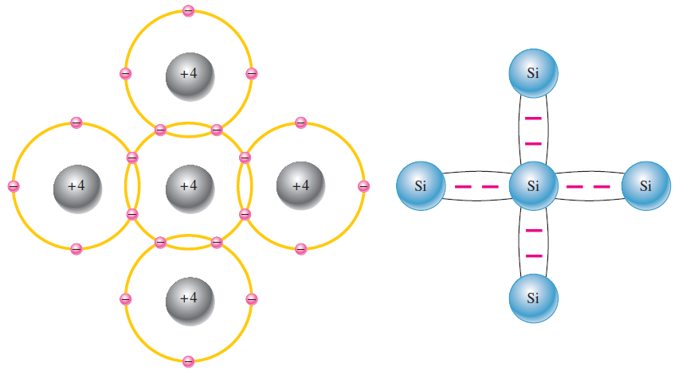
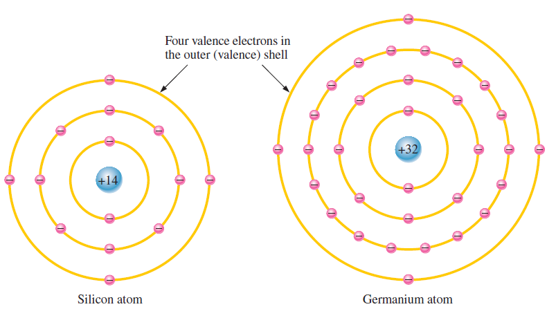
Silicon and Germanium
3.At absolute zero temperature intrinsic semiconductor behaves as insulator.
2.No movement from Valence band to conduction band
1. No energy (all freeze or colder temperature )
2,8,18,4

Slide 10
Advantages Si over Ge
Band Gap
Abundance and Cost
Thermal Stability
Silicon can form a stable SiO₂ layer, which is an excellent insulator.

Slide 11
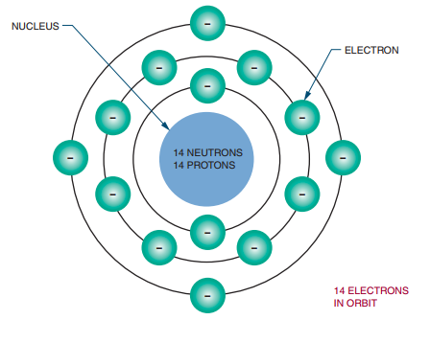
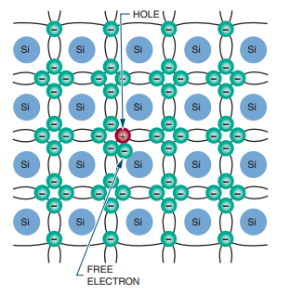
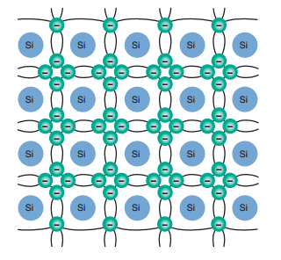
Pure Silicon (Intrinsic)
valence electrons which are loosely attached to the nucleus
At Room temperature
Sharing of valence e called …bonding ??
1.Electron-hole pair generation
2.Recombination (generation of heat ) again breaking of bonds
3. Negative temperature coefficient
Movement of electron from valence to conduction band results electron current and have negative charge

Slide 12
QUICK QUIZ (POLL)
A semiconductor has generally ……………… valence electrons.
3
4
5
6

Slide 13
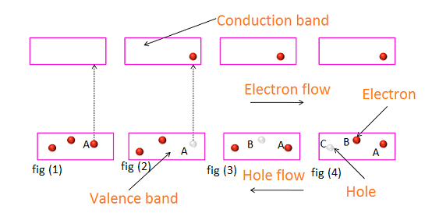
Concept of Hole Current

Slide 14
Summarize Intrinsic Semiconductors
properties of pure semiconductor:
Electrons and holes solely created by thermal excitation.
Number of free electrons = number of holes.
Electron and hole currents both present in pure semiconductor
Conduction capability small at room temperature
How conductivity can be increased ?

Slide 15
QUICK QUIZ (POLL)
A semiconductor is formed by __________ bonds
Covalent
Electrovalent
Co-ordinate
None of the above

Slide 16
POLL
At absolute zero temperature, a pure semiconductor has:
a) Some free electrons in the conduction band.
b) No free electrons in the conduction band.
c) Many free electrons in the conduction band.
d) Only holes in the conduction band.

Slide 17
QUICK QUIZ (POLL)
Intrinsic semiconductors are those
A. Which are made of semiconductor material in its purest form
B. Which has zero energy gap
C. Which have more electrons than holes
D. Which are available locally

Slide 18
Extrinsic Semiconductor
Impure semiconductor- formed by doping
two types - depending upon type of impurity added.
Pentavalent Impurities
Bismuth, Antimony, Arsenic, Phosphorus
Pentavalent atom is called as a donor atom
2. Trivalent Impurities
Gallium, Indium, Aluminum, Boron
Trivalent atom is called as an acceptor atom

Slide 19
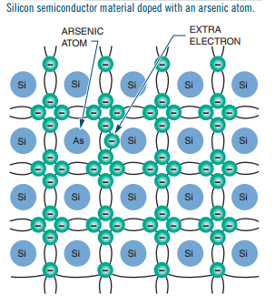
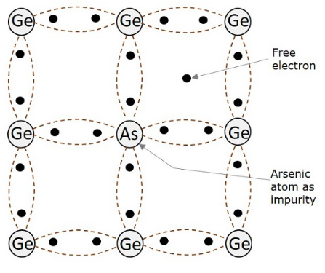
N-Type Extrinsic Semiconductors
as the conduction takes place through electrons,
electrons - majority carriers
holes - minority carriers

Slide 20
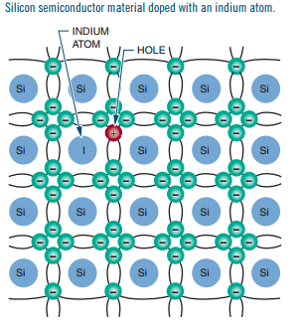
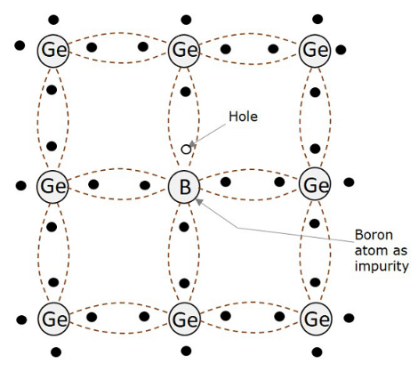
P-Type Extrinsic Semiconductors
as the conduction takes place through holes, holes are majority carriers
electrons are minority carriers.

Slide 21
An n-type semiconductor is created by doping silicon with an element that has:
a) More electrons than silicon
b) Fewer electrons than silicon
c) No electrons at all
d) The same number of electrons as silicon

Slide 22
QUICK QUIZ (POLL)
A P-type semiconductor results when
A. A pentavalent impurity is added to an intrinsic semiconductor
B. A trivalent impurity is added to an intrinsic semiconductor
C. Either a pentavalent or trivalent impurity is added to an intrinsic semiconductor
D. None of the above

Slide 23
Homework
Draw the energy band gap diagram for Insulator, Semiconductor and Conductor and explain the reason for different conductivity.
What is the difference between Intrinsic and Extrinsic Semiconductor? Differentiate between N-type and P-type Semiconductor.

Slide 24

