Slide 1
Unit-6:
Applications of Sequential Logic
Register

Slide 2
Register
Flip-flop is a 1 bit memory cell.
Group of flip-flop is known as a Register.
n-bit register- n number of flip-flop

Slide 3
Application of shift register
As a parallel to serial converter,
As a serial-to-parallel converter,
Used as a sequence generator.
Used as counters
Those are Ring counter and Johnson Ring counter.

Slide 4
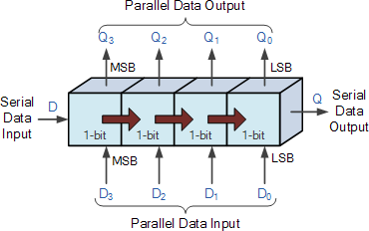
Types of Shift Register
The Shift Register used for the storage or the transfer of binary data.
Serial-in to Serial-out (SISO)
Serial-in to Parallel-out (SIPO)
Parallel-in to Serial-out (PISO)
Parallel-in to Parallel-out (PIPO)

Slide 5
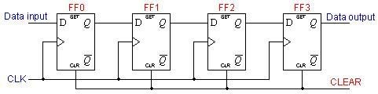
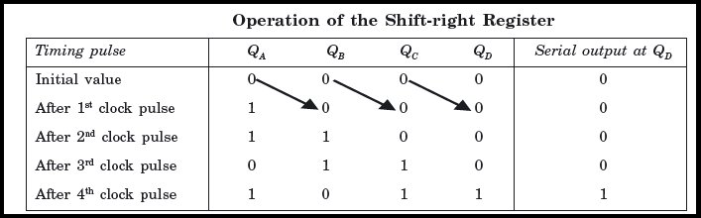
Serial-in to Serial-out (SISO) Shift Register
All the FF are reset .
logical input 1011 is applied at the serial input line connected to stage FF0

Slide 6
MCQ
Assume that a 4-bit serial in/serial out shift register is initially clear. We wish to store the nibble 1100. What will be the 4-bit pattern after the second clock pulse? (Right-most bit first)
a) 1100
b) 0011
c) 0000
d) 1111

Slide 7
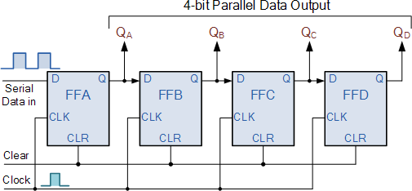
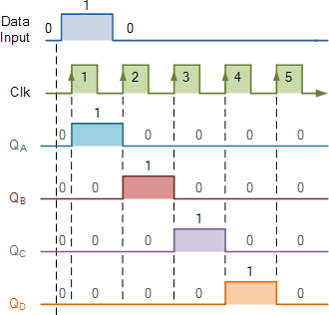
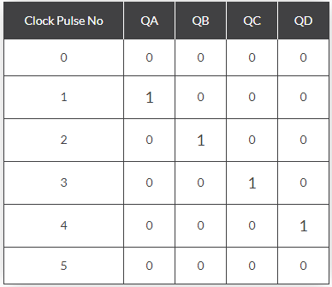
Serial-in to Parallel-out Shift Register

Slide 8
MCQ
The group of bits 11001 is serially shifted (right-most bit first) into a 5-bit parallel output shift register with an initial state 01110. After three clock pulses, the register contains ________ .
a) 01110
b) 00001
c) 00101
d) 00110

Slide 9
MCQ
A serial in/parallel out, 4-bit shift register initially contains all 1s. The data nibble 0111 is waiting to enter. After four clock pulses, the register contains _______ .
a) 0000
b) 1111
c) 0111
d) 1000

Slide 10
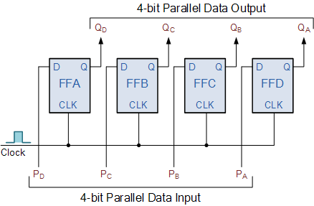
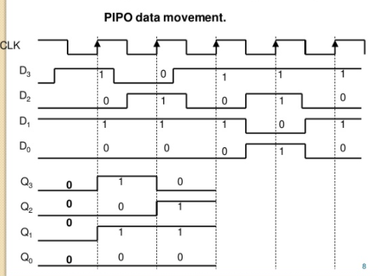
Parallel-in to Parallel-out Shift Register

Slide 11
MCQ
In a PIPO register, what happens to the data when the clock signal is triggered?
A) Data is shifted serially from input to output.
B) Data is written to the input and appears at the output.
C) Data is discarded from the register.
D) Data is stored in the register but not transferred.

Slide 12
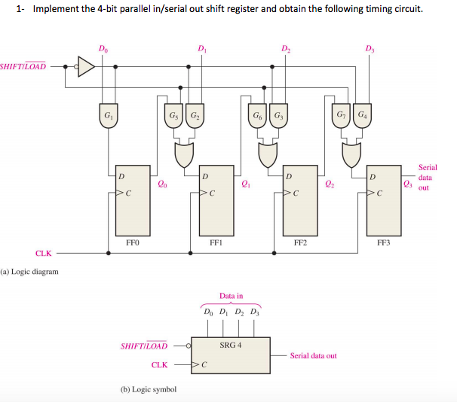
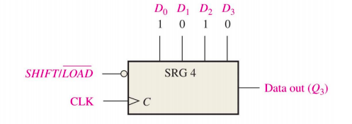
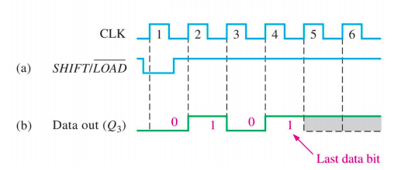
PISO Shift Register
Require 1 clk to load parallel data

