Slide 1
Unit-4 : Combinational Circuit
Decode-Encoder

Slide 2
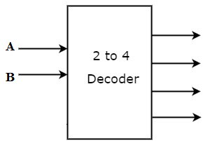

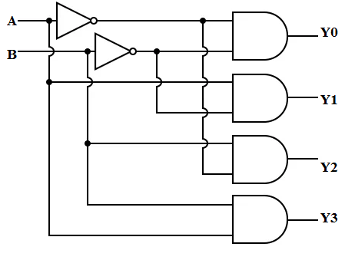
Decoder
A combinational circuit that has ‘n’ input lines and maximum of 2^{n} output lines.
One of these outputs will be active High based on the combination of inputs present, when the decoder is enabled.
The outputs of the decoder are min terms of ‘n’ input variables lines when it is enabled.
Size of Decoder are 2:4, 3:8, 4:16….
A₁ | A₀ | Y₃ | Y₂ | Y₁ | Y₀
0 | 0 | 0 | 0 | 0 | 1
0 | 1 | 0 | 0 | 1 | 0
1 | 0 | 0 | 1 | 0 | 0
1 | 1 | 1 | 0 | 0 | 0

Slide 3
MCQ
Which one of the following represents the decoder ?
4:1
1:4
3:8
8:3

Slide 4
MCQ
How many inputs and outputs for four variable function in a decoder.
4,1
4,16
3,8
16, 1

Slide 5
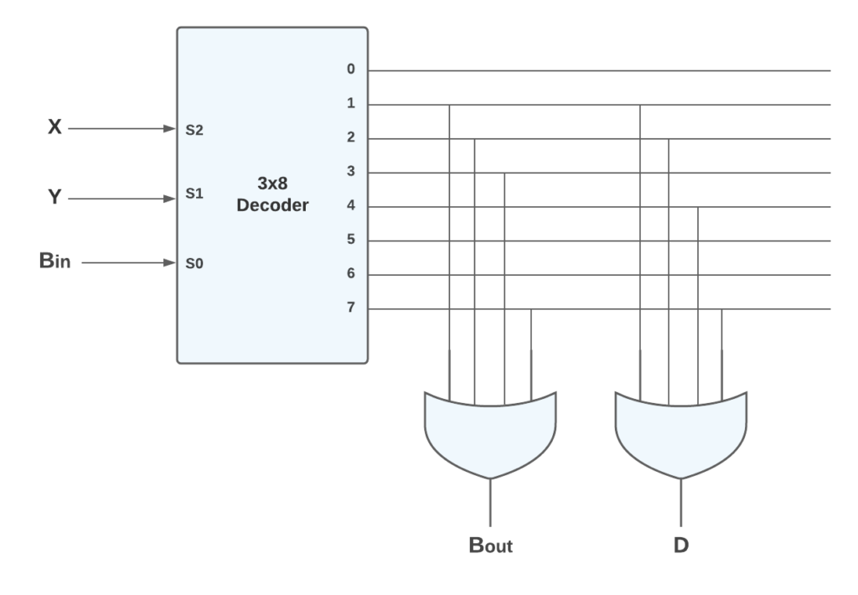
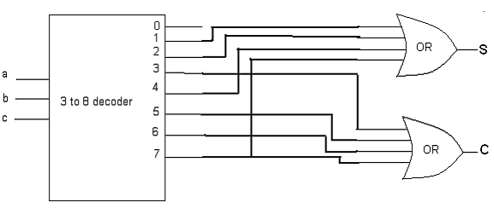
Full Adder using 3:8 Decoder
Full Subtractor using 3:8 Decoder
S = A’B’C + A’BC’ + AB’C’ + ABC = Σ(1,2,4,7)
CY = A’BC +AB’C +ABC’+ABC= Σ (3, 5, 6, 7)
Difference (D) = A’B’C + A’BC’ + AB’C’ + ABC = Σ(1,2,4,7)
Borrow(Bout) = A’B’C +A’BC’ +A’BC+ABC= Σ (1, 2, 3, 7)
Y

Slide 6
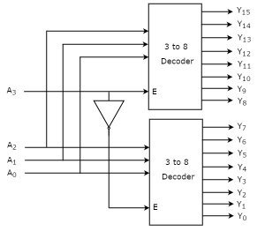
Q. Implement 4:16 decoder using 3:8 decoder.

Slide 7
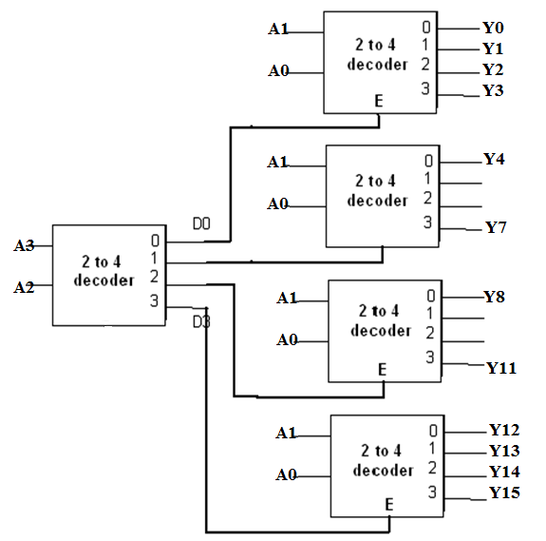
Q. Implement 4:16 decoder using 2:4 decoder
A3 | A2 | A1 | A0 | HIGH OUTPUT
0 | 0 | 0 | 0 | Y0
0 | 0 | 0 | 1 | Y1
0 | 0 | 1 | 0 | Y2
0 | 0 | 1 | 1 | Y3
0 | 1 | 0 | 0 | Y4
0 | 1 | 0 | 1 | Y5
0 | 1 | 1 | 0 | Y6
0 | 1 | 1 | 1 | Y7
1 | 0 | 0 | 0 | Y8
1 | 0 | 0 | 1 | Y9
1 | 0 | 1 | 0 | Y10
1 | 0 | 1 | 1 | Y11
1 | 1 | 0 | 0 | Y12
1 | 1 | 0 | 1 | Y13
1 | 1 | 1 | 0 | Y14
1 | 1 | 1 | 1 | Y15

Slide 8
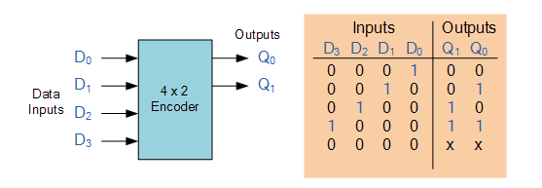
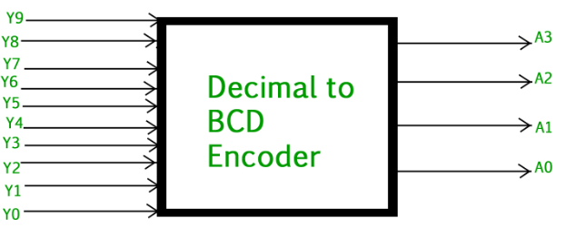
Encoder
Reverse operation of a Decoder.
It has a maximum of 2^n input lines and 'n' output lines.
It encodes the information from 2^n inputs into an n-bit code.
It will produce a binary code equivalent to the input, which is active High.

