Slide 1
Unit-4 : Combinational Circuit
Multiplexers-De-multiplexers

Slide 2
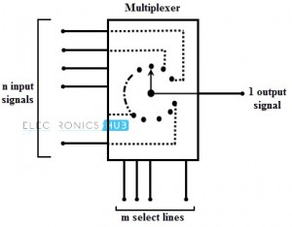
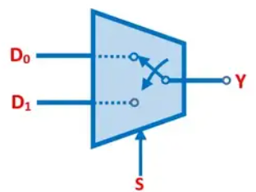



Multiplexer
Also called data selectors.
Basic function: Select one of its $2^{n}$ data input lines and place the corresponding information onto a single output line.
$n$ input bits needed to specify which input line is to be selected.
Place binary code for a desired data input line onto its $n$ select input lines.
$$2^{n}$$
$$n$$

Slide 3
Q1. What is the primary function of a multiplexer?
A) To perform arithmetic operations B) To select one input from multiple inputs C) To store data D) To decode data

Slide 4
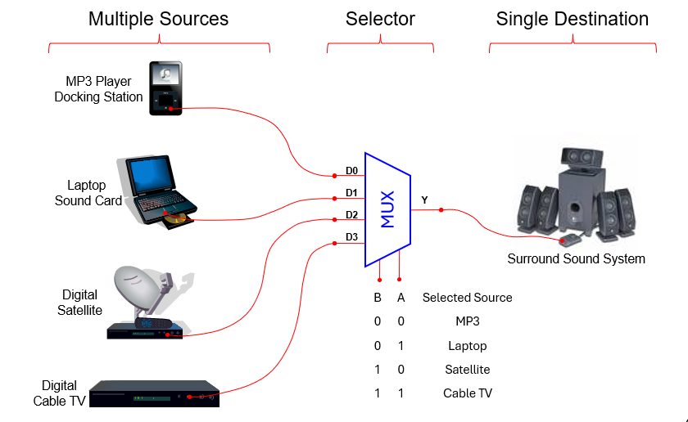
Typical Application of a MUX
One of the primary applications of multiplexers is to provide for the transmission of information from several sources over a single path. This process is known as multiplexing

Slide 5
MCQ
Q. The two input MUX would have __________
a) 1 select line b) 2 select lines c) 4 select lines d) 3 select lines

Slide 6
MCQ
Q. 4 to 1 MUX would have ____________
a) 2 inputs b) 3 inputs c) 4 inputs d) 5 inputs

Slide 7
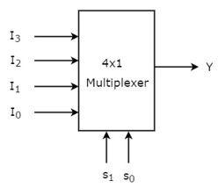
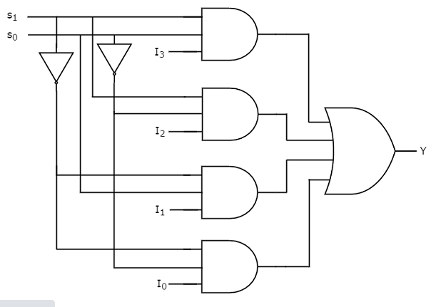

4:1 Multiplexer
Selection Lines |  | Output
S₁ | S₀ | Y
0 | 0 | I₀
0 | 1 | I₁
1 | 0 | I₂
1 | 1 | I₃

Slide 8
Q. Y(A, B,C) = ∑m (1, 3, 5, 6) implement with 4:1 multiplexer

Slide 9
Q. Y(A, B,C) = ∑m (1, 2, 4, 5) implement with 4:1 multiplexer.

Slide 10
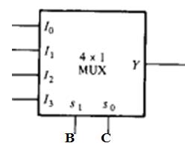
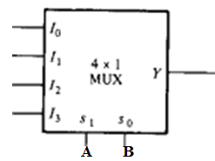
Expression implementation with Multiplexer
Q. Y(A, B,C) = ∑m (1, 3, 5, 6) implement with 4:1 multiplexer
Q. Y(A, B,C) = ∑m (1, 2, 4, 5) implement with 4:1 multiplexer
Any 2 input (AB/BC/AC) select line
Any 2 input (AB/BC/AC) select line
0
C
1
C’
A
1
A’
0
Rearrange equation with selection line
Rearrange equation with selection line
I0 I1 I2 I3
I0 I1 I2 I3

Slide 11
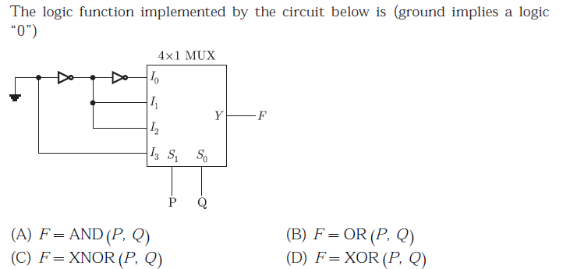
MCQ

Slide 12
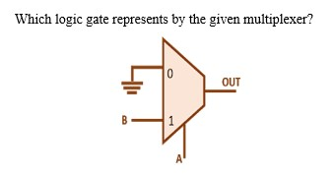
Logic Gate implementation with 2:1 Multiplexer
AND
OR
XOR
NAND

Slide 13
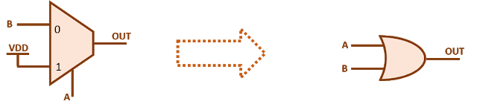
AND
OR
XOR
NAND

Slide 14
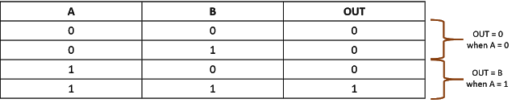

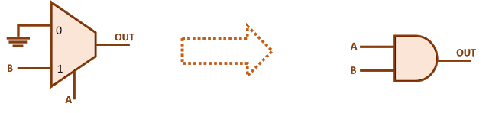


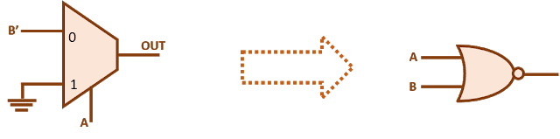
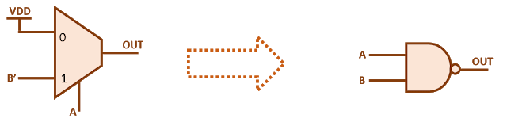
Logic Gate implementation with 2:1 Multiplexer
AND GATE
OR GATE
NOR GATE
NAND GATE

Slide 15


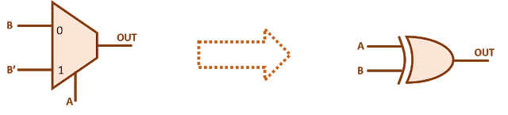
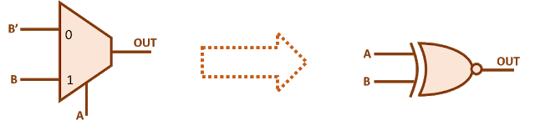
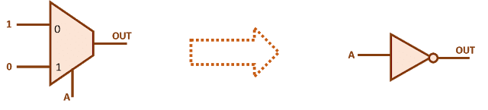

Logic Gate implementation with 2:1 Multiplexer
XOR GATE
XNOR GATE
NOT GATE

Slide 16
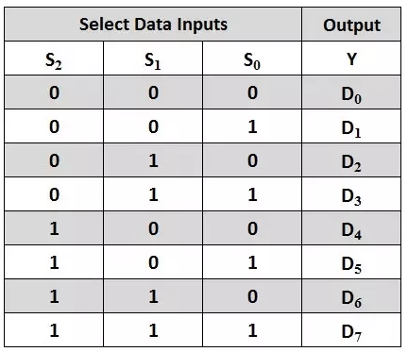
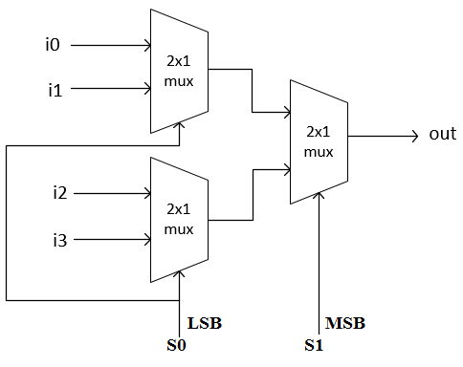
4:1 Mux using 2:1 Mux
8:1 Mux using 4:1 and 2:1 Mux
S1 (MSB) | S0(LSB) | Out
0 | 0 | I0
0 | 1 | I1
1 | 0 | 12
1 | 1 | I3

Slide 17
Q. Design 16:1 MUX using 4:1 MUX

Slide 18
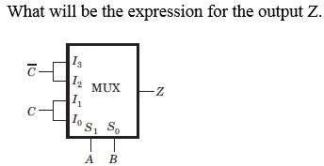
Question:

Slide 19
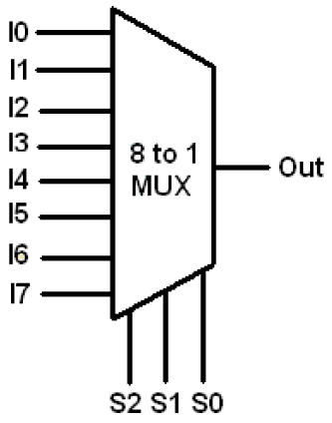
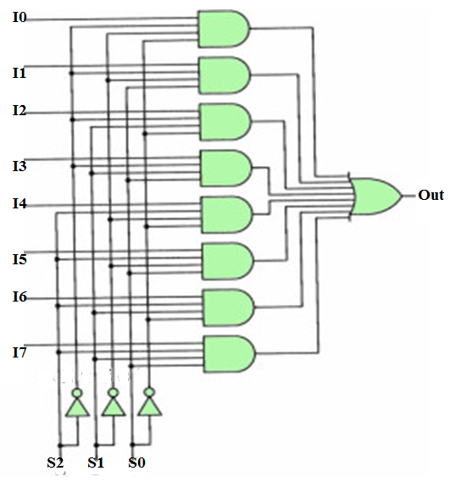
8:1 Multiplexer
S2 | S1 | S0 | Out
0 | 0 | 0 | I0
0 | 0 | 1 | I1
0 | 1 | 0 | I2
0 | 1 | 1 | I3
1 | 0 | 0 | I4
1 | 0 | 1 | I5
1 | 1 | 0 | I6
1 | 1 | 1 | I7
Out=S2’S1’S0’I0 + S2’S1’S0I1+ S2’S1S0’I2+ S2’S1S0I3
S2S1’S0’I4+ S2S1’S0I5+ S2S1S0’I6+ S2S1S0I7

Slide 20
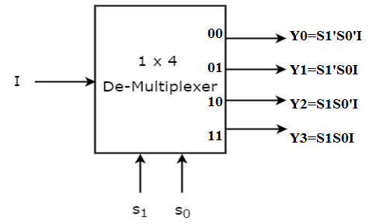
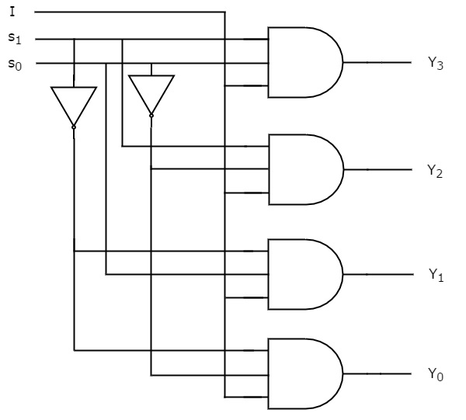
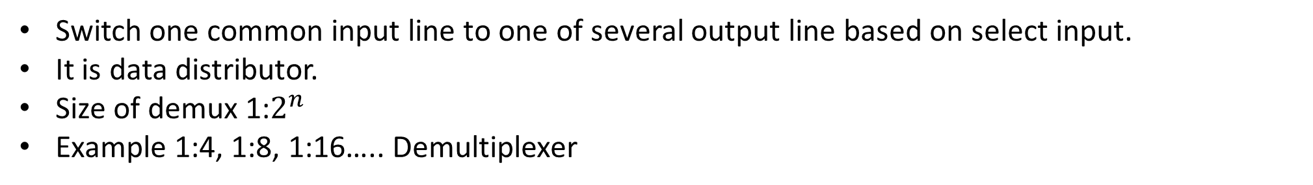
De-multiplexer
Switch one common input line to one of several output line based on select input.
It is data distributor.
Size of demux 1:$2^{n}$
Example 1:4, 1:8, 1:16….. Demultiplexer
Selection Inputs |  | Outputs
S₁ | S₀ | Y₃ | Y₂ | Y₁ | Y₀
0 | 0 | 0 | 0 | 0 | I
0 | 1 | 0 | 0 | I | 0
1 | 0 | 0 | I | 0 | 0
1 | 1 | I | 0 | 0 | 0

Slide 21
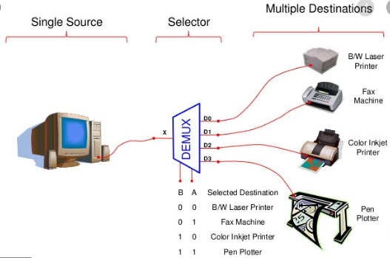
Application

Slide 22
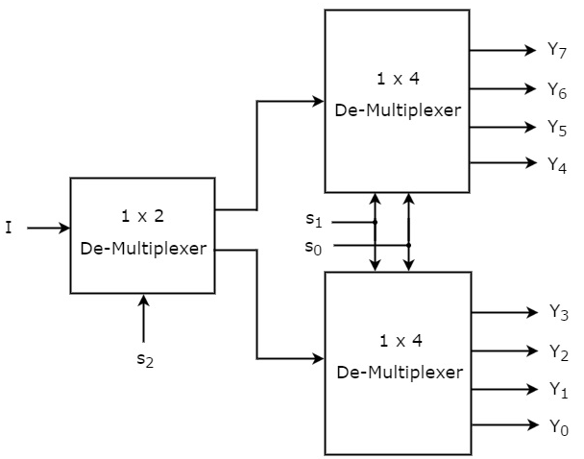
1:8 De-Multiplexer using lower order De-Mux

