Slide 1


Slide 2

EDU
Revolution: Be the Change
New Year New Beginning New Excitement
2

Slide 3
Subtractor
Adder
Combinational Circuits
Comparator
Multiplexer
De- Multiplexer
Encoder
Decoder

Slide 4
Outlin e
Revision of last class
Subtrcator

Slide 5
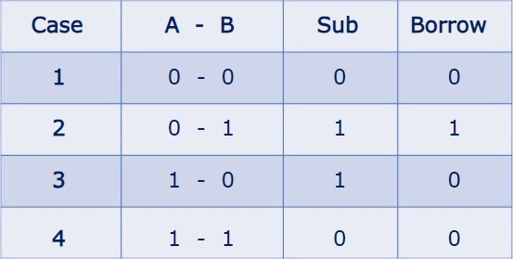
Binary Subtraction

Slide 6
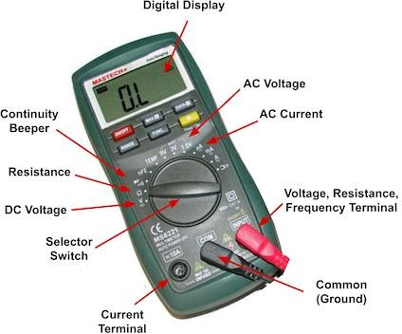




Subtractor
Subtractor is a digital circuit
subtraction of numbers.
that
performs
Subtract
or

Slide 7
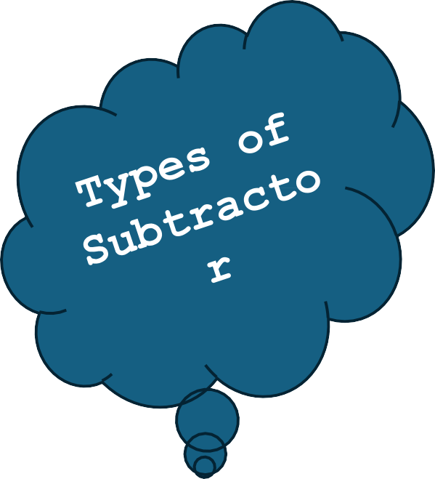
Types of Subtractor
Half Subtract or
Full Subtract or

Slide 8
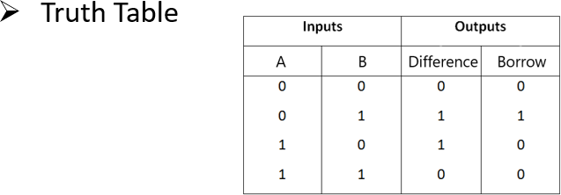
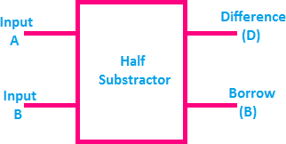
Half Subtractor
Half subtractor is a combination circuit with two inputs and two outputs (difference and borrow).
Block diagram

Slide 9
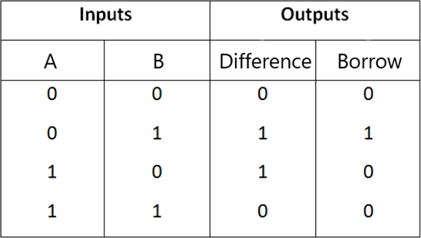
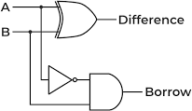
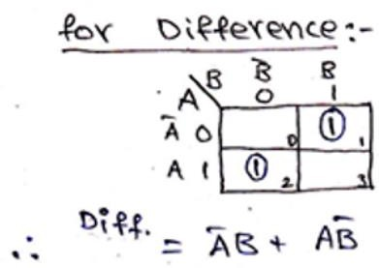
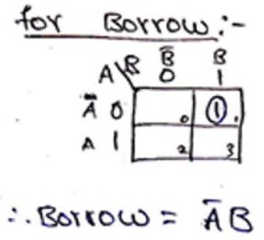
Half Subtractor

Slide 10
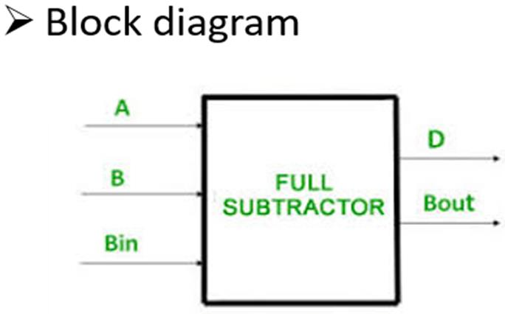
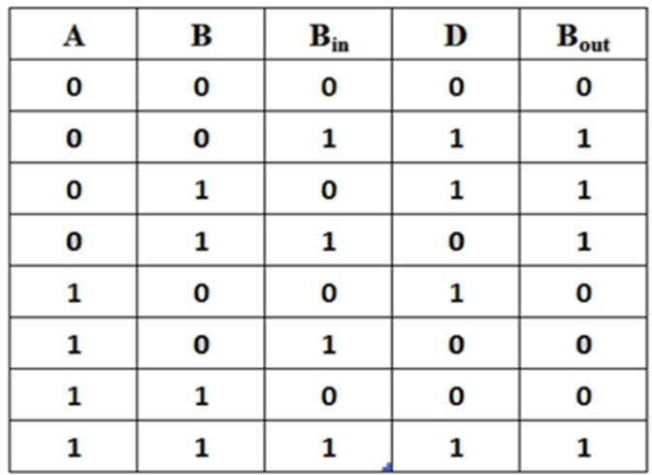
Full Subtractor
The full subtractor is a combinational circuit inputs A, B, B_{in} and two output D and B_{out}
with
three

Slide 11
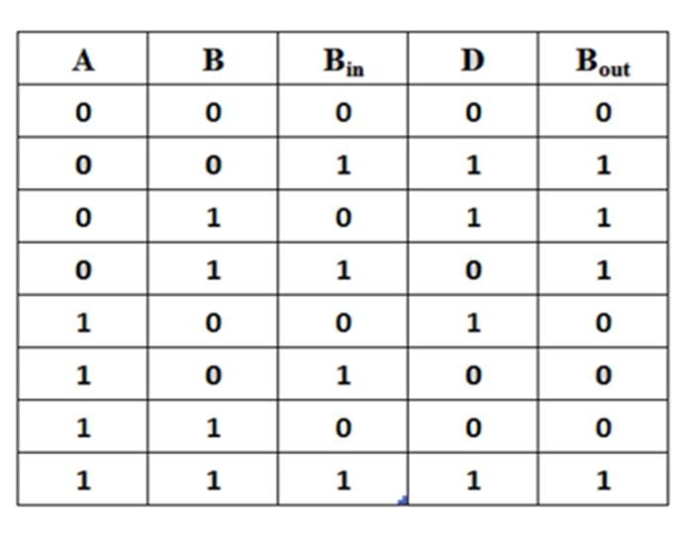
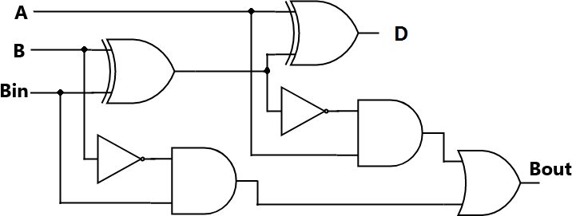

Full Subtractor

Slide 12
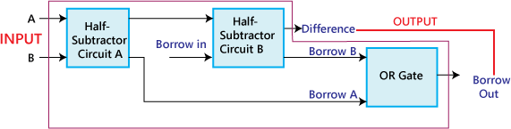
Full Subtractor
1-bit Full-subtractor implemented with two half subtractors and one OR
gate

Slide 13
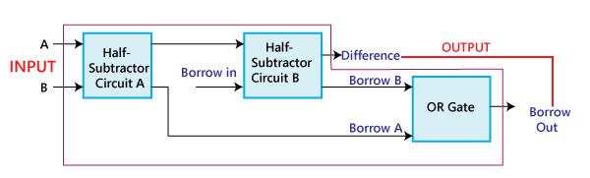
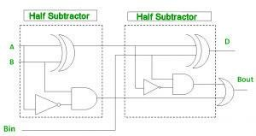
Full Subtractor

Slide 14
Quick Quiz: Poll
The difference between half adder and full adder is
Half adder has two inputs while full adder has four inputs
Half adder has one output while full adder has two outputs
Half adder has two inputs while full adder has three inputs
All of the Mentioned

Slide 15



