Slide 1
Today’s Highlights
K-map

Slide 2
Need for Karnaugh Map (K-map)
Simplifies Boolean Expressions
Minimization of Logic Circuits
Eliminates Human Errors
Easy Identification of Prime Implicants
Visual Representation
Avoids Redundant Terms
Applicable to Both SOP and POS Forms
Widely Used in Digital Circuit Design

Slide 3
Karnaugh Map Method
The map method presented here provides a simple, straightforward rule based procedure for minimizing Boolean functions(used to remove redundant operations in a Boolean function).
This method may be regarded as a pictorial form (two-dimensional graphical representation ) of a truth table.
The map method is also known as the Karnaugh map or K-map.
It is named after Maurice Karnaugh, an American mathematician and physicist, who developed K- Map at Harvard Computation Laboratory

Slide 4
Karnaugh Map RULES
Construct K-map according to variables and place 1’s or 0’s in the squares according to the truth table.
The number of 1’s or 0’s in a group must be a power of 2
Grouping is done horizontally, vertically but never diagonally.
The groups must be made as large as possible.(start from octet, quard and then pair)
Groups can overlap and wrap around the sides of the K-map

Slide 5
Karnaugh Map Method
The map is made up of squares, with each square representing one minterm of the function that is to be minimized.
The simplified expressions produced by the map are always in one of the two standard forms: sum of products or product of sums.
This expression produces a circuit diagram with a minimum number of gates and the minimum number of inputs to each gate.

Slide 6
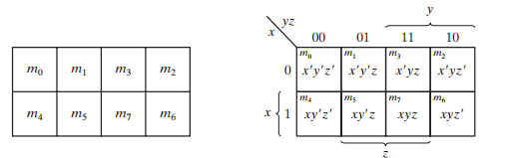
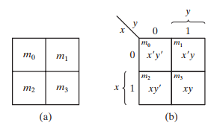
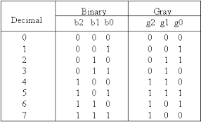
Explanation
Follow Gray code
2 variable ,3 variable,4 variable K-map
The minterms are arranged, not in a binary sequence, but in a sequence similar to the Gray code.
The characteristic of this sequence is that only one bit changes in value from one adjacent column to the next.

Slide 7
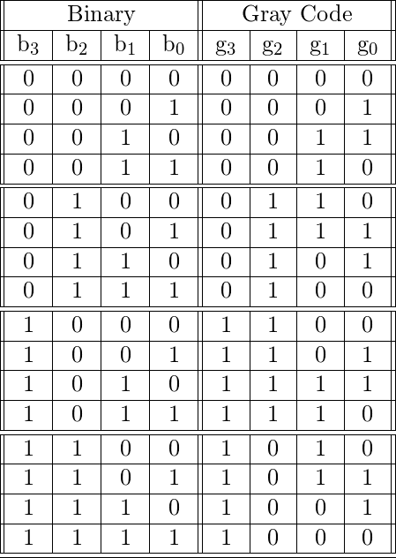
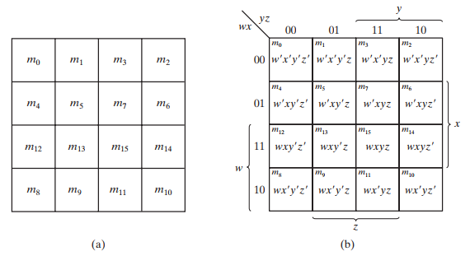
4 variable K-map

Slide 8
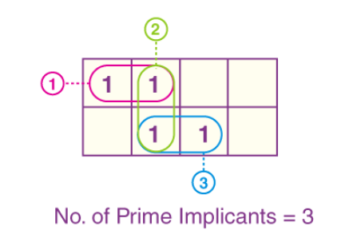
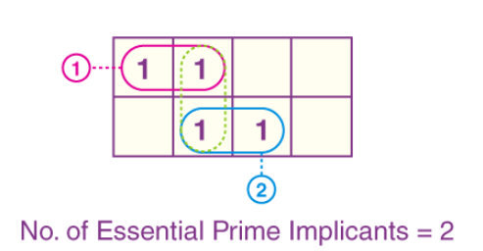
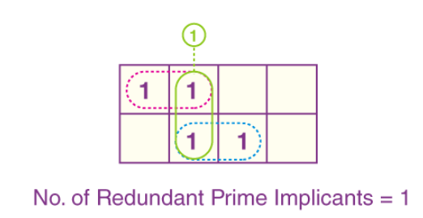
Prime Implicants
It is an implicant that (from the point of view of the map) is not fully contained within any one other impli It is an implicant that (from the point of view of the map) is not fully contained within any one other implicant cant
Redundant Prime Implicants:RPI refer to the prime implicants for which every one of its minterms gets covered by some important prime implicants
Essential Prime Implicants: Groups that cover at least one of the minterms that can’t get covered by another prime

Slide 9
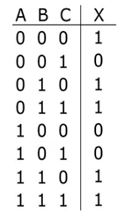
Explanation
Poll
How many variable K-map required for given function?
A) 2 variable
B) 3 variable
C) 4 varaiable
D) none

Slide 10
Exercise
Simplify

Slide 11
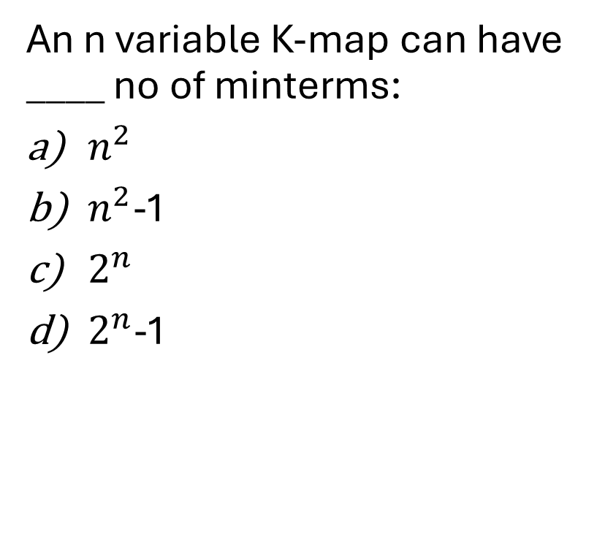
QUIZ (POLL)
An n variable K-map can have ____ no of minterms:
$n^{2}$
$n^{2}$-1
$2^{n}$
$2^{n}$-1
Diagonal groups are not allowed
Which of the following combination of cells is NOT possible?
a) True
b) False
4
8
12
16

Slide 12
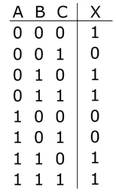
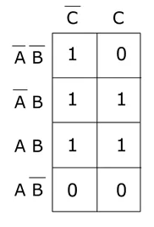
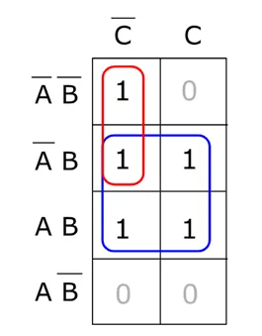
Vertical K-map
X

Slide 13
Quick Poll
After making group in form of pair,how many variables are eliminate?
A) 3 variables
B) 2 variables
C) 1 variables
D) Not applicable

Slide 14

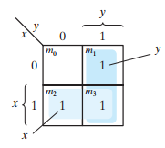
Example
Two Variable Karnaugh Map
There are four minterms for two variables; hence, the map consists of four squares, one for each minterm.
Which Grouping do you think ?
Octet, Quard, Pair ?
How many variable eliminates after pair ?

Slide 15
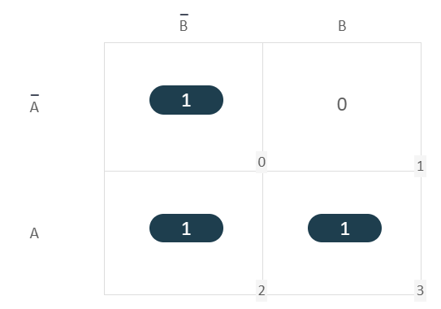
Q1. Solve 2 Variables K-Map for ∑(0, 2, 3)
Truth Table
K-map
A | B | Y
0 | 0 | 1
0 | 1 | 0
1 | 0 | 1
1 | 1 | 1
1
1
1
Boolean Expression: Y = B + A

Slide 16

Try Yourself
Q1. Reduce the function using K-map F(A,B) = Σ(0,2,3)?
Attempt Poll:
What does each cell in a Karnaugh map represent?
A. A single minterm or maxterm
B. A group of variables
C. A truth table output row
D. A simplified Boolean expression

Slide 17

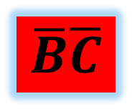


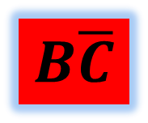

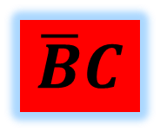
Three Variable Karnaugh Map
Question: Simplify the Boolean function $f(A,B,C)=\sum{\left(0,4,5\right)}$ using K-Map?
$$\overline{B}\overline{C}$$
$$\overline{B}C$$
$$BC$$
$$B\overline{C}$$
$$\overline{A}$$
$$A$$

Slide 18

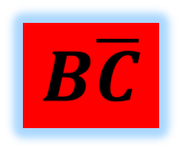
Question: Simplify the Boolean function $f(A,B,C)=\sum{\left(0,2,4,5\right)}$ using K-Map?
A’C’+AB’
AC’+AB
A’C’+AB
$$\overline{B}\overline{C}$$
$$\overline{B}C$$
$$BC$$
$$B\overline{C}$$
$$\overline{A}$$
1 |  |  | 1
1 | 1
$$A$$

Slide 19
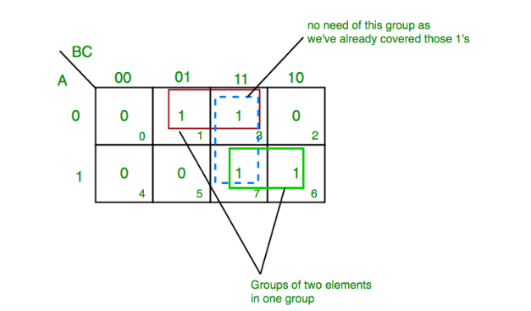

Ques. Solve for F(A,B,C)= $\sum{(1,3,6,7)}$ using K-map
A | B | C | y
0 | 0 | 0 | 0
0 | 0 | 1 | 1
0 | 1 | 0 | 0
0 | 1 | 1 | 1
1 | 0 | 0 | 0
1 | 0 | 1 | 0
1 | 1 | 0 | 1
1 | 1 | 1 | 1
From red group we get product term— A’C
From green group we get product term— AB
Summing these product terms we get- Final expression (A’C+AB)

Slide 20


Question: Simplify the Boolean function $f(A,B,C)=\sum{\left(1,2,4,7\right)}$ using K-Map?
$$\overline{B}\overline{C}$$
$$\overline{B}C$$
$$BC$$
$$B\overline{C}$$
$$\overline{A}$$
$$A$$

Slide 21


Question: Simplify the Boolean function $f(A,B,C)=\sum{\left(1,4,5,6,7\right)}$ using K-Map?
$$\overline{B}\overline{C}$$
$$\overline{B}C$$
$$BC$$
$$B\overline{C}$$
$$\overline{A}$$
$$A$$

Slide 22
Exercise
Simplify

Slide 23
Try Yourself
Home assignments
Share on lpu live
Q1. Reduce the function y(A,B,C) = Σ (0,1,3,6,7)
Q2. Simplify the sop function F(A,B,C) = Σ (1,2,3,7)

Slide 24
Four Variable Karnaugh Map

Slide 25
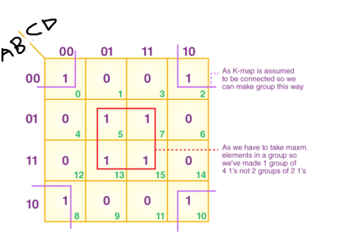
Ques. Solve for F (A, B, C, D) = ∑(0, 2, 5, 7, 8, 10, 13, 15)
From the red group, the product term would be —BD
From the lilac group, the product term would be —B’D’
If we sum these product terms, then we will get this final expression (BD + B’D’)

Slide 26
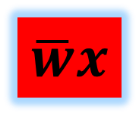
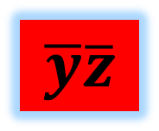
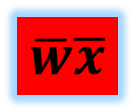

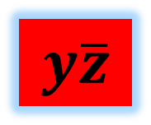
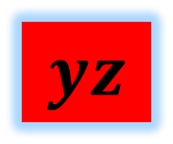
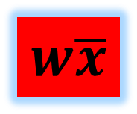
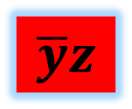
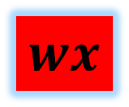
Question: Simplify the Boolean function:
$f(w,x,y,z)=\sum{\left(0,1,2,4,5,6,8,9,12,13,14\right)}$ into POS form?
$$\overline{y}\overline{z}$$
$$\overline{y}z$$
$$yz$$
$$y\overline{z}$$
$$\overline{w}\overline{x}$$
$$\overline{w}x$$
$$wx$$
$$w\overline{x}$$

Slide 27
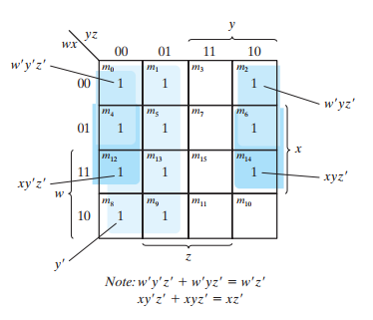

Question: Simplify the Boolean function:
$f(w,x,y,z)=\sum{\left(0,1,2,4,5,6,8,9,12,13,14\right)}$ into POS form?

Slide 28

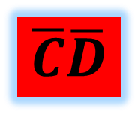
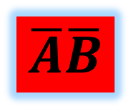
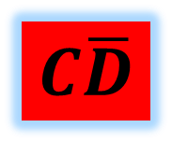
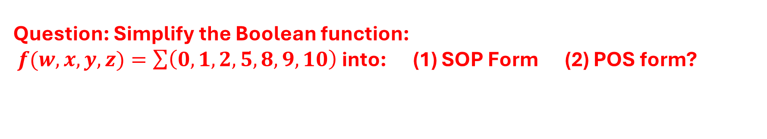

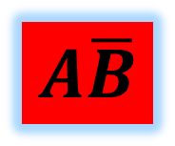
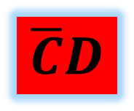

Question: Simplify the Boolean function:
$f(w,x,y,z)=\sum{\left(0,1,2,5,8,9,10\right)}$ into: (1) SOP Form (2) POS form?
$$\overline{C}\overline{D}$$
$$\overline{C}D$$
$$CD$$
$$C\overline{D}$$
$$\overline{A}\overline{B}$$
$$\overline{A}B$$
$$AB$$
$$A\overline{B}$$

Slide 29
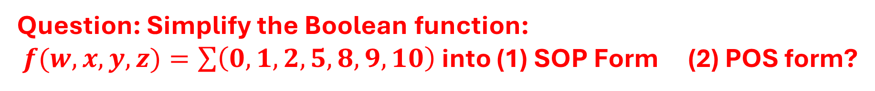
Question: Simplify the Boolean function:
$f(w,x,y,z)=\sum{\left(0,1,2,5,8,9,10\right)}$ into (1) SOP Form (2) POS form?
$$\overline{C}\overline{D}$$
$$\overline{C}D$$
$$CD$$
$$C\overline{D}$$
$$\overline{A}\overline{B}$$
$$\overline{A}B$$
$$AB$$
$$A\overline{B}$$

Slide 30
Don’t Care conditions
In practice, in some applications the function is not specified for certain combinations of the variables.
As an example, the four-bit binary code for the decimal digits has six combinations that are not used and consequently are considered to be unspecified.
In most applications, we simply don’t care what value is assumed by the function for the unspecified minterms.
For this reason, it is customary to call the unspecified minterms of a function don’t-care conditions.
These don’t-care conditions can be used on a map to provide further simplification of the Boolean expression.
Symbol of don’t care: X

Slide 31

Qsn: Implement the given function using K-Map:
$$\overline{C}\overline{D}$$
$$\overline{C}D$$
$$CD$$
$$C\overline{D}$$
$$\overline{A}\overline{B}$$
$$\overline{A}B$$
$$AB$$
$$A\overline{B}$$

Slide 32
NAND and NOR Implementation
Digital circuits are frequently constructed with NAND or NOR gates rather than with AND and OR gates. NAND and NOR gates are easier to fabricate with electronic components and are the basic gates used in all IC digital logic families.
They are a universal gates because any logic circuit can be implemented with them.

Slide 33
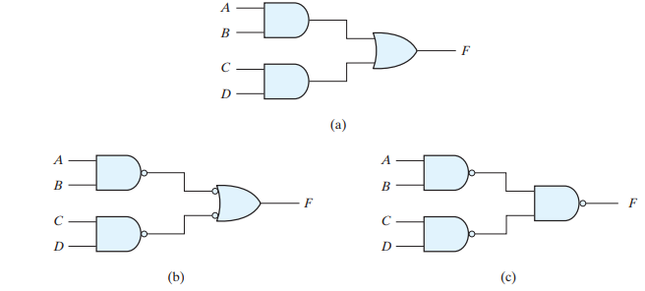
NAND Implementation

Slide 34
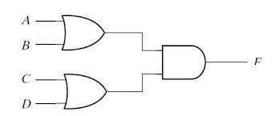
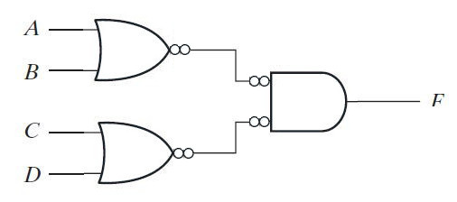
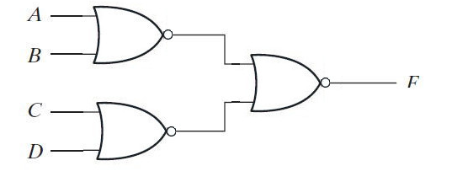
NOR Implementation

Slide 35

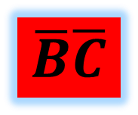

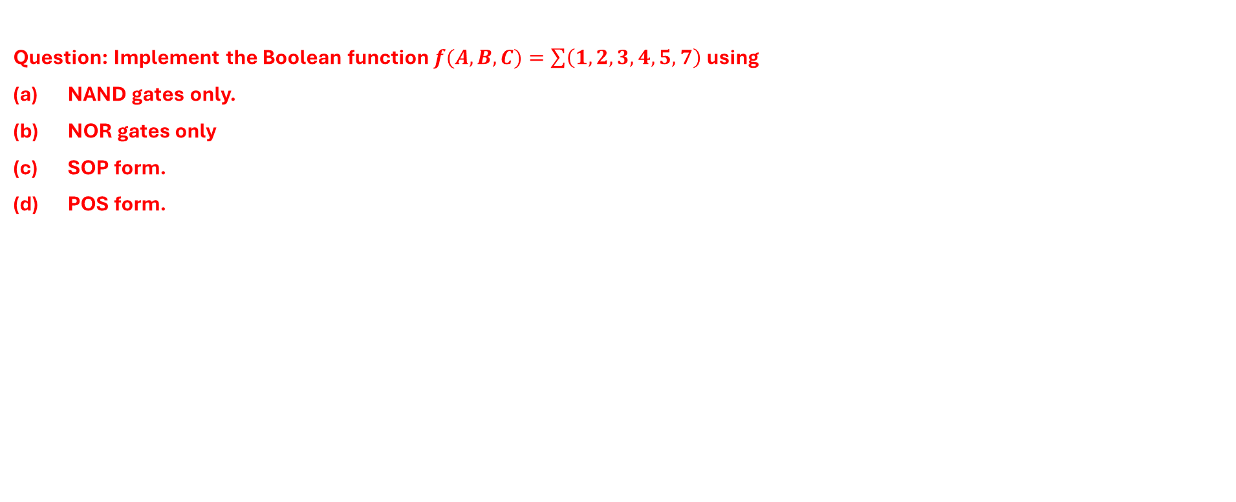


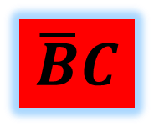
NAND and NOR Implementation
Question: Implement the Boolean function $f(A,B,C)=\sum{\left(1,2,3,4,5, 7\right)}$ using
NAND gates only.
NOR gates only
SOP form.
POS form.
$$\overline{B}\overline{C}$$
$$\overline{B}C$$
$$BC$$
$$B\overline{C}$$
$$\overline{A}$$
$$A$$

Slide 36


Ex-3: Minimize the following function in SOP minimal form using K-Maps: f = m(1, 5, 6, 11, 12, 13, 14) + d(4) and implement using Universal gate like NAND gate.
Therefore, SOP minimal is,
f = BC' + BD' + A'C'D + AB'CD

Slide 37
Try Yourself
Q. F(A,B,C,D) = ∑( m0, m1, m2, m4, m5, m6, m8, m9, m12, m13, m14 )
In a 4-variable K-map, which of the following represents an overlap in grouping?
A. Two separate groups of 2 cells
B. One group of 8 cells and one group of 4 cells
C. Groups of 1 cell each
D. Overlapping groups are not allowed

Slide 38


Ex-4: Minimize the following function in SOP minimal form using K-Maps: F(A, B, C, D) = m(1, 2, 6, 7, 8, 13, 14, 15) + d(0, 3, 5, 12) and implement using NAND gate
The SOP K-map for the given expression is: f = AC'D' + A'D + A'C + AB

Slide 39


Ex-5: Simplify the boolean function Y(A, B, C, D) = Π M (2, 3, 8, 9, 11, 13, 15) and implement using universal NOR gate
The simplified output expression is Y = (A’+B+C) (A’+D’) (A+B+C’)

Slide 40
Simplify the boolean function Y(A, B, C, D) = Π M (2, 3, 8, 9, 11, 13, 15) and implement using universal NOR gate

Slide 41
Try Yourself
Home assignments
Share on lpu live
Q1. Simplify the following Boolean expression using the 4-variable K-map : F⟮A,B,C,D⟯=∑m⟮2,3,6,7,8,10,13,15⟯ and Implement the reduce expression using NAND gate
Q2. Reduce the following Boolean function using 4-variable K-map
f⟮A,B,C,D⟯=∑m⟮0,1,2,5,8,10,11,13,14,15⟯ +d(3,7)

