Slide 1
Today’s Highlights
SOP
POS

Slide 2
Boolean expression
Sum-of-Products (SOP)
variables are operated by AND (product) are OR(sum) together
Product-of-sums (POS)
variables are operated by OR (sum) are AND (product) together

Slide 3
Sum-of-Products (SOP) :
If the number of input variables are n, then the total number of combinations in Boolean algebra is 2n.
If the input variable (let A) value is :
Zero (0) – A is LOW -It should be represented as A’ (Complement of A)
One (1) – A is HIGH -It should be represented as A

Slide 4
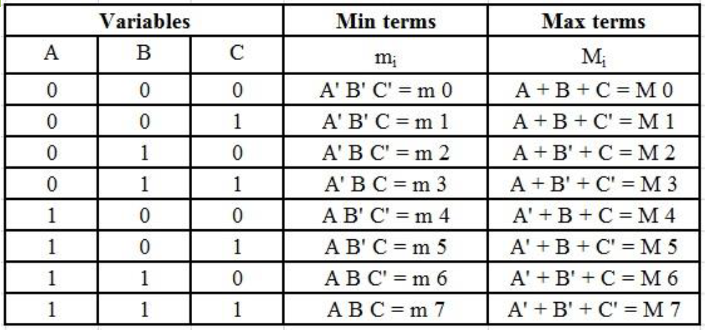
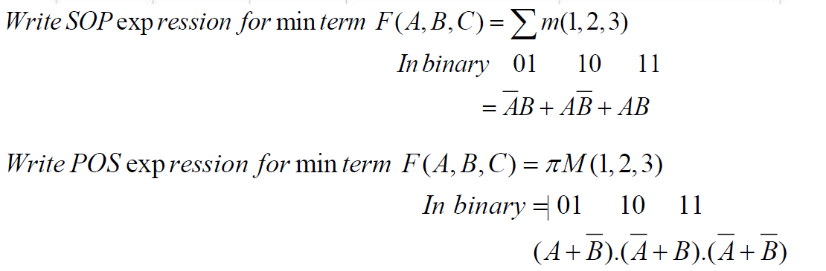
Min Term –Max Term

Slide 5
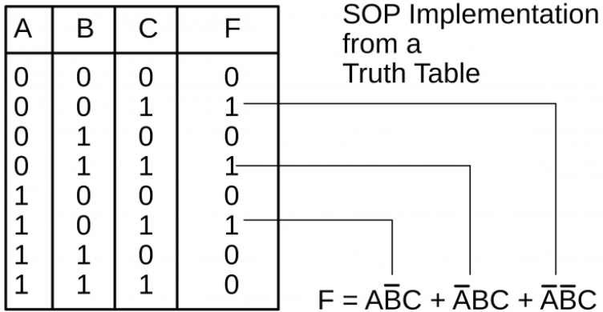
Construct SOP from a function X (SOP) = Σ m(1, 3, 6)

Slide 6
QUICK QUIZ (POLL)
Q. Which of the following represents the standard SOP (Sum of Products) form for the Boolean function F(A,B,C) where the truth table values for F are 1 at rows 1, 4, and 7?
A′B′C+AB′C’+ABC
A′B′C+ABC’+AB’C
A′B′C′+ABC’+A’BC
A′BC+AB′C’
POLL
Which of the following correctly describes the relationship between SOP and POS for a Boolean function?
A. SOP represents the OR of products, and POS represents the AND of sums.
B. SOP represents the AND of sums, and POS represents the OR of products.
C. Both SOP and POS represent the same type of expressions.
D. SOP uses only AND operations, and POS uses only OR operations.

Slide 7
QUICK QUIZ (POLL)
Q. Which of the following represents the SOP form for the Boolean expression derived from the min-terms m1,m3,m5 for a 3-variable function?
A′B′C+A’BC+AB’C
A′B′C+ABC’+A’BC
AB′C′+A’BC’
A′B’C+AB′C’
POLL
The output of a Boolean function is 1 for the rows where A=0,B=0,C=1 and A=1,B=1,C=0. What is the SOP form for this Boolean function?
A’B’C+ABC’
A’BC+AB’C
AB’C+ABC’
A’B’C+ABC

Slide 8
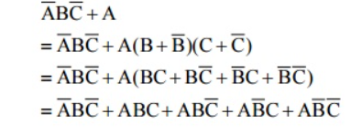
Conversion from Minimal SOP to Canonical SOP Form
Home assignment
Convert the following Boolean function into Canonical SOP form.
F = pq + qr + pr

Slide 9
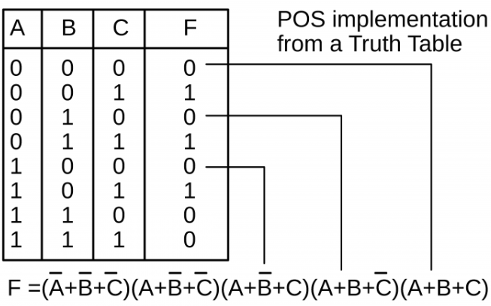
Product of Sums (POS) form
POS is product of maxterms and is represented as: If variable A is Low(0) - A A is High(1) - A’

Slide 10
Conversion from Minimal POS to Canonical form POS
F = (A̅+B̅) (B+C)
F = (A’+B’+CC’) (B+C+AA’)
F = (A’+B’+C)(A’+B’+C’)(A+B+C)(A’+B+C)
Home assignment
Convert the following Boolean function into Canonical POS form. f=(p+q)⋅(q+r)⋅(p+r)

Slide 11

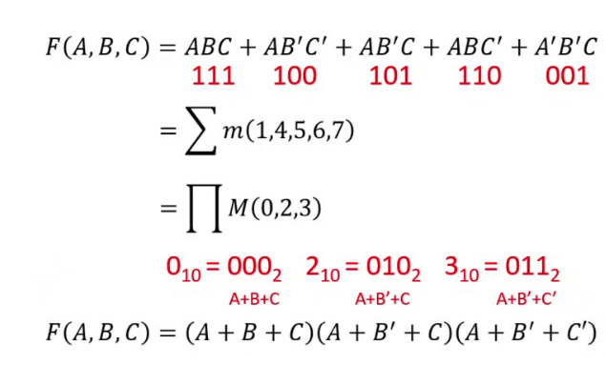
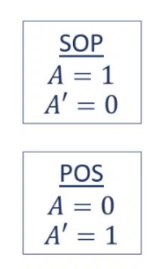

Slide 12
QUICK QUIZ (POLL)
POLL
Q1. Which of the following is the POS (Product of Sums) form of the Boolean expression A′B+AB′
(A+B)(A’+B’)
(A’+B)(A+B’)
(A+B)(A’+B)
(A’+B)(A+B)

Slide 13
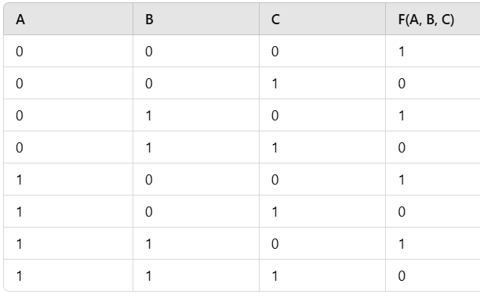
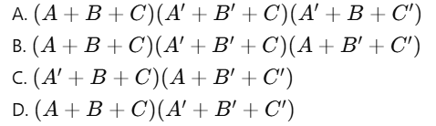
Q2.Given the following truth table for a 3-variable Boolean function
QUICK QUIZ (POLL)
Which of the following is the POS form for the Boolean function?

Slide 14
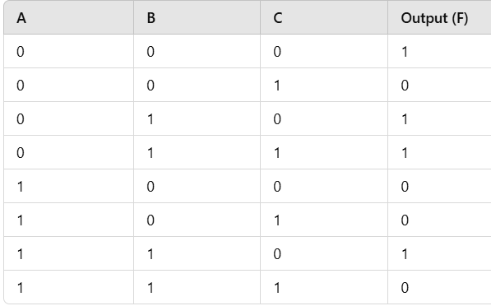
Try Yourself
Home assignments
Share on lpu live
Q1. Convert the following truth table into its SOP (Sum of Products) form.
Q2. Convert the same truth table into its POS (Product of Sums) form.

Slide 15

Why K-map Needed??

