Slide 1
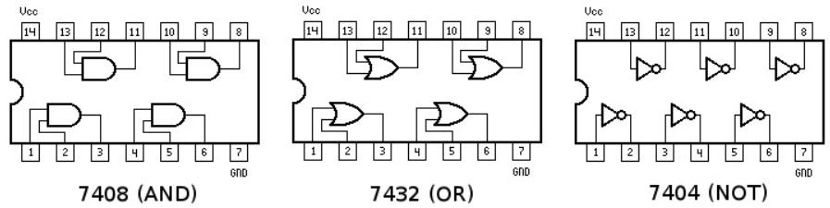
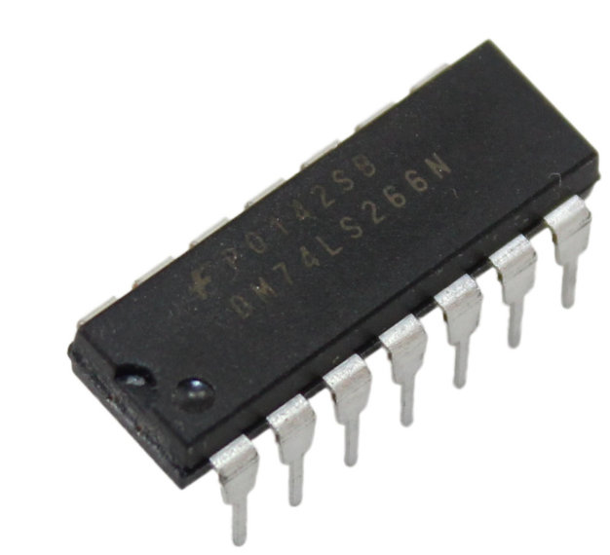
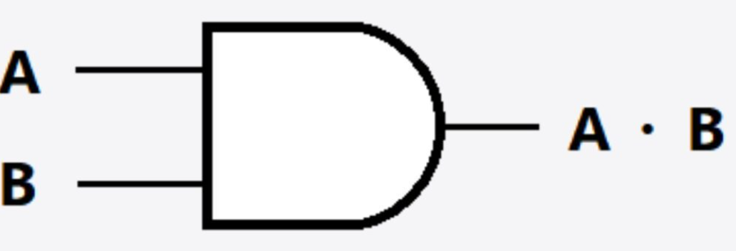
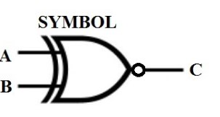
LOGIC GATE, BOOLEAN ALGEBRA

Slide 2
Today’s Highlights
Logic Gates (Truth Table)
Rules of Boolean Algebra
Simplification of Functions

Slide 3
Need for Logic gates
Signal Processing
Data Storage
Arithmetic & Computation
Decision Making
Simplified Circuit Design

Slide 4
Logic Gates
Basic Gates
Arithmetic Gates
Universal Gates
AND
XOR
OR
NAND
XNOR
NOT
NOR

Slide 5
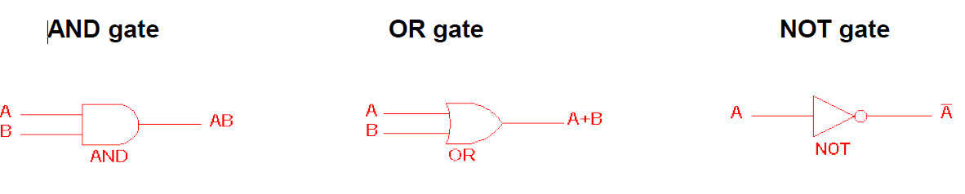
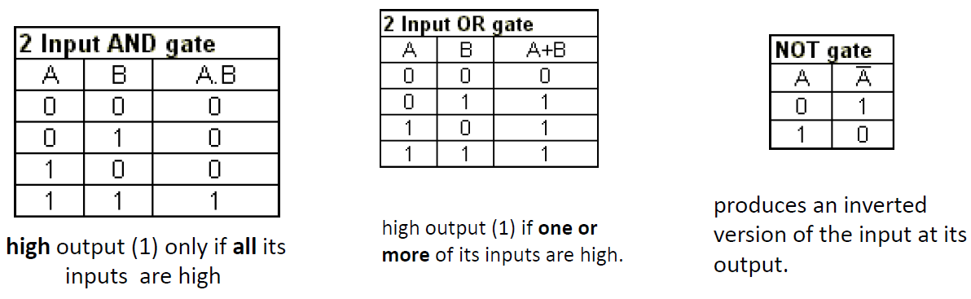
LLogic Gate
IC 7408
IC 7432
IC 7404

Slide 6
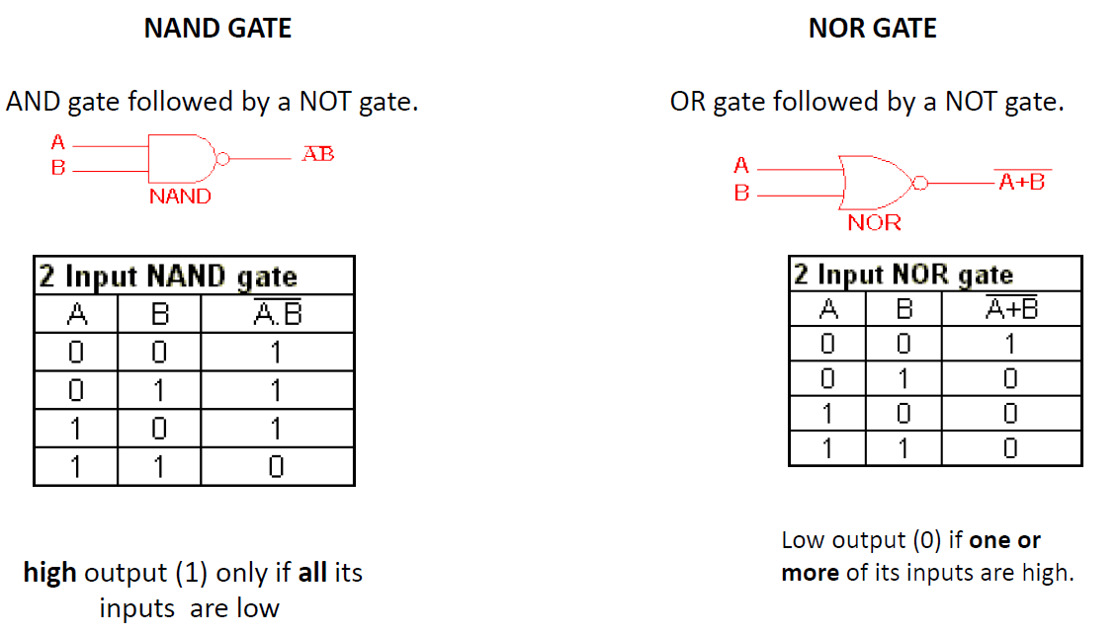
NAND and NOR gates are called Universal gates called universal
IC 7400
IC 7402

Slide 7
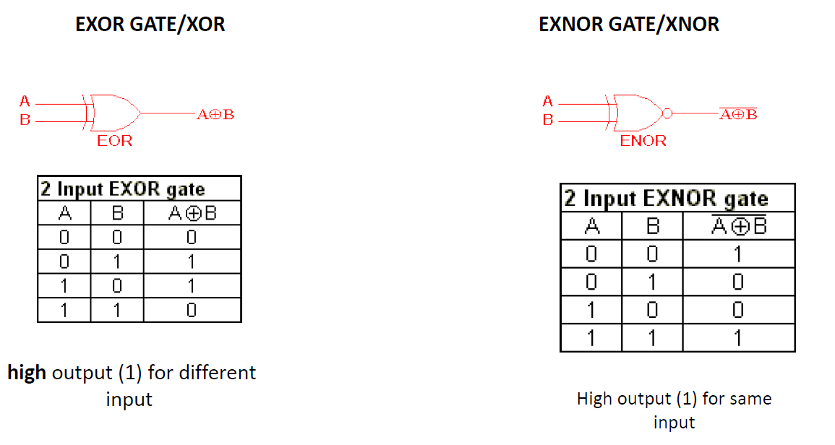
IC 7486
IC 747266

Slide 8
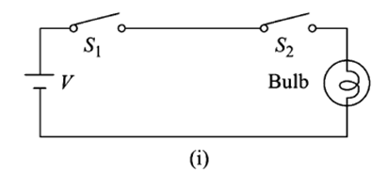
Poll
AND
OR
NOT
XOR

Slide 9
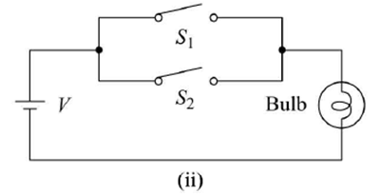
Poll
AND
OR
NOT
XOR

Slide 10
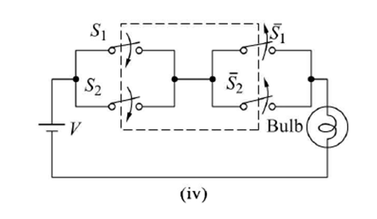
Poll
AND
OR
XOR
XNOR

Slide 11
QUICK QUIZ (POLL QUESTION)
The output of an AND gate with three inputs, A, B, and C, is HIGH when ________. A. A = 1, B = 1, C = 0 B. A = 0, B = 0, C = 0 C. A = 1, B = 1, C = 1 D. A = 1, B = 0, C = 1

Slide 12
Rules of Boolean Algebra
Also known as switching algebra
S.no | Rule Name | OR law | AND law
1 | Null element | A+1=1 | A.0=0
2 | Identity law | A+0=A | A.1=A
3 | Idempotent Law | A+A=A | A.A=A
4 | Complement Law | A+A’=1 [controlling pin] | A.A’=0 [controlling pin]
5 | Commutative law | A+B=B+A [order does not matter] | A.B=B.A [order does not matter]
6 | Associative law | A+(B+C)=(A+B)+C | A.(B.C)=(A.B).C
7 | Distributive law | A+(B.C)=(A+B).(A+C) | A.(B+C)=(A.B)+(A.C)
8 | Absorption law | A+AB=A | A.(A+B)=A

Slide 13
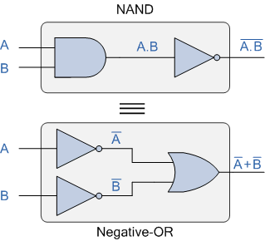
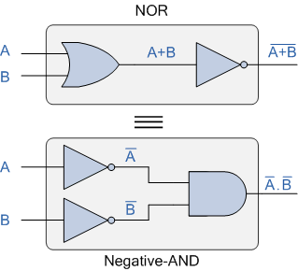
Rules of Boolean Algebra
9 | Double Inversion law | A’’=A
10 | Redundant Literal Rule (RLR) | A+A’B=A+B or A’+AB=A’+B or A’+AB’=A’+B’ or A +A’B’=A+B’
11 | Consensus Theorem | AB+A’C+BC=AB+A’C
De Morgan’s First Law Implementation using Logic Gates
De Morgan’s Second Law Implementation using Logic Gates
NAND = Bubbled OR gate
NOR=bubbled AND

Slide 14
Need for De Morgan’s Law
Simplification of Boolean Expressions
Inversion of Logic Gates
Gate Optimization
Designing with Negative Logic
Conversion Between NAND and NOR
Fault Tolerance and Redundancy
Easier Circuit Design and Implementation
Universality in Digital Systems

Slide 15
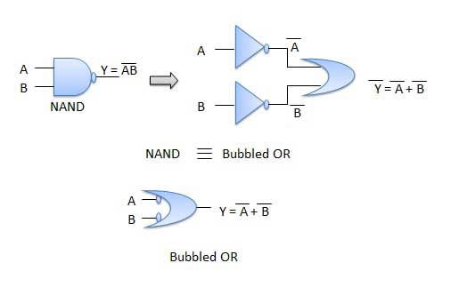

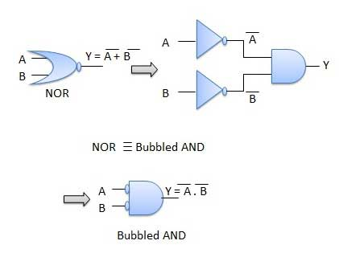

De’ Morgan Laws:

Slide 16
QUICK QUIZ (POLL QUESTION)
Which of the following Boolean theorem is incorrect? A. A + A = A
B. A + 1 = 1
C. A + 0 = A
D. A + A’ = 0

Slide 17
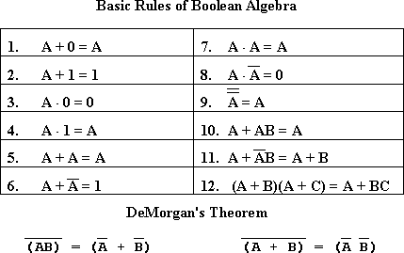
DUAL of the function

Slide 18
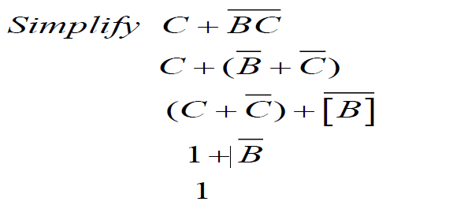
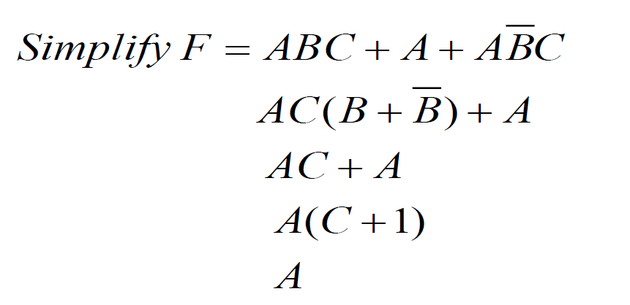
Simplification

Slide 19
Quick Poll
Simplify the expression
Z=X’Y
Z =X+Y’
Z=XY
Z=X+Y

Slide 20
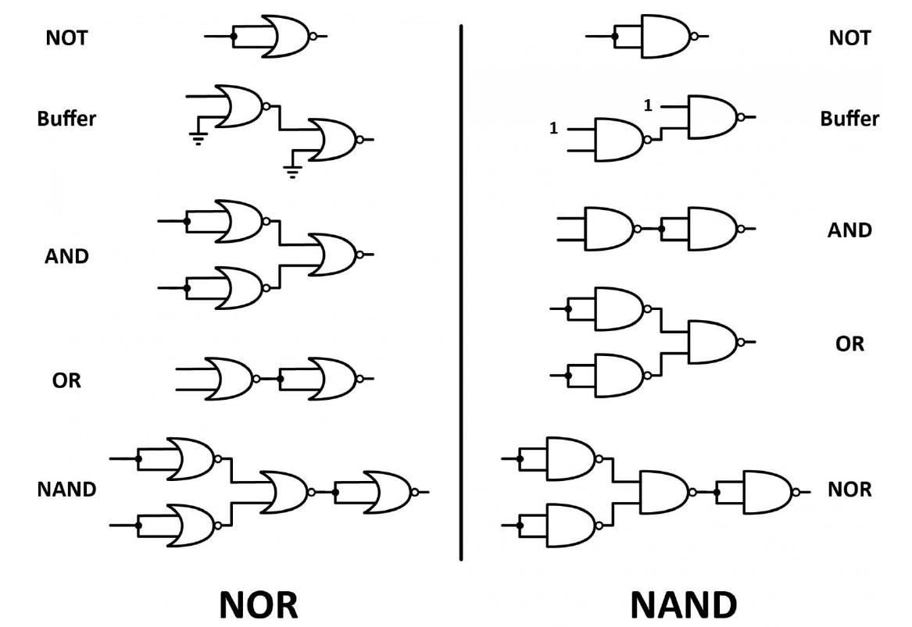
Logic Gate Implement with NAND-NOR

Slide 21
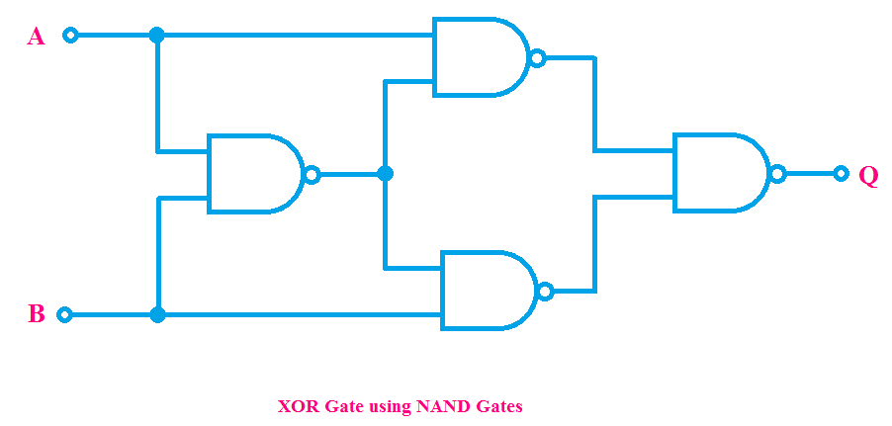
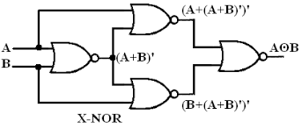
NAND and NOR as Universal Gates
Home assignment XNOR using NAND and XOR using NOR send on LPU live

Slide 22
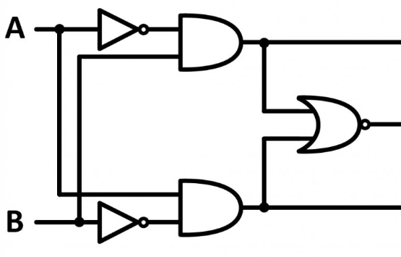
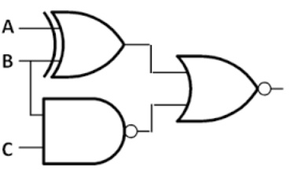
Combination of Gates

Slide 23
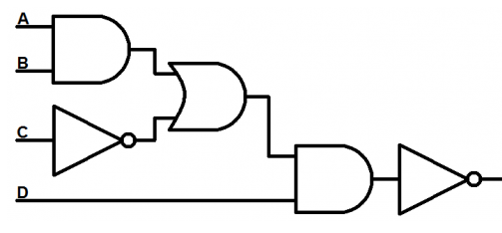
Combination of Gates
Exercise
Draw circuit for

Slide 24
Simplification using Boolean Algebra
Practice Question:

Slide 25
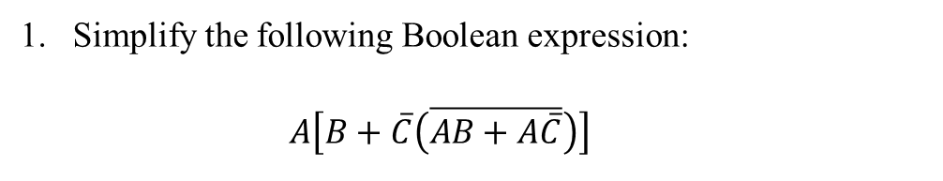
Simplification using Boolean Algebra
Home Assignment
Practice Question:
AB
A’B
AB+AC’
A’B+AC’
Simplify the following Boolean expression:
$$A\left[B+\overline{C}\left(\overline{AB+A\overline{C}}\right)\right]$$

Slide 26
Advantages of Boolean Algebra
[1]
[2]
[3]
To obtain simpler expression
To reduce the number of gates in the circuit
To reduce the number of inputs in the circuit
[4]
To reduce complexity
[5]
To reduce cost.

Slide 27
QUICK QUIZ (POLL QUESTION)
Minimum number of two input NAND gates required to implement XOR function is: A. 3 B. 4 C. 5 D. 6

Slide 28

Limitation OF Boolean Algebra and Expressions
1. Lack of Representation for Negative Values
2. Limited to Binary States
3. Complexity in Simplification
4. Lack of Direct Representation for Arithmetic Operations
5. Handling of Multiple Inputs and Outputs
6. No Support for Continuous Data
How to Overcome Said problem

