Slide 1
Today’s Highlights
1’s Complement
2’s Complement
Binary Addition
Binary Subtraction

Slide 2
Why 1's and 2's Complement are Needed
Simplification of Arithmetic Operations
Representation of Negative Numbers
Elimination of Borrow in Subtraction
Consistency in Arithmetic Operations
Ease of Implementation in Hardware

Slide 3
1’s Complement
It is a binary number system in which each bit of a binary number is inverted (flipped), meaning 0 becomes 1 and 1 becomes 0.
Ex: Binary number: (1010) ₂
1's complement: ( 0101 ) ₂

Slide 4
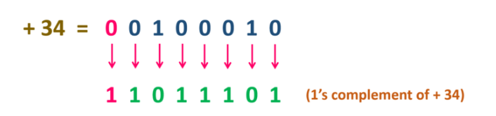
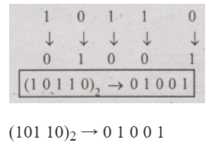
Q1. Represent 34 in 1’s complement form
Q2. Find 1's complement of (10110)2

Slide 5
QUICK QUIZ (POLL)
Q. What is the 1's complement of the binary number 1011001?
A. 0100110
B. 1100110
C. 1010110
D. 0110100

Slide 6
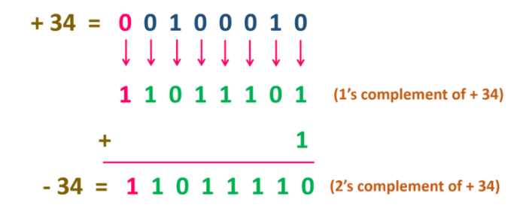
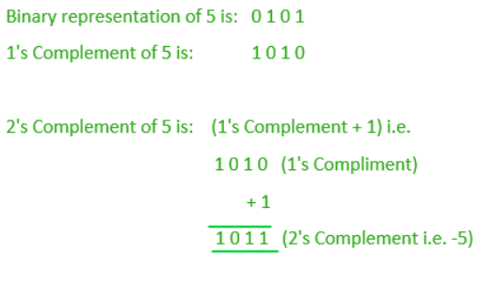
2’s Complement
Represent 34 and 5 as 2’s Complement

Slide 7
QUICK QUIZ (POLL)
Q. What is the 2's complement of the binary number 1100101?
A. 0011011
B. 1100110
C. 0011010
D. 0011011

Slide 8
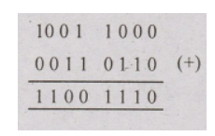
Binary Addition
Q. Add the binary number (1001 1000)2 and (00110110)2

Slide 9
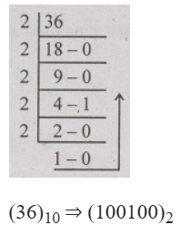
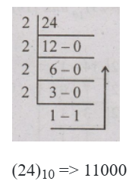
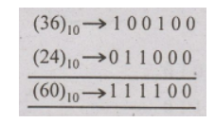
Q. Add the numbers using binary addition (36)10 and (24)10.

Slide 10
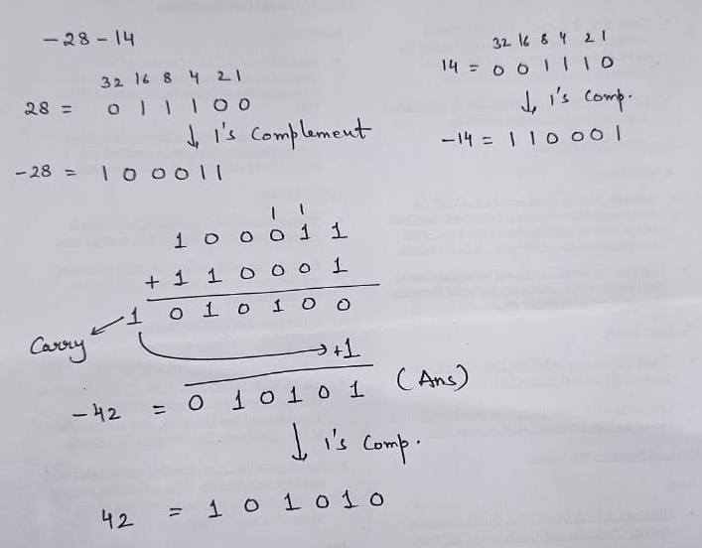
Q. Add the number using binary addition (-28)10 and (-14)10.

Slide 11
QUICK QUIZ (POLL)
Q1. What is the result of adding 1011 and 1101 in binary?
A. 10100
B. 10010
C. 11000
D. 11110

Slide 12
QUICK QUIZ (POLL)
Q2. In binary addition, what is 1 + 1 + 1?
A. 10
B. 11
C. 01
D. 111

Slide 13
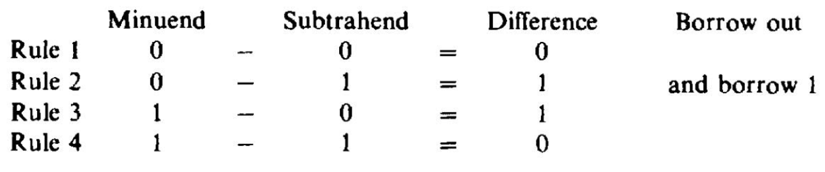
Binary Subtraction

Slide 14
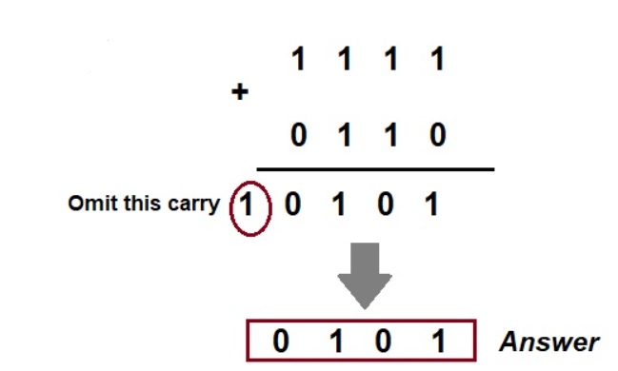
Subtract (1010)2 from (1111)2 using 2’s complement method
Step-1: 2’s complement of (1010)2 is (0110)2.
Step-2: Add (0110)2 to (1111)2.

Slide 15
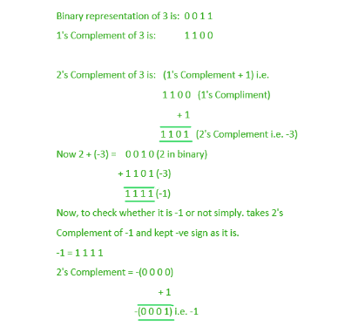
Subtract 3 from 2

Slide 16
QUICK QUIZ (POLL)
Q. What is the 2's complement of the binary number 01101?
A. 10010
B. 11010
C. 10101
D. 10011

Slide 17
QUICK QUIZ (POLL)
Q. Solve 1101 - 1010 using 2's complement. What is the final result?
A. 0011
B. 0110
C. 0101
D. 1111

Slide 18
QUICK QUIZ (POLL)
Q. Subtract 0110 from 1010 using 2's complement. What is the result?
A. 0100
B. 1000
C. 1100
D. 0010

Slide 19
Try Yourself
Home assignments
Share on lpu live
Q1. Find the 2's complement of the binary number
(101110) ₂
Q2. Add the binary numbers (1101) ₂
and (1011) ₂ using 2's complement.
Q3. Subtract (0111) ₂ from (1010) ₂ ​using 2's complement.

Slide 20
Limitation OF 1’s and 2’s Complement
1. Ambiguity in Zero Representation
2. Complexity in Arithmetic Operations
3. Inefficient for Some Operations
4.Additional Hardware Complexity
5. Difficulties with Negative Numbers
6. Limited Range of Representations

