Slide 1
Today’s Highlights
Code Conversion

Slide 2
Need for Code Conversion
Inter-System Compatibility
Simplified Circuit Design
Error Detection and Correction
Human-Readable Output
Optimization of Memory and Processing
Application-Specific Requirements
Need for Code Conversion

Slide 3
Code Conversion
Decimal to BCD code
1.In the BCD numbering system, the given decimal number is segregated into chunks of four bits for each decimal digit within the number.
2. Each decimal digit is converted into its direct binary form (usually represented in 4-bits).
Decimal Number | BCD | Excess 3 code
0 | 0000 | 0011
1 | 0001 | 0100
2 | 0010 | 0101
3 | 0011 | 0110
4 | 0100 | 0111
5 | 0101 | 1000
6 | 0110 | 1001
7 | 0111 | 1010
8 | 1000 | 1011
9 | 1001 | 1100

Slide 4
Ex-1: Convert (123)₁₀ in BCD
From the truth table above,
1 -> 0001
2 -> 0010
3 -> 0011
Thus, BCD becomes -> 0001 0010 0011
Ex-2: Convert (324)₁₀ in BCD
(324)₁₀
Again from the truth table above,
3 -> 0011
2 -> 0010
4 -> 0100
thus, BCD becomes -> 0011 0010 0100

Slide 5
QUICK QUIZ (POLL)
Q. What is the BCD representation of the decimal number 57?
  A. 0101 0111
  B. 0110 0111
  C. 0101 0110
  D. 1001 0110

Slide 6
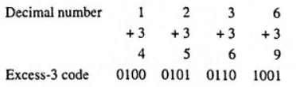
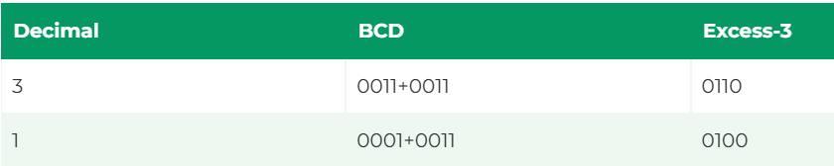

Decimal to Excess-3 Conversion
Ex-1
Ex-2 Decimal number 31
Home assignment

Slide 7
QUICK QUIZ (POLL)
Q. What is the Excess-3 code for the decimal number 9?
A. 1010
B. 1100
C. 1001
D. 1110

Slide 8
Try Yourself
Home assignments
Share on lpu live
Q1. What is the BCD (Binary-Coded Decimal) representation of the decimal number 75?
Q2. Which of the following is the Excess-3 code for the decimal number 26?

Slide 9
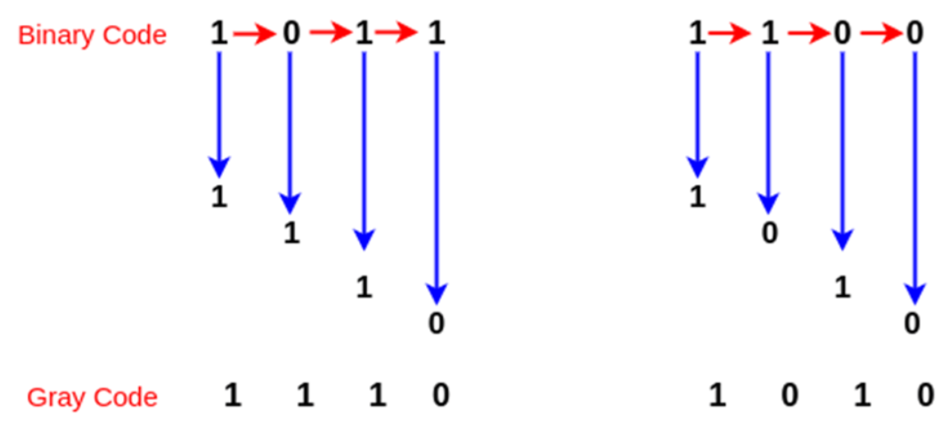
Binary to Gray Code Conversion

Slide 10
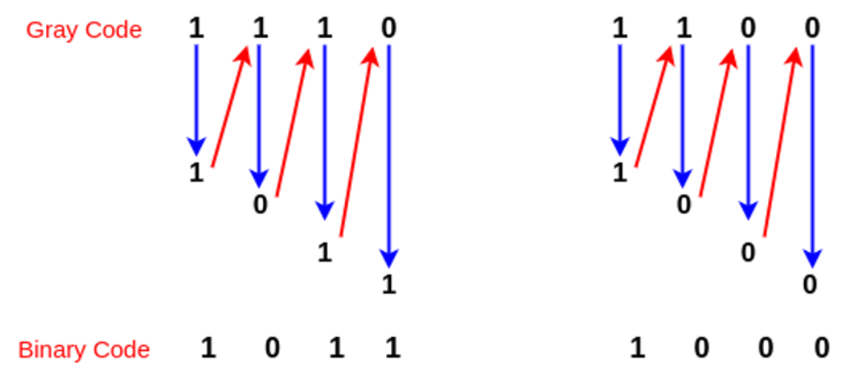
Gray Code to Binary Conversion

Slide 11
QUICK QUIZ (POLL)
Q. What is the Gray code equivalent of the binary number 1011?
A. 1100
B. 1110
C. 1001
D. 0111

Slide 12
QUICK QUIZ (POLL)
Q. What is the binary equivalent of the Gray code 1101?
A. 1000
B. 1011
C. 1111
D. 1100

Slide 13
Try Yourself
Home assignments
Share on lpu live
Q1. Convert the decimal number 187 into BCD (Binary-Coded Decimal) code.
Q2. Convert the decimal number 56 into Excess-3 code.
Q3. Convert the decimal number 23 into Gray Code.

Slide 14

Why 1’s and 2’s Complement Needed??

