Slide 1
UNIT-3
Number System
Number System Conversion
Any to decimal
Logic gates and Boolean Algebra
Compliments
decimal to Any
1’s Complement
SOP and POS
SOP Form
B-G
2’s complement
Code Conversion
G-B
Excess-3
BCD code
Binary Addition and Subtraction
Logic gates
Boolean Algebra Rules
Simplification of Boolean Algebra
POS Form
Octal and Hexadecimal into Binary
Kmap
K-map Rule
Simplification using Kmap

Slide 2
Today’s Highlights
Number System Conversion
Any to decimal
Binary to Decimal
Octal to Decimal
Hexadecimal to Decimal
Decimal to Any
Decimal to binary
Decimal to Octal
Decimal to Hexadecimal
Octal and Hexadecimal into Binary
Octal to Hexadecimal
Hexadecimal to octal

Slide 3
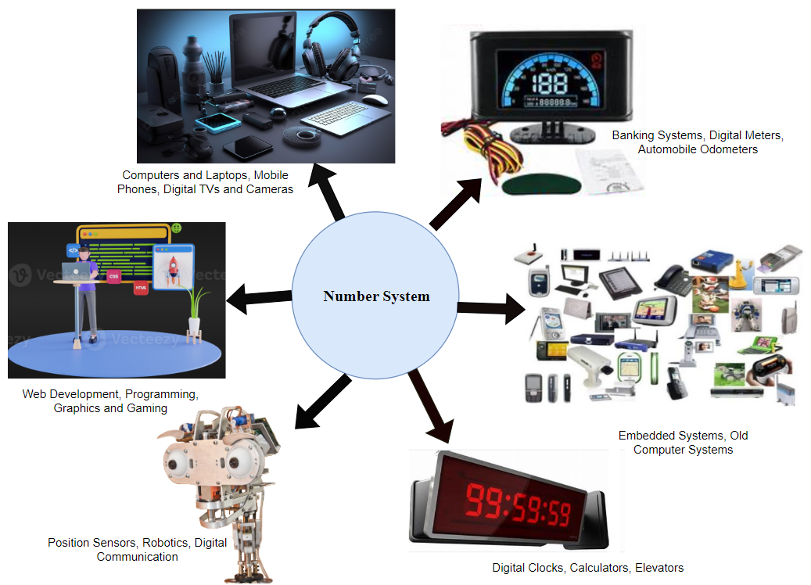

Slide 4
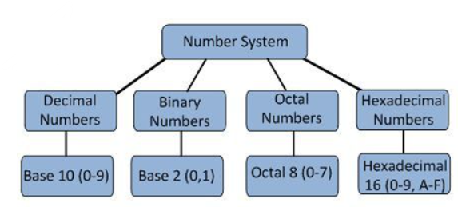

Slide 5

IS (𝟐𝟖𝟗𝟏)8
is octal ???
Explanation Slide
MSB and LSB
A) True
B) False
5

Slide 6
IS (𝟐𝟖𝟗𝟏) 𝟏𝟔 is Hexadecimal?
??
MSB and LSB
Explanation Slide
A) True
B) False
6

Slide 7
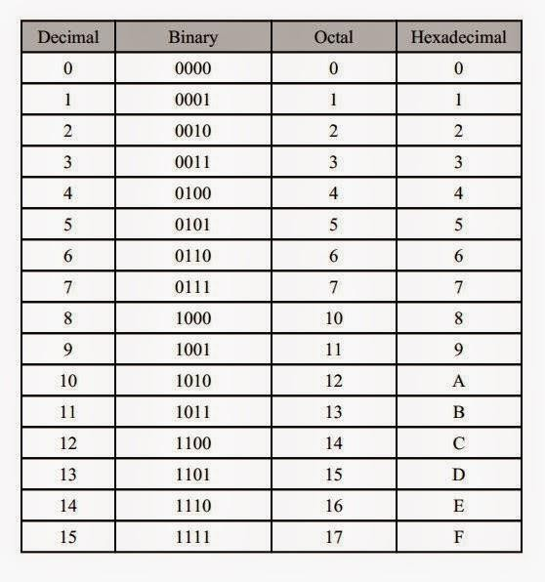
Types of Number System: COMPARISON

Slide 8
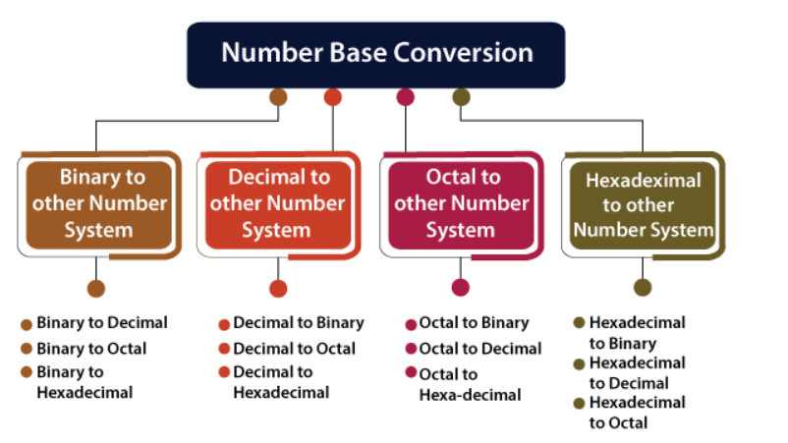

Slide 9
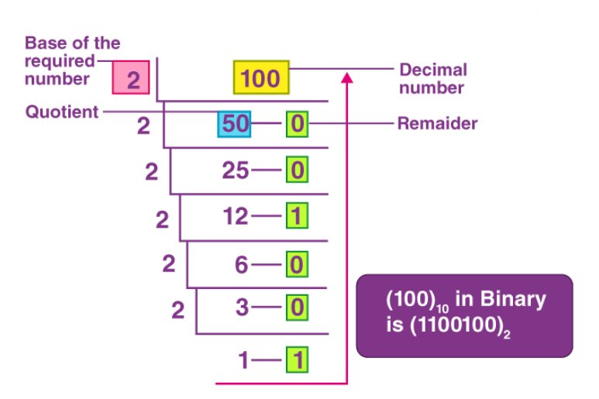
Number Conversion: Decimal to Other Base
1. Decimal to Binary Conversion:
Step 1: Continuously divide by 2 until quotient is either 0 or 1.
Step 2: Note down the remainder corresponding to each division.
Step 3: The pattern of 1’s and 0’s at the remainder column represented from bottom to top represents the equivalent binary number.

Slide 10
 |  | QUICK QUIZ (POLL)
Q. a) | 28 ₁₀ in binary is: 110110
b) | 11011
c) | 11000
d) | 11100

Slide 11
Try Yourself
Q1. Convert the following into Binary equivalents?
a) 247 ₁₀
b) 27 ₁₀

Slide 12
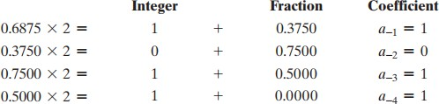
Number System: Base Conversion with Fractions
1. Decimal to Binary Conversion:
𝐶𝑜𝑛𝑣𝑒𝑟𝑡(0.6875)₁₀ to binary?
Step 1: Continuously multiply by 2 until fractional part is 0. Or Multiply by 2 until you observe that the fractional part is either repeating or never ending.
Step 2: Note down the integer part corresponding to each multiplication
Step 3: The pattern of 1’s and 0’s at the integer column represented from top to bottom represents the fractional part into an equivalent binary number.

Slide 13
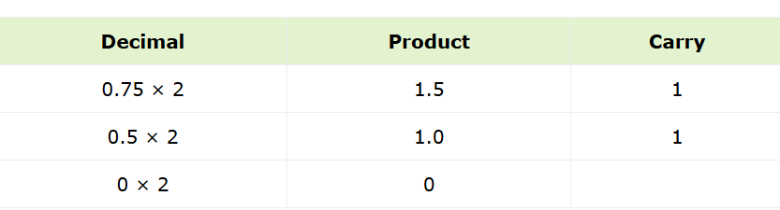
Ex2 :Convert decimal number 0.75 into binary form
Steps: 1. Multiply the fractional decimal number by 2.
2. Integral part of resultant decimal number will be first digit of fraction binary number.
3.Repeat step 1 using only fractional part of decimal number and then step 2.
Reading the carries from top to bottom, the result is 0.11.
Thus, the binary equivalent of (0.75)₁₀ is (0.11)₂

Slide 14

Try Yourself
Q1. Convert the following into Binary equivalents?
a) 0.65 ₁₀
Attempt Poll:
𝟑𝟕. 𝟔𝟓𝟔𝟐𝟓 _{𝟏𝟎}
---- Binary
a) 100101.10101
b) 101101.10111
c) 110101.11101

Slide 15
Explanation Slide

Slide 16
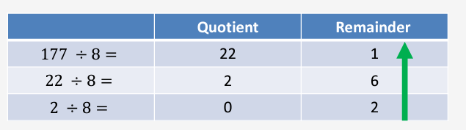
Ex 3: Convert (177)10 to octal equivalent
Answer = 261
Note: 0 6 2 the answer is read from bottom to top, the same as with the binary case.

Slide 17
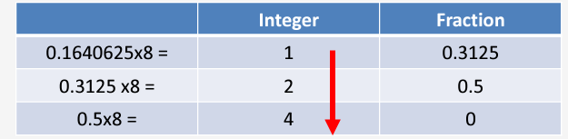
Ex4: Convert (0.1640625)10 to octal
Therefore, 0.164062510 = (0.124)8.

Slide 18
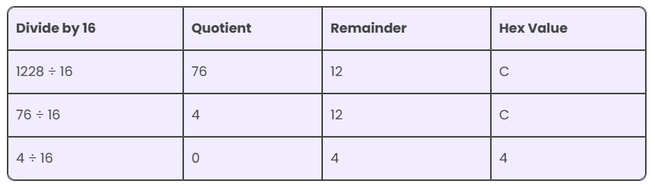
Ex 4: Convert decimal number 1228₁₀ into hex
1228₁₀ = 4CC₁₆

Slide 19
QUICK QUIZ (POLL)
FRACTION part
POLL
(0.6875)10…….( )8
A.45
B.54
C.55
D5.5
Q. Convert the following to octal: 305 ₁₀
a) 440
b) 441
c) 460
d) 461

Slide 20
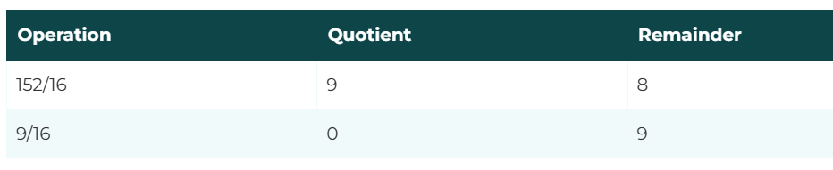
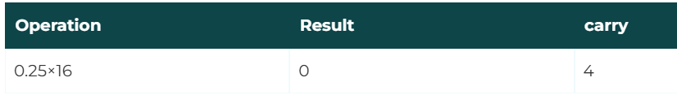
Ex 6: Convert (152.25)₁₀ Hexadecimal
Step 1: Divide the number 152 and its successive quotients with base 16.
(152)10=(98)16
Step 2: Now perform the multiplication of 0.25 and successive fraction with base 16.
(0.25)10=(4)16
hexadecimal number of the decimal number 152.25 is 230.4.

Slide 21
QUICK QUIZ (POLL)
Q. Convert the following to hexadecimal: 7825 ₁₀
a) 𝐵321
FRACTION part : (0.760)10…….( )16 A)DF120
B)C28F5 C)CA8F5 D)DA8F6
b) 1E91
c) 123A
d) E240

Slide 22



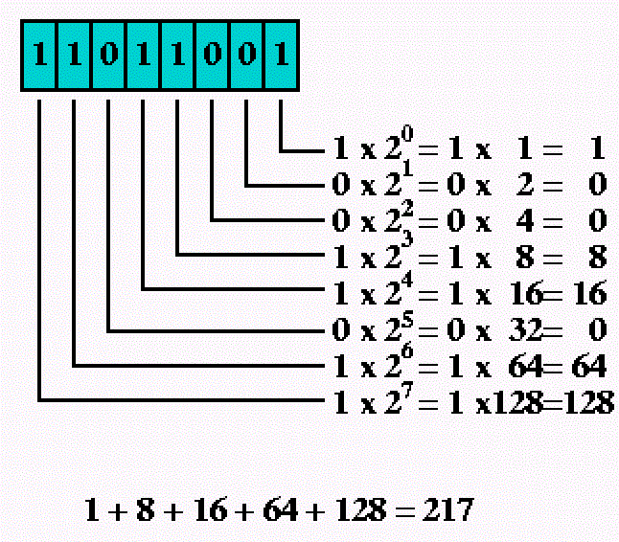
Number System: Base Conversion
Integer part
1. Binary to Decimal Conversion:
MSB
LSB
Step 1: Multiply with the powers of 2^{𝑛}
where n=0,1,2,3,… starting from the LSB.
Step 2: Add all the decimal numbers corresponding to the coefficients.
Step 3: The sum obtained would be the equivalent decimal number representation of the given binary number.

Slide 23
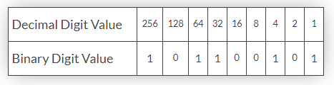
Number System: Base Conversion
₂nd
example
Binary to Decimal Conversion:
Step 1: Multiply with the powers of 2^{𝑛}
where n=0,1,2,3,… starting from the LSB.
Step 2: Add all the decimal numbers corresponding to the coefficients.
Step 3: The sum obtained would be the
𝐵𝑖𝑛𝑎𝑟𝑦: (101100101)₂
equivalent | decimal |  | number
representation | of the | given | binary
number.
𝑅𝑒𝑠𝑢𝑙𝑡: (357)₁₀

Slide 24
QUICK QUIZ (POLL)
Q. Convert the following binary number to decimal:
a) 11
01011
2
b) 35
c) 15
d) 10

Slide 25
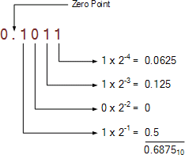

Number System: Base Conversion with Fractions
1. Binary to Decimal Conversion:
Step 1: Multiply with the powers of 2^{−𝑛}
where n=1,2,3,… starting from the MSB.
Step 2: Add all the decimal numbers corresponding to the coefficients.
Step 3: The sum obtained would be the
𝐶𝑜𝑛𝑣𝑒𝑟𝑡(0.1011)₂ to decimal?
equivalent representation number.
decimal
number binary
of the given
Fraction part

Slide 26
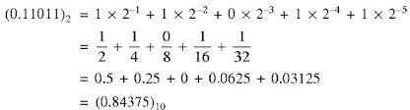
Number System: Base Conversion with Fractions
1. Binary to Decimal Conversion:
Step 1: Multiply with the powers of 2^{−𝑛}
where n=1,2,3,… starting from the MSB.
Step 2: Add all the decimal numbers corresponding to the coefficients.
Step 3: The sum obtained would be the
𝐶𝑜𝑛𝑣𝑒𝑟𝑡(0.11011)₂ to decimal?
equivalent | decimal |  | number
representation | of the | given | binary
number.

Slide 27
Try Yourself
Home assignments
Q1. Convert the following into Decimal equivalents?
a) 01101.10011 ₂
b) 1010111.001101 ₂
Share on lpu live

Slide 28
QUICK QUIZ (POLL)
Q1. Convert the following into Decimal equivalents? (1011.10011)₂
A) (11.59735)10
B) (10.59735)10
C) (11.59375)10
D) (10.59375)10

Slide 29
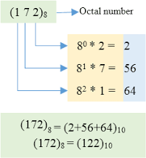
Number System: Base Conversion
2. Octal to Decimal:
• The method is quite similar to the transformation of any binary number to decimal, the only difference is that in this case the 2 will be replaced by 8 and everything else i.e. the methods will remain same.
• We have to start multiplying the digits of the number from LSB side with increasing powers of 8 staring from 0 and finally summing up all the products.

Slide 30
QUICK QUIZ (POLL)
Q. Convert the following to decimal:
a) 280.00123
431.32 ₈
b) 281.40625
c) 421.40625
d) 431.4343

Slide 31
(.32 )8------( )10
Convert (6432)8 into decimal

Slide 32
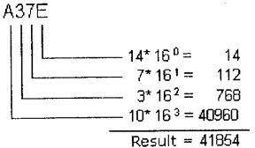
Number System: Base Conversion
3. Hexadecimal to Decimal:
• The method is quite similar to the transformation of any binary number to decimal, the only difference is that in this case the 2 will be replaced by 16 and everything else i.e. the methods will remain same.
• we have to start multiplying the digits of the number from LSB side with increasing powers of 16 staring from 0 and finally summing up all the products.

Slide 33
QUICK QUIZ (POLL)
Q. Convert the following to decimal: 3𝐹𝐵 a) 1210
16
b) 1019
c) 4821
d) 1101

Slide 34
QUICK QUIZ (POLL)
Q. Convert the following to decimal: A9.8 ₁₆
a) 121.0
b) 101.9
c) 169.5
d) 110.1

Slide 35
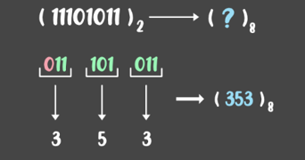
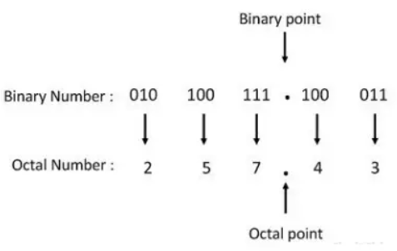
Binary to Octal Conversion
Step1: To convert from binary to octal, start grouping the bits in groups of 3 from the right end
Step2: Write the equivalent octal for the 3-bit binary.
Step3: Add 0’s on the left to adjust the groups.

Slide 36
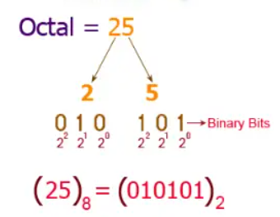
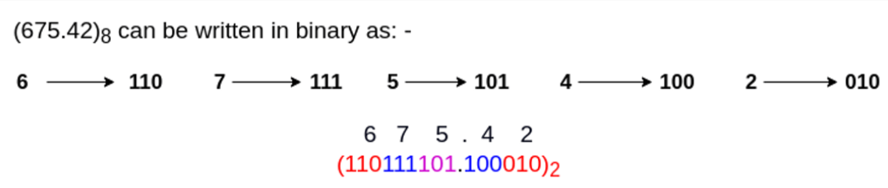
Octal to Binary Conversion

Slide 37
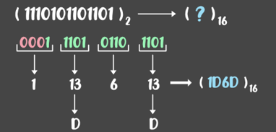
Binary to Hexadecimal Conversion
Step1: To convert from binary to octal, start grouping the bits in groups of 4 from the right end
Step2: Write the equivalent octal for the 3-bit binary.
Step3: Add 0’s on the left to adjust the groups.

Slide 38
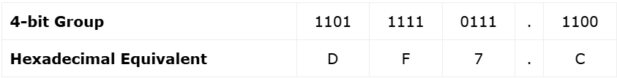
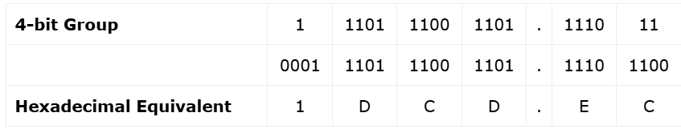
Ex-1 Convert (110111110111.1100)2 to hexadecimal
The hexadecimal equivalent of (110111110111.1100)2 is (DF7.C)16.
EX-2: Convert (1110111001101.111011)₂ to hexadecimal
The hexadecimal equivalent of the given binary number is (1DCD.EC)16.

Slide 39
Hexadecimal to Binary Conversion
Ex-1: The given hexadecimal number is 6FD16. Find out its binary form.
6₁₆ = 0110₂
F₁₆ = 1111₂
D₁₆ = 1101₂
Ans: 6FD₁₆ = 0110 1111 1101₂

Slide 40
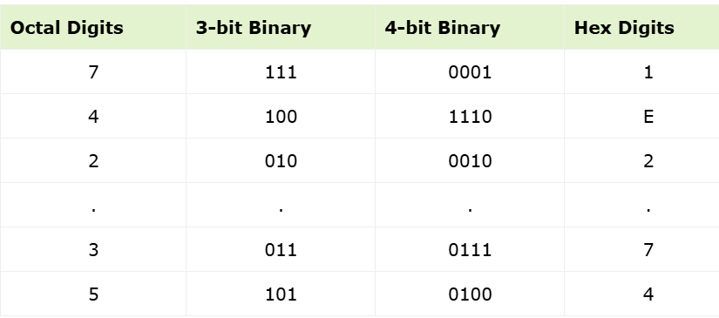
Octal to Hexadecimal Conversion
Step 1 − Convert each digit of the given octal number to its equivalent binary of 3-bits.
Step 2 − Make groups of 4 bits each of the obtained binary number.
Step 3 − Convert each 4-bit binary group to its equivalent hexadecimal.
EX 1: Convert (742.35)8 to hexadecimal.
Hexadecimal equivalent of the given octal number is (1E2.74)16.

Slide 41
POLL
Q1.(3CFB.2E)16---------(?)8
A) (36363.134)8
B) (36373.134)8
C) (37373.134)8
Q2. (574.32)8-------------(?)16
A) (17C.68)16 B) (17D.78)16 C) (17E.78)16

Slide 42
Practice Question
Convert (25)₁₀ in Binary
What is equivalent value of (278)₁₀ in Binary?
Convert decimal number 0.125 into binary form
Convert decimal number 65.16 into binary form
Convert (82.523)10 to octal equivalent up to 3 decimal places.
Convert 7562₁₀ to hex
Convert (524.26)₁₀ to hexadecimal.
Convert hexadecimal number 8F4E9A16 to its binary form.

Slide 43

Disadvantages of Number System
How to Overcome
this problems ??
Complex Arithmetic Operations
Error-Prone Data Entry
Unstable StaHuman Readability Issueste
Increased Hardware Requirements
Inefficient Memory Usage

