Slide 1
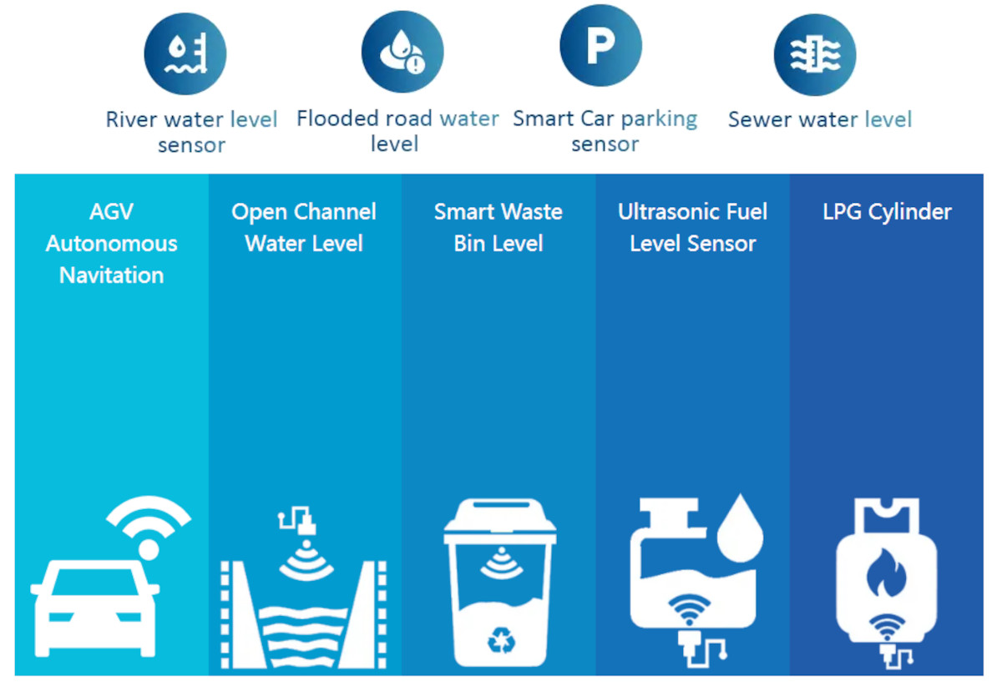
Ultrasonic Sensor

Slide 2
Ultrasonic Sensor
An ultrasonic sensor is an instrument that measures the distance to an object using ultrasonic sound waves.
An ultrasonic sensor uses a transducer to send and receive ultrasonic pulses that relay back information about an object’s proximity
Ultrasonic sensors work by sending out a sound wave at a frequency above the range of human hearing.
The transducer of the sensor acts as a microphone to receive and send the ultrasonic sound.
Our ultrasonic sensors, like many others, use a single transducer to send a pulse and to receive the echo.
The sensor determines the distance to a target by measuring time lapses between the sending and receiving of the ultrasonic pulse.

Slide 3
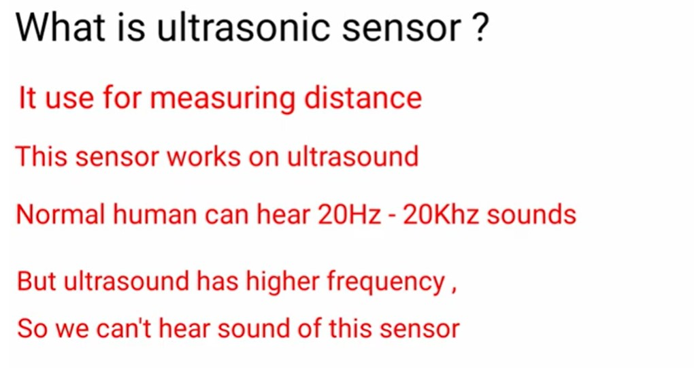

Slide 4
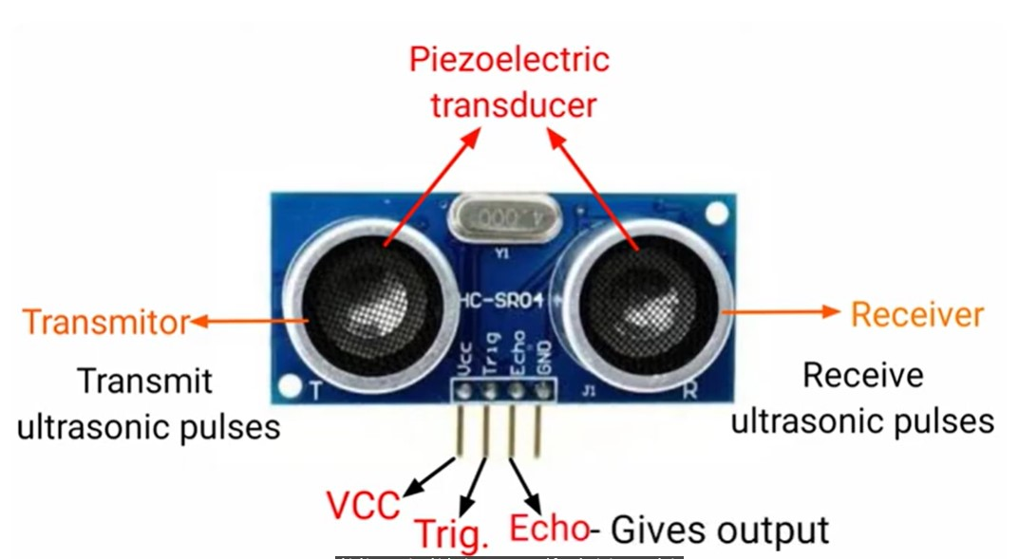
GND

Slide 5
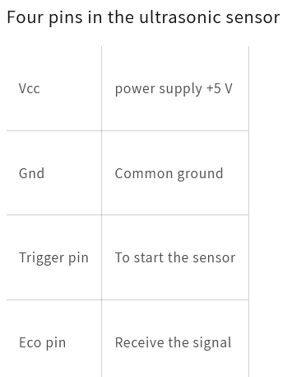

Slide 6
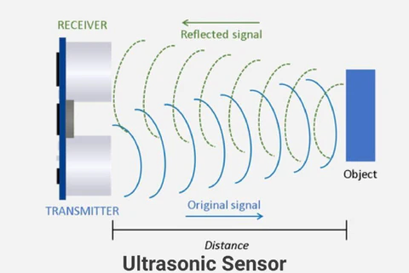

Slide 7
In order to calculate the distance between the sensor and the object, the sensor measures the time it takes between the emission of the sound by the transmitter to its contact with the receiver.
The formula for this calculation is D = ½ T x C (where D is the distance, T is the time, and C is the speed of sound ~ 343 meters/second).
For example, if a scientist set up an ultrasonic sensor aimed at a box and it took 0.025 seconds for the sound to bounce back, the distance between the ultrasonic sensor and the box would be
or about 4.2875 meters.
D = 0.5 x 0.025 x 343

Slide 8
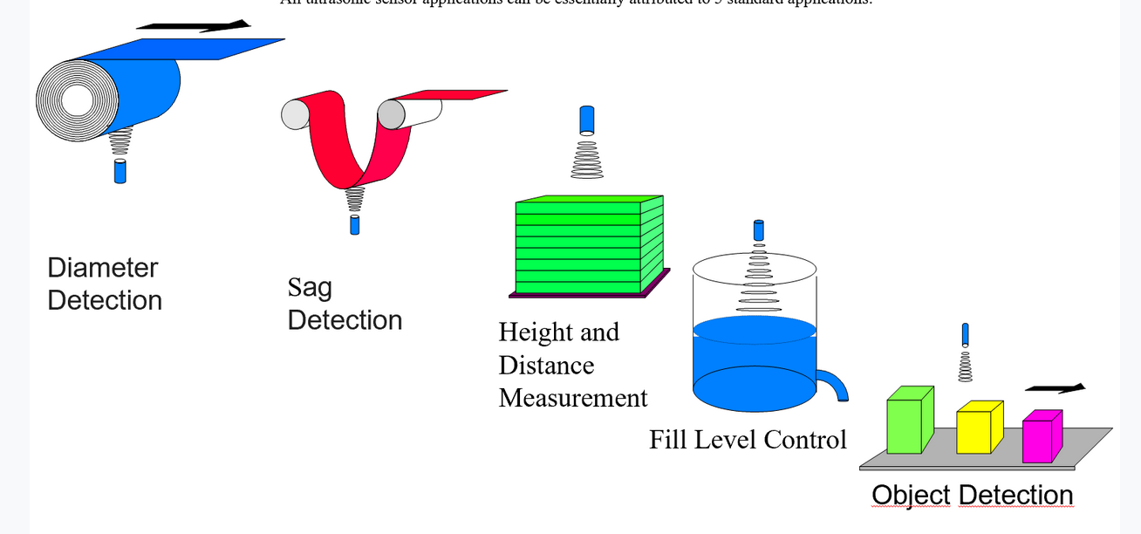

Slide 9
Ultrasonic Object Detection in Driving Assistance
Both self-driving cars (as well as human-driven vehicles that incorporate driver assistance technology) use sensors extensively to monitor road and surrounding conditions. For example, ultrasonic sensors can detect cars in adjacent lanes for “blind spot detection” and alert human drivers if a car is in their blind spot.
Ultrasonic Distance Detection
For example, when parking your car, the sensors can monitor how close the car comes to a wall or other vehicles and alert you to stop. This works in traffic as well, because these sensors function accurately even when both objects are in motion.
Ultrasonic Diameter Detection
Consider printing facilities, such as those that print newspapers or magazine pages. The paper typically starts out in a roll; as the paper gets used, the roll’s diameter diminishes. With ultrasonic sensors, the facility can automatically detect when the roll is about to run out, so they can be prepared to swap it out for a fresh roll without losing productivity.

Slide 10
Ultrasonic Sag Detection
Ultrasonic sensors can also ensure that any conveyor belts, wires, or cables that might be used in a manufacturing or other industrial setting are positioned as they should be. Cable sag can slow or stop production lines, and these sensors can automatically detect if these objects are running evenly, or even they need to be tightened.
Ultrasonic Level Detection
Here’s another example of process automation, this time in the food production industry. Hoffmann + Krippner makes an ultrasonic sensor with a hygienic design and fully encapsulated stainless steel that makes it perform well even when working with food items. For example, it can help creameries produce cheese continuously, rather than in batches, by monitoring milk and rennet levels in a coagulator machine.

Slide 11
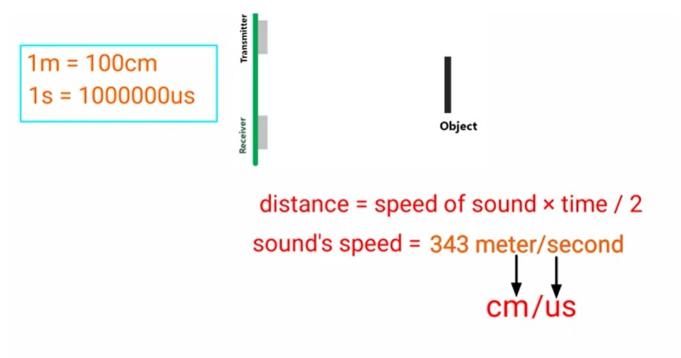

Slide 12
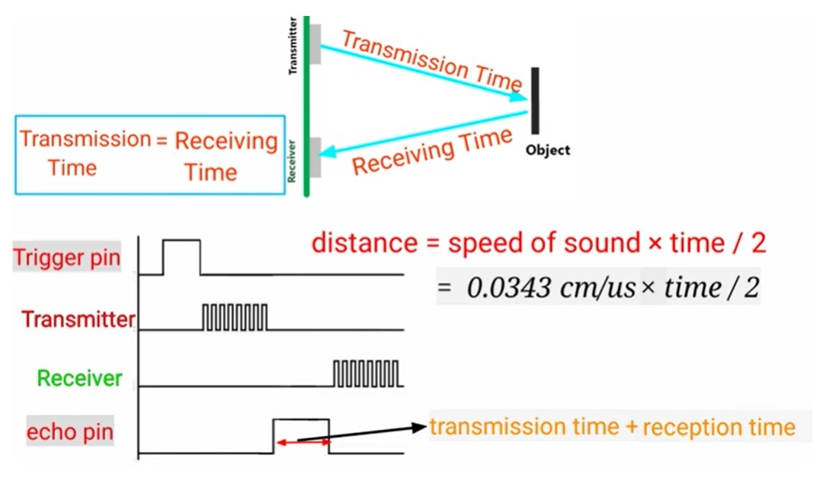

Slide 13
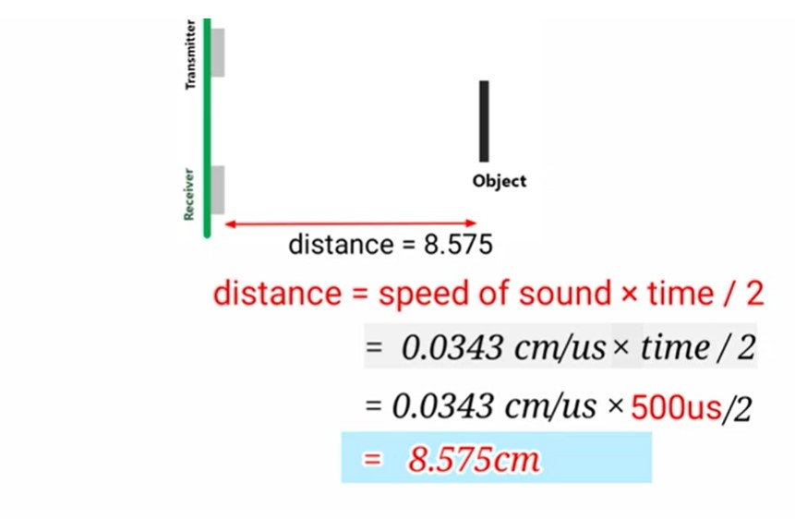

Slide 14
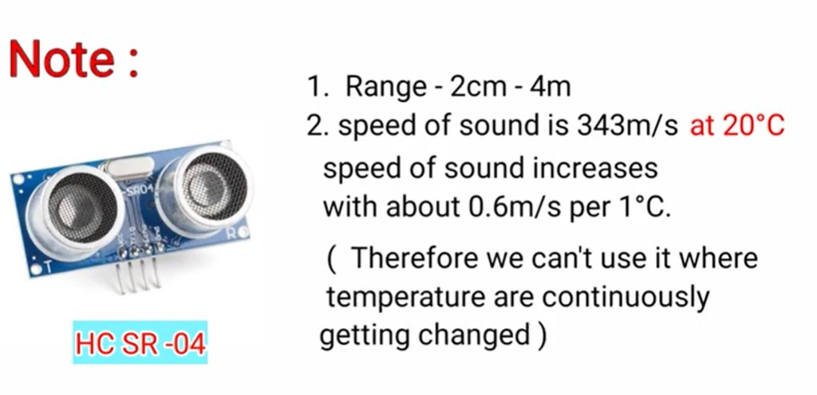

Slide 15
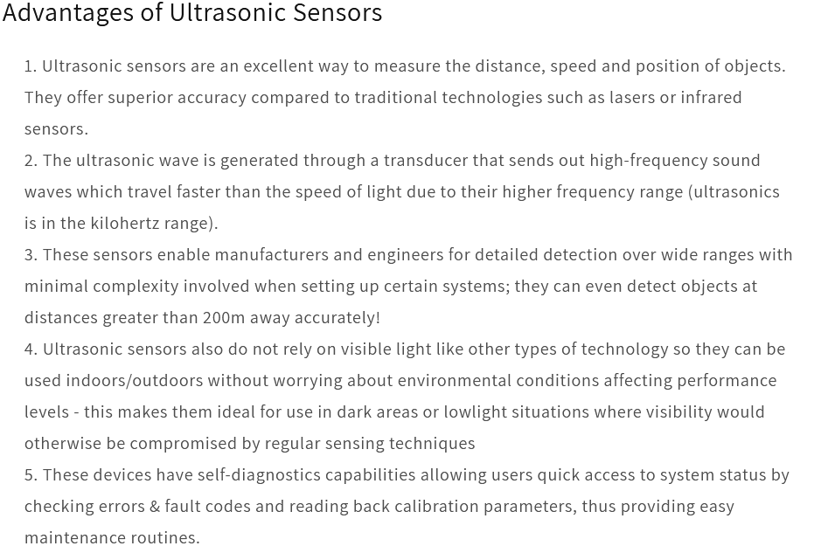

Slide 16
Arduino Sketch
/*
* Ultrasonic Sensor HC-SR04 and Arduino Tutorial
*/
// defines pins numbers
const int trigPin = 9;
const int echoPin = 8;
// defines variables
long duration;
int distance;
void setup()
{
pinMode(trigPin, OUTPUT); // Sets the trigPin as an Output
pinMode(echoPin, INPUT); // Sets the echoPin as an Input
Serial.begin(9600); // Starts the serial communication
}

Slide 17
Arduino Sketch (Cont..)
void loop()
{ // Clears the trigPin
digitalWrite(trigPin, LOW);
delayMicroseconds(2);
// Sets the trigPin on HIGH state for 10 micro seconds
digitalWrite(trigPin, HIGH);
delayMicroseconds(10);
digitalWrite(trigPin, LOW);
// Reads the echoPin, returns the sound wave travel time in microsec.
duration = pulseIn(echoPin, HIGH);
// Calculating the distance
distance= (duration*0.034)/2;
// Prints the distance on the Serial Monitor
Serial.print("Distance: ");
Serial.print(distance);
Serial.println("cm");
delay(500); //500 m.sec = 0.5 sec
}

Slide 18
pulsein()
Reads a pulse (either HIGH or LOW) on a pin.
For example, if value is HIGH, pulseIn() waits for the pin
to go from LOW to HIGH, starts timing, then waits for the pin
to go LOW and stops timing.
Returns the length of the pulse in microseconds or
gives up and returns 0 if no complete pulse was received
within the timeout.

Slide 19
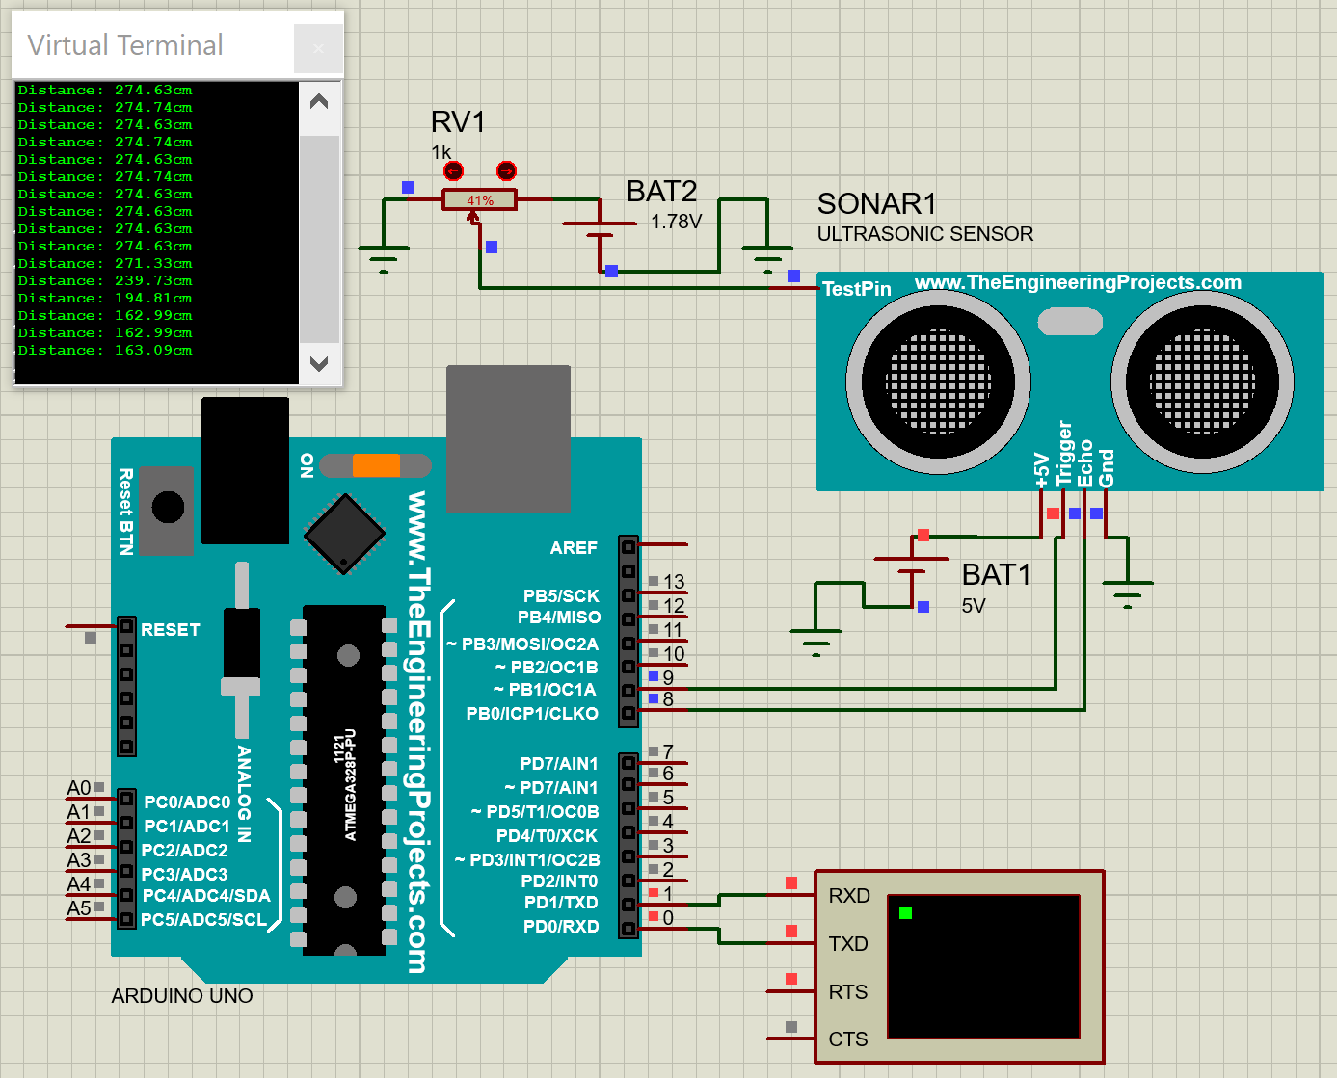
Proteus design:

Slide 20
Links to download the software's:
Link to download Proteus 8.1:
https://getintopc.com/softwares/3d-cad/proteus-professional-2020-free-download/
Link to download Proteus Libraries:
https://github.com/officialdanielamani/proteus-library-collection
Link to download Arduino IDE 1.8.19:
https://www.arduino.cc/en/software

Slide 21

Temperature Sensors

Slide 22
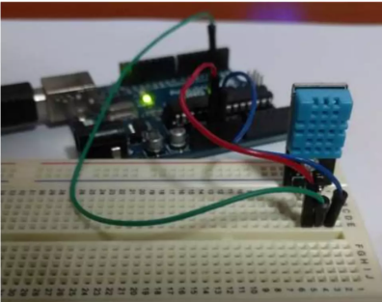
Interfacing DHT11 – Temperature and Humidity Sensor with Arduino Uno

Slide 23
Hardware Required
Laptop Installed with Arduino IDE
Arduino Uno
USB Cable
DHT11
Breadboard
3 Jumper Wires

Slide 24
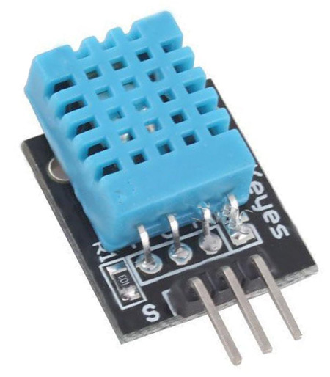
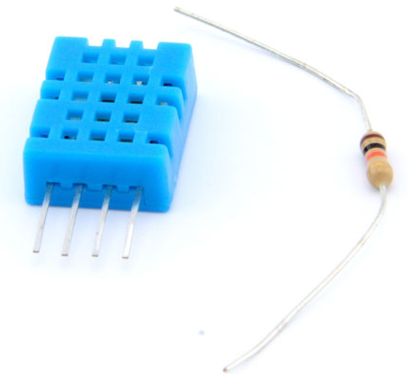
What is DHT 11 ?
Temperature and Humidity Sensor
Raw DHT11
Requires resistor (10Kohms) Pull-up to Vcc
Connections from left: Vcc(3-5V), Data Out, None, GND
Humidity: 20 – 90 % (±5%)
Temperature: 0 – 50 C (±2%)
Raw DHT11 with Breakout
On-Board Pull-up Resistor
Connections from left: Vcc(3-5V), Data Out, GND
Humidity: 20 – 90 % (±5%)
Temperature: 0 – 50 C (±2%)
** A better DHT22 version exists, that can be used if you have a choice

Slide 25
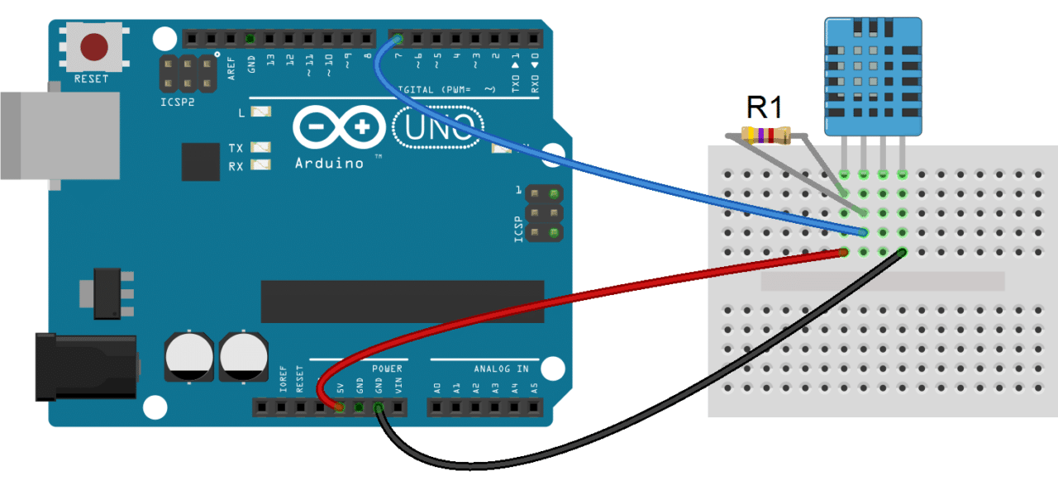
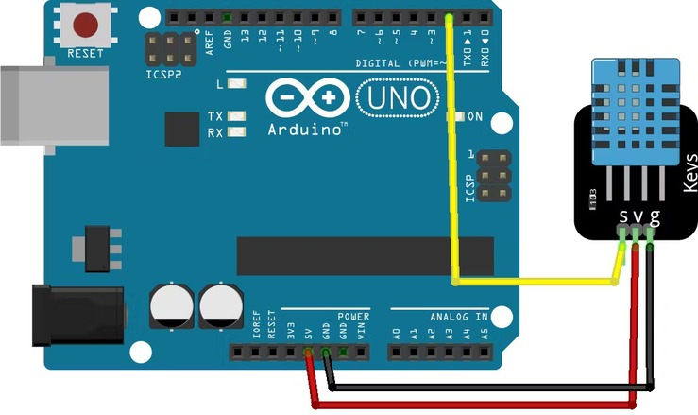
Connection with Arduino
For Raw DHT11
10Kohm resistor is required between Data and Vcc
For DHT11 Breakout
5V to V
Arduino to any Input Pin to Out of DHT11
GND to G

Slide 26
Process
#include <dht11.h>
#define DHT11PIN 4
dht11 DHT11;
void setup()
{
Serial.begin(9600);
}
void loop()
{
Serial.println();
int chk = DHT11.read(DHT11PIN);
Serial.print("Humidity (%): ");
Serial.println((float)DHT11.humidity, 2);
Serial.print("Temperature (C): ");
Serial.println((float)DHT11.temperature, 2);
delay(2000);
}
Code
You need to add the library to the Arduino IDE.
Upload the code.
When the code is uploaded, open the Serial Monitor and set the baud rate to 9600
You will see the humidity and temperature on the Monitor
Don't forget to add this library to the Arduino IDE.

Slide 27
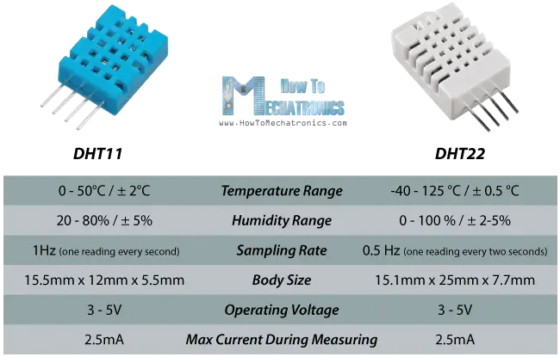
DHT11 vs DHT22

