Slide 1
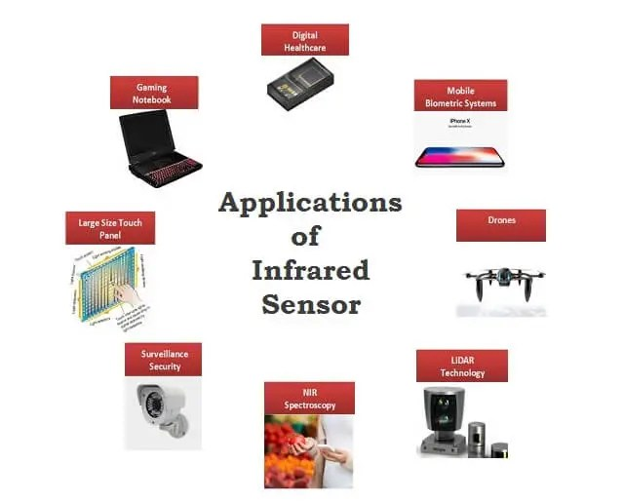
IR Sensor

Slide 2

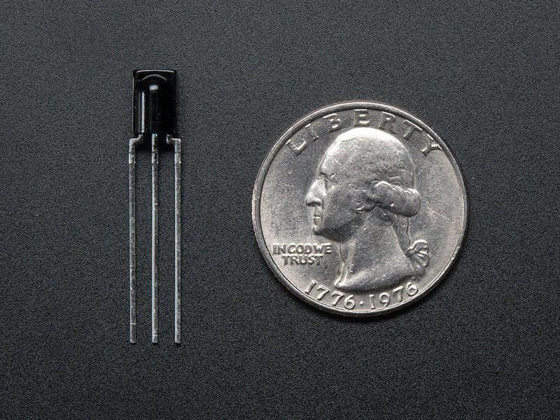
IR Sensor
Created by lady ada
https://learn.adafruit.com/ir-sensor
Last updated on 2022-12-01 01:49:09 PM EST

Slide 3
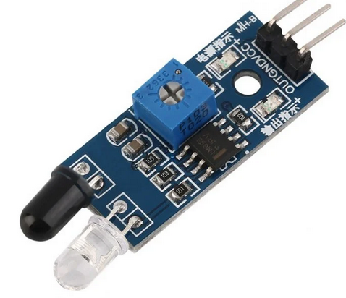
IR Sensor : Circuit Diagram & Its Working
IR technology is used in daily life and also in industries for different purposes.
For example, TVs use an IR sensor to understand the signals which are transmitted from a remote control.
The main benefits of IR sensors are low power usage, their simple design & their convenient features.
IR signals are not noticeable by the human eye. The IR radiation in the electromagnetic spectrum can be found in the regions of the visible & microwave.
Usually, the wavelengths of these waves range from 0.7 µm to 1000µm.
The IR spectrum can be divided into three regions like near-infrared, mid, and far-infrared.

Slide 4
An infrared sensor is an electronic device, that emits in order to sense some aspects of the surroundings.
An IR sensor can measure the heat of an object as well as detects the motion.
These types of sensors measure only infrared radiation, rather than emitting it that is called a passive IR sensor.
Usually, in the infrared spectrum, all the objects radiate some form of thermal radiation.
These types of radiations are invisible to our eyes, which can be detected by an infrared sensor.
The emitter is simply an IR LED (Light Emitting Diode) and the detector is simply an IR photodiode that is sensitive to IR light of the same wavelength as that emitted by the IR LED.
When IR light falls on the photodiode, the resistances and the output voltages will change in proportion to the magnitude of the IR light received.

Slide 5
Types of IR Sensor
There are two types of IR sensors are available and they are,
Active Infrared Sensor
Passive Infrared Sensor
Active Infrared Sensor
Active infrared sensors consist of two elements: infrared source and infrared detector. Infrared sources include the LED or infrared laser diode. Infrared detectors include photodiodes or phototransistors. The energy emitted by the infrared source is reflected by an object and falls on the infrared detector.
Passive Infrared Sensor
Passive infrared sensors are basically Infrared detectors. Passive infrared sensors do not use any infrared source and detector. Thermal infrared sensors use infrared energy as the source of heat.
Example of passive sensor is eye. Eye just detects light that already exist.
Example of active sensor is eye and flashlight in the dark: eye detects light produced by flashlight.

Slide 6
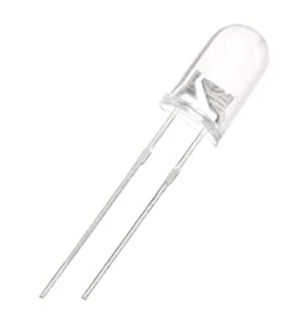
Working Principle
An IR sensor consists of an IR LED and an IR Photodiode, together they are called as PhotoCoupler or OptoCoupler.
IR Transmitter or IR LED
Infrared Transmitter is a light emitting diode (LED) which emits infrared radiations called as IR LED’s.
Even though an IR LED looks like a normal LED, the radiation emitted by it is invisible to the human eye.
The picture of an Infrared LED is shown below.

Slide 7
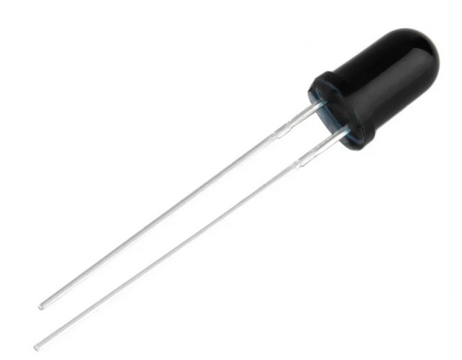
IR Receiver or Photodiode
Infrared receivers or infrared sensors detect the radiation from an IR transmitter.
IR receivers come in the form of photodiodes and phototransistors. Infrared Photodiodes are different from normal photo diodes as they detect only infrared radiation.
Below image shows the picture of an IR receiver or a photodiode,

Slide 8
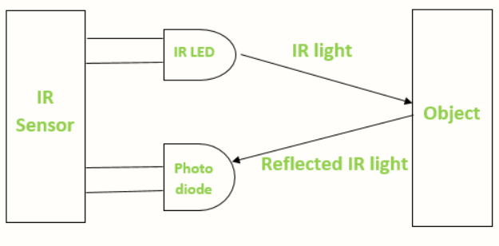
Different types of IR receivers exist based on the wavelength, voltage, package, etc. When used in an infrared transmitter – receiver combination, the wavelength of the receiver should match with that of the transmitter.
The emitter is an IR LED and the detector is an IR photodiode. The IR photodiode is sensitive to the IR light emitted by an IR LED. The photo-diode’s resistance and output voltage change in proportion to the IR light received. This is the underlying working principle of the IR sensor.

Slide 9
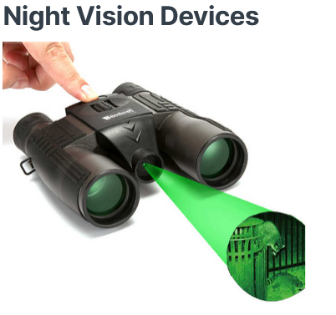
Applications of IR Sensor

Slide 10
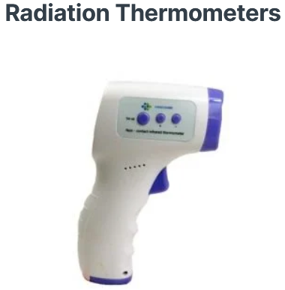
IR sensor uses in radiation thermometers to measure the temperature depend upon the temperature and the material of the object and these thermometers have some of the following features
Measurement without direct contact with the object
Faster response
Easy pattern measurements

Slide 11
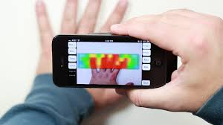
Infrared Tracking
An Infrared tracking or Infrared homing, is a missile guidance system which operates using the infrared electromagnetic radiation emitted from a target to track it.
IR Imaging Devices:

Slide 12
Other Key Application Areas
Other key application areas that use infrared sensors include:
Climatology
Meteorology
Photobiomodulation
Flame Monitors
Gas detectors
Water analysis
Moisture Analyzers
Anesthesiology testing
Petroleum exploration
Rail safety
Gas Analyzers

Slide 13
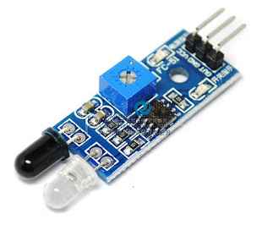
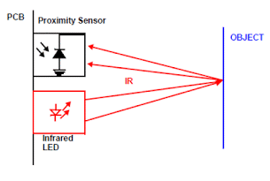
InfraRed (IR) Sensor
Features-
Can be used for obstacle sensing, fire detection, line sensing, etc
Input Voltage: 5V DC
Comes with an easy to use digital output
Can be used for wireless communication and sensing IR remote signals
IR Sensor have three Pins
1. VCC = +5V DC
2. GND
3. D0 or OUT (Digital Output)

Slide 14
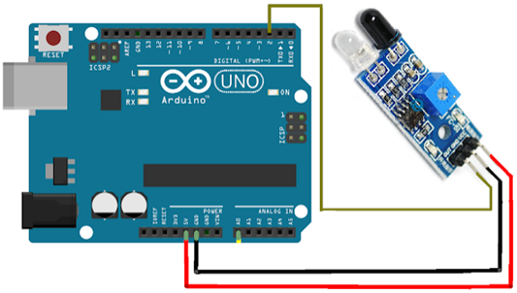
Arduino sketch & Circuit diagram
const int ProxSensor=2;
void setup()
{
pinMode(13, OUTPUT);
pinMode(ProxSensor, INPUT);
}
void loop()
{
if(digitalRead(ProxSensor)==HIGH)
{
digitalWrite(13, HIGH);
}
else
{
digitalWrite(13, LOW);
}
delay(100);
}

Slide 15
IR Sensor Interfacing, display the o/p on Serial Monitor
/*
IR Proximity Sensor interface code
Turns on an LED on when obstacle is
detected, else off.
*/
const int ProxSensor=2;
void setup()
{
// initialize the digital Serial port.
Serial.begin(9600);
// initialize the digital pin as an output.
pinMode(13, OUTPUT);
pinMode(ProxSensor,INPUT);
}
void loop()
{
if(digitalRead(ProxSensor)==LOW)
//Check the sensor output
{
digitalWrite(13, HIGH); // set the LED on
Serial.println("Stop something is ahead!! "); //Message on Serial Monitor
}
else
{
digitalWrite(13, LOW); // set the LED off
Serial.println("Path is clear");
//Message on Serial Monitor
}
delay(1000); // wait for a second
}

Slide 16
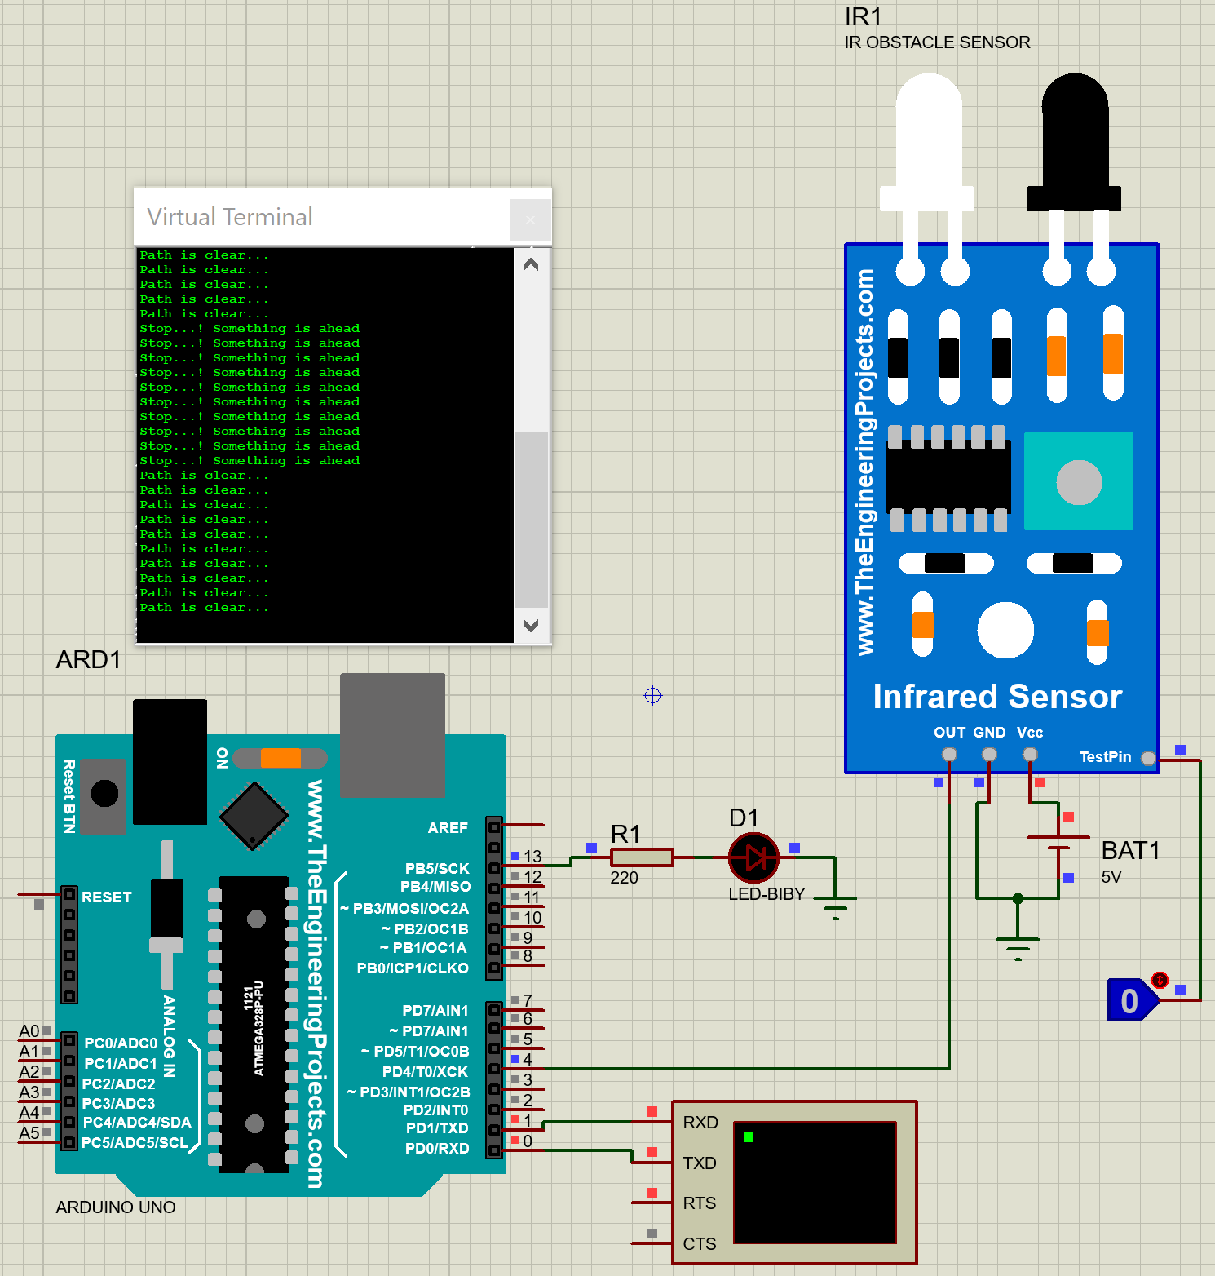
Proteus design:

Slide 17
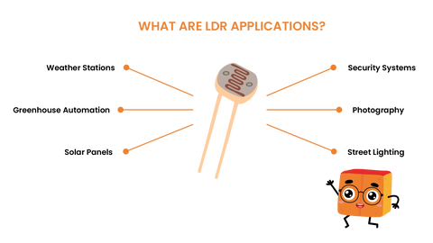
Light Dependent Resistor
Smart Home Lighting
Traffic Light Control
Street Light Automation
Solar Tracking Systems
Security Alarm Triggers
Environmental Monitoring
Automatic Garden Light

Slide 18
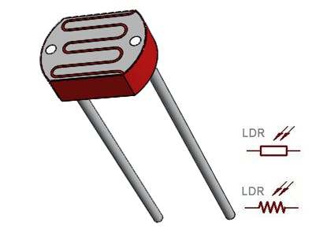
Light Dependent Resistor
LDR ( Light Dependent Resistor ) also called as photoresistor is responsive to light.
Photoresistors are used to indicate the light intensity (or) the presence or absence of light.
When there is darkness then the resistance of photoresistor increases, and when there is sufficient light it’s resistance decreases.

Slide 19
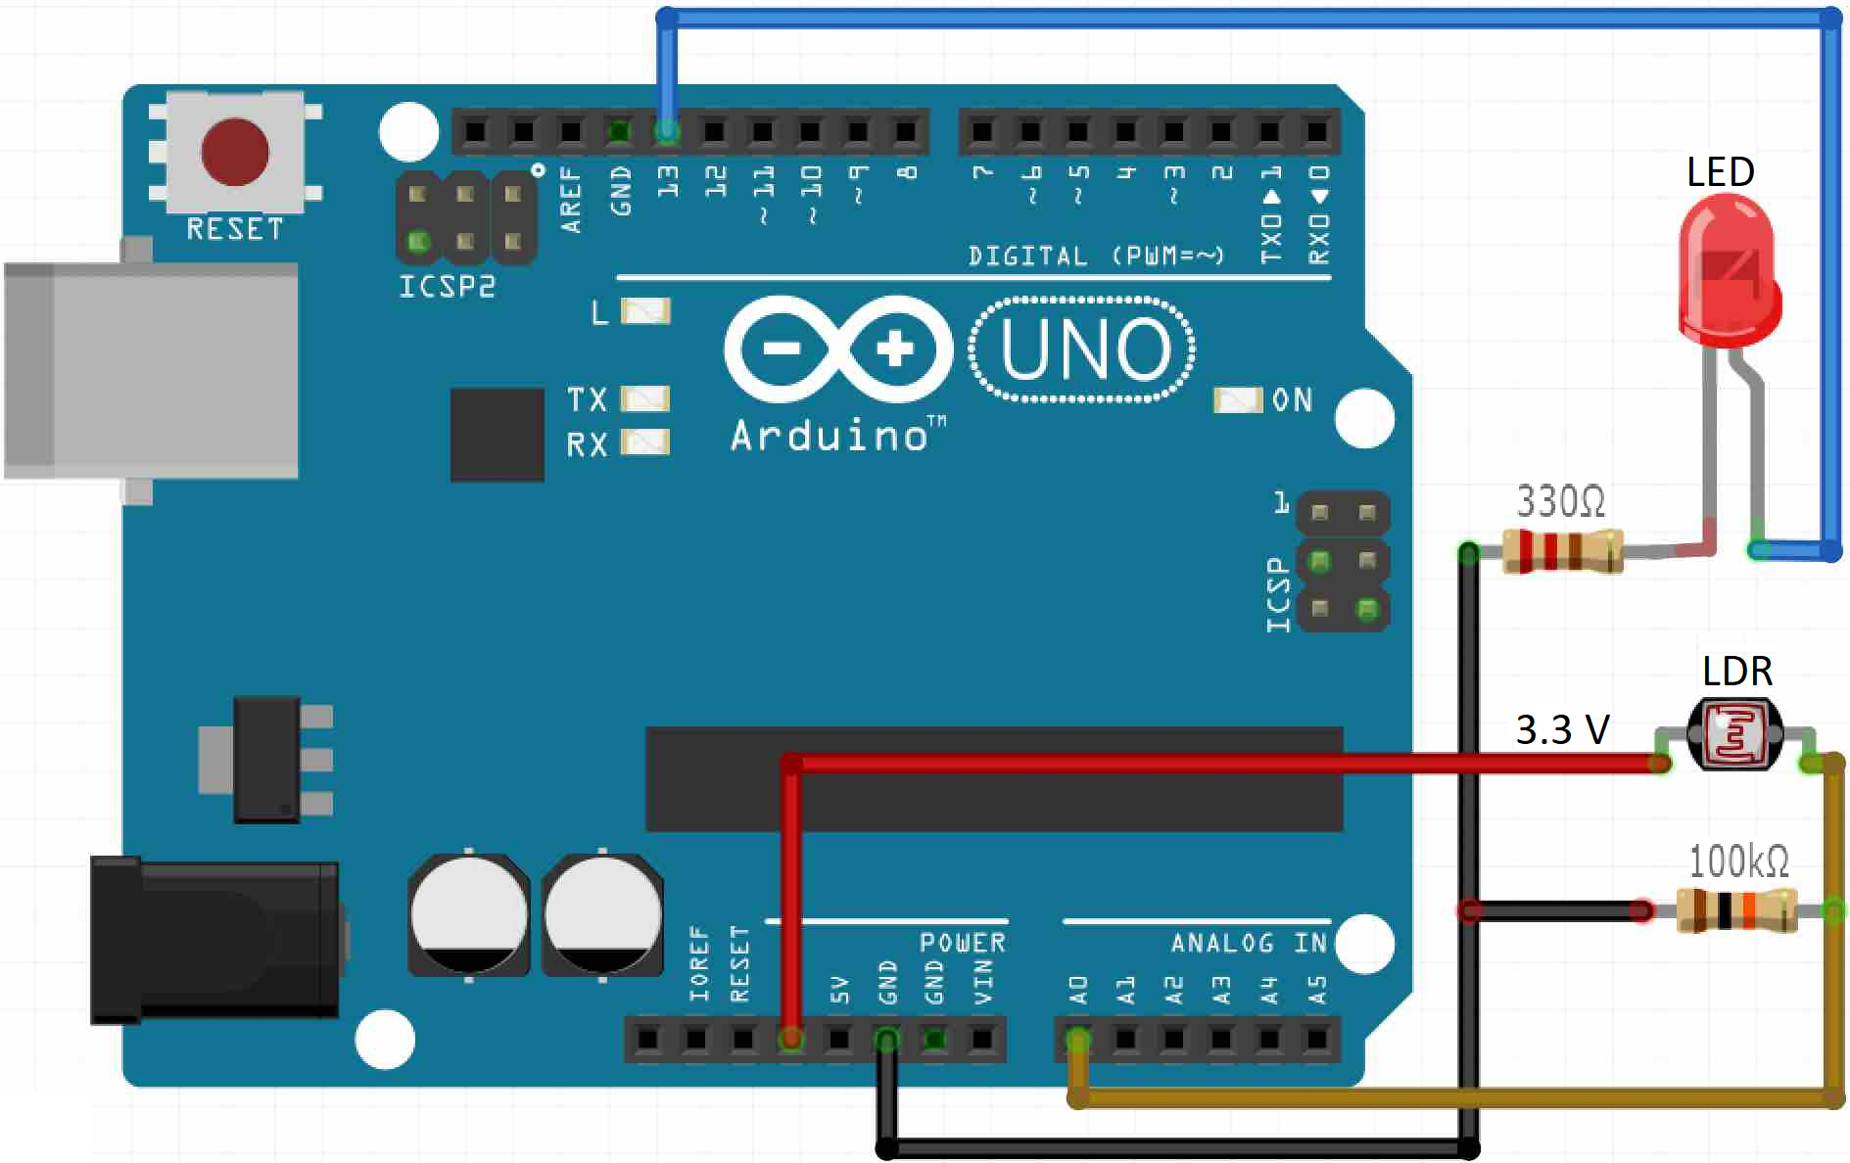
LDR with Arduino: sketch & Circuit
const int ledPin = 13; //pin at which LED is connected
const int ldrPin = A0; //pin at which LDR is connected
int threshold = 600;
void setup()
{
Serial.begin(9600);
pinMode(ledPin, OUTPUT); //Make LED pin as output
pinMode(ldrPin, INPUT); //Make LDR pin as input
}
void loop()
{
int ldrStatus = analogRead(ldrPin); //saving the analog values received from LDR
if (ldrStatus <= threshold) //set the threshold value below at which the LED will turn on
{ //you can check in the serial monior to get approprite value for your LDR
digitalWrite(ledPin, HIGH); //Turing LED ON
Serial.print("Its DARK, Turn on the LED : ");
Serial.println(ldrStatus);
}
else
{
digitalWrite(ledPin, LOW); //Turing OFF the LED
Serial.print("Its BRIGHT, Turn off the LED : ");
Serial.println(ldrStatus);
}
}

Slide 20
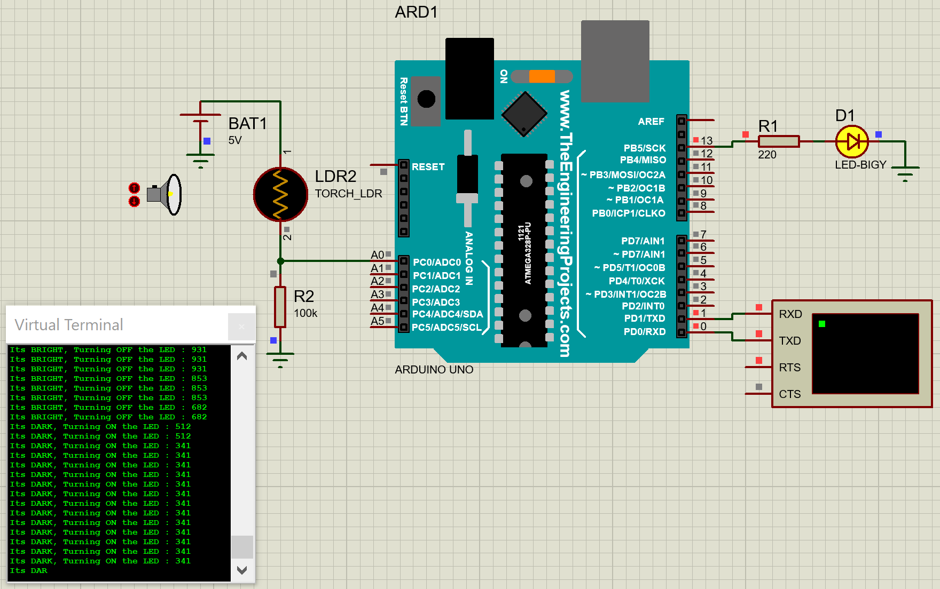
Proteus Design:

Slide 21
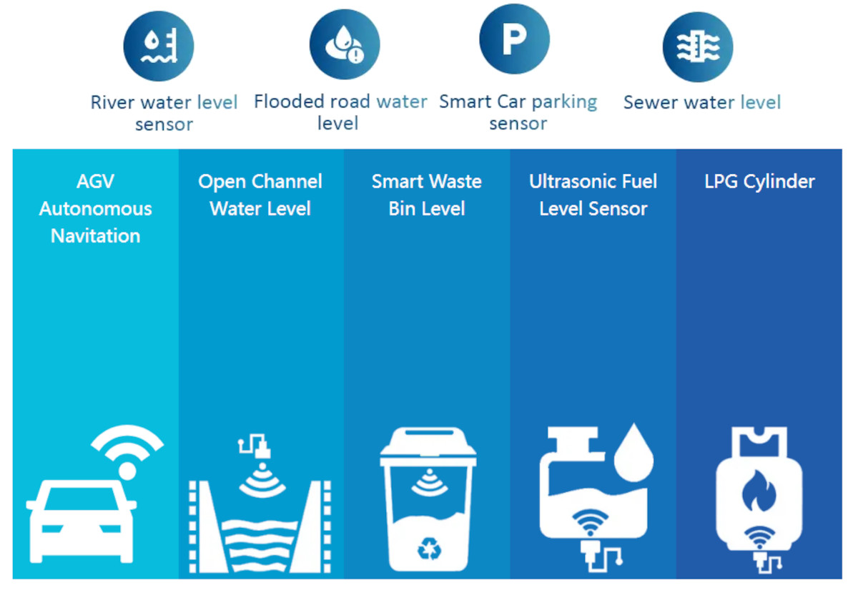
Ultrasonic Sensor

