Slide 1
Natural Disasters
Flood and cyclone

Slide 2
Lecture Objective:
  Making students aware about cause, effects and control of flood and cyclone
Lecture Outcome:
  Students will learn about the types of floods, causes, effects and control of flood
  Students will learn about the types of cyclone, causes, effects and management of cyclone

Slide 3
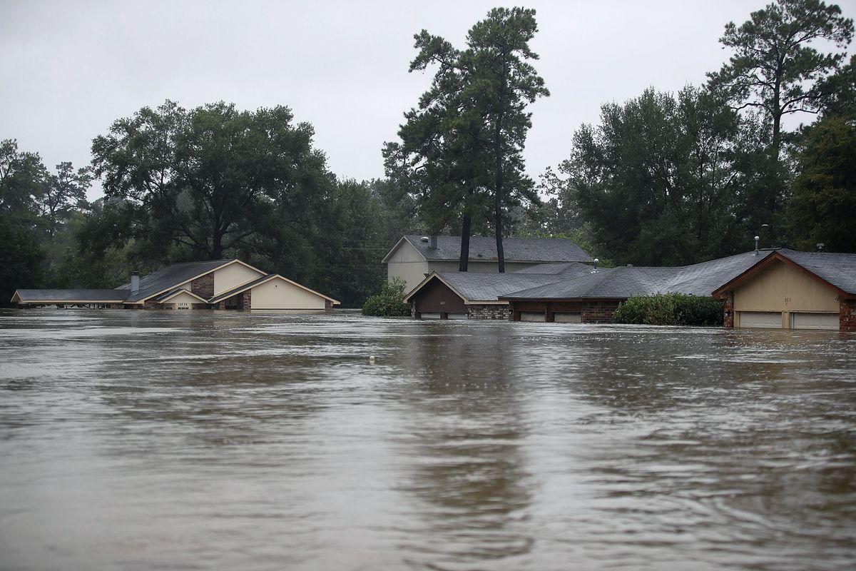
Floods
The accumulation of a large quantity of water at a place or the presence of more water than can be handled by the drainage of the area is known as flood.
Types of Floods
  Flash floods
  River floods
  Coastal floods

Slide 4
Floods
Flash flood
  Flash floods are defined as those flood events where the rise in water is either during or within a few hours of the rainfall that produces the rise.
Causes of flash flood
  Dam failure
  Sudden snowmelt or thawing of glaciers
  A sudden release of water by a debris flow or ice jam
  Steeply-slopped watershed

Slide 5
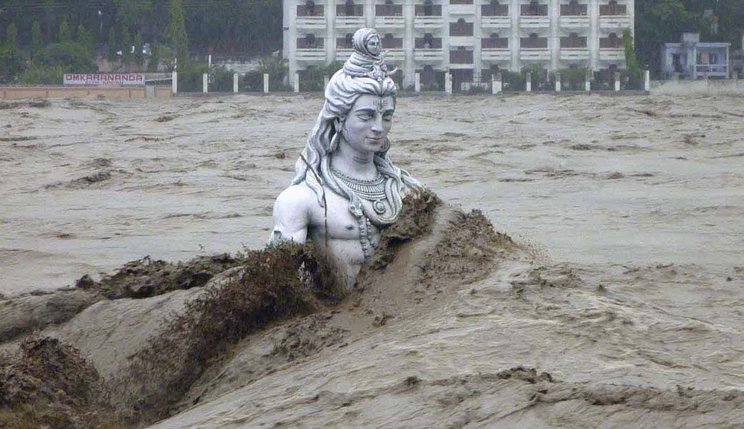
Flash floods

Slide 6
Floods
River flood
  A river flood occurs when a river overspills its banks; that is, when its flow can no longer be contained within its channel.
Causes of river Floods
  Heavy rain
  Snow melt in Spring
  Deforestation
  Weather events like cyclones

Slide 7
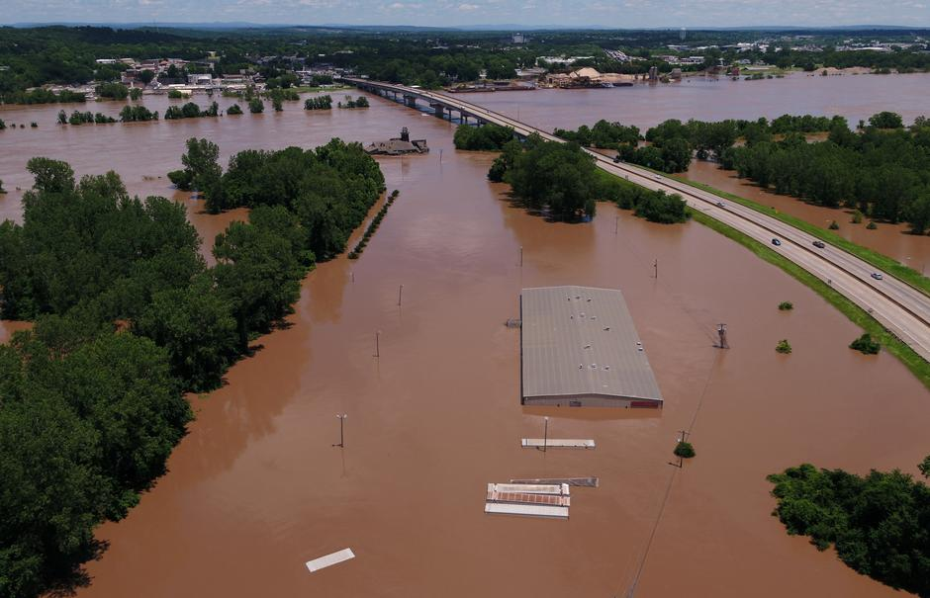
River flood

Slide 8
Floods
Coastal floods
  When a coastal process—such as waves, tides, storm surge, or heavy rainfall from coastal storms—produces that flood, it is called a coastal flood.
Causes of coastal floods
  Rising Sea Levels
  Tsunamis
  Reclaimed Land
Notes:
Reclaimed land which that is under the sea or was in a very poor condition but has been improved so that it can be used for farming or biliding.

Slide 9
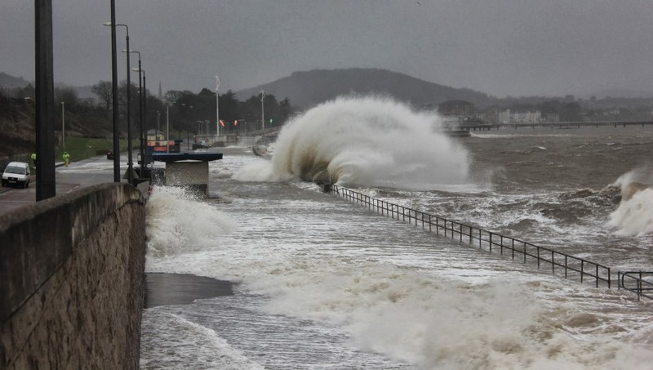
Coastal floods

Slide 10
Floods
Effects of floods
  Damage to agricultural crops
  Damage to life and property
  Disturbances in transportation
  Increase in populations of disease vectors and pathogens
  Loss of biodiversity
  Economic crisis

Slide 11
Floods
Control of floods
  Plantation on slopes
  Drainage management
  Flood plain zoning
  Forecasting
Notes:
Flood plain zoning means zoning of danger zone area to decrease the damage.
Forcasting- future prediction

Slide 12
Cyclone
In northern hemisphere, a cyclone refers to an area of low atmospheric pressure surrounded by a wind system in a counter-clockwise direction.
Types of cyclone
  Tropical Cyclones (Hurricanes, Cyclone, Typhoons and Tornadoes)
  Mesocyclones
  Extratropical Cyclones
  Arctic Hurricanes
Notes:
Cyclone –inside low pressure and high pressure. It is low pressure area with winds spirlling inwards.

Slide 13
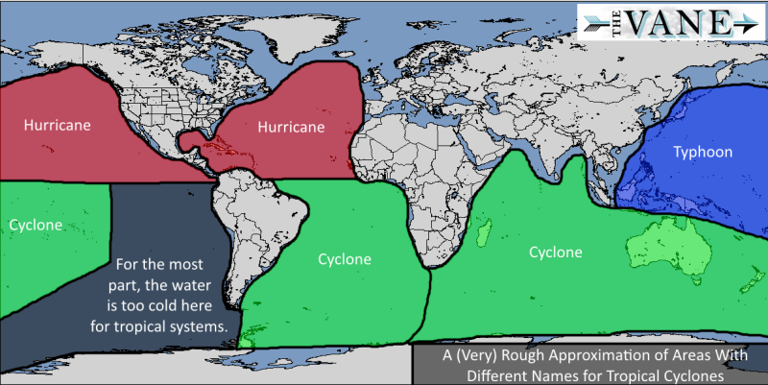
Tropical Cyclones
Notes:
Cyclone – indian ocean, tornadoes – coastal USA, typhoons –china sea,

Slide 14
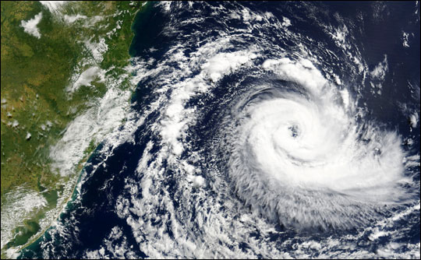
Tropical Cyclone

Slide 15
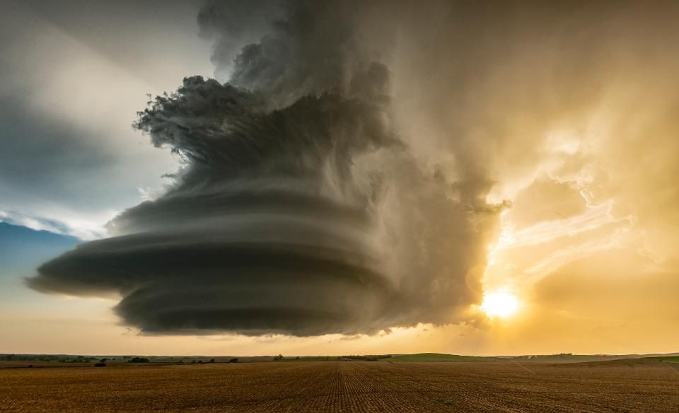
Mesocyclone

Slide 16
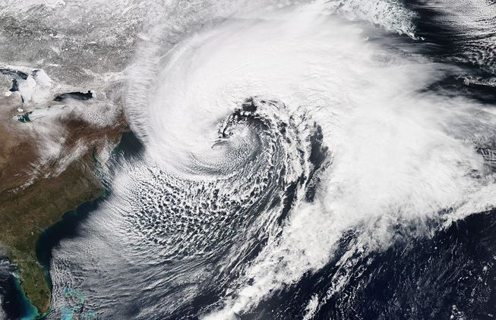
Extratropical Cyclones

Slide 17
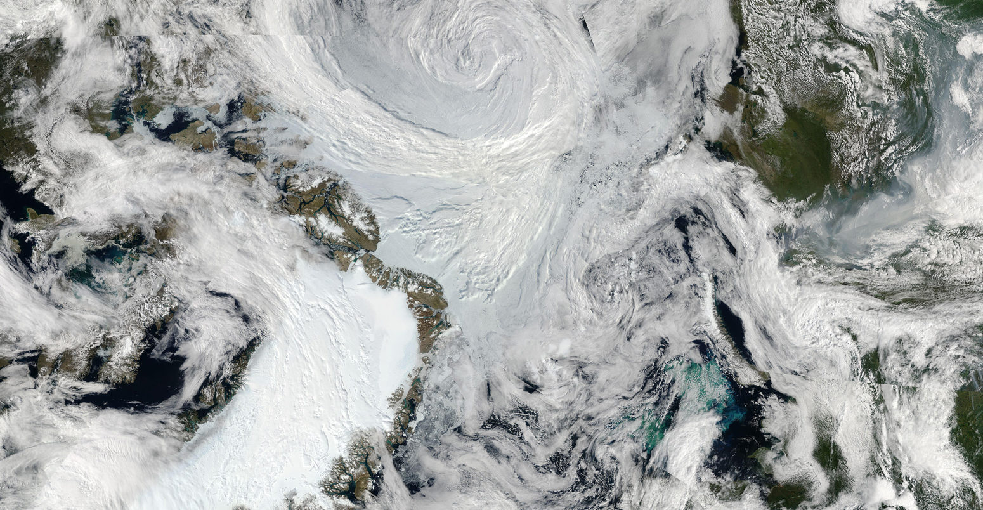
Arctic Hurricanes

Slide 18
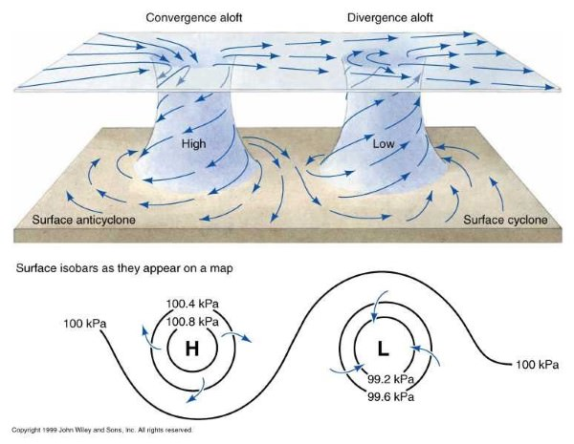
Cyclone and Anticyclone

Slide 19
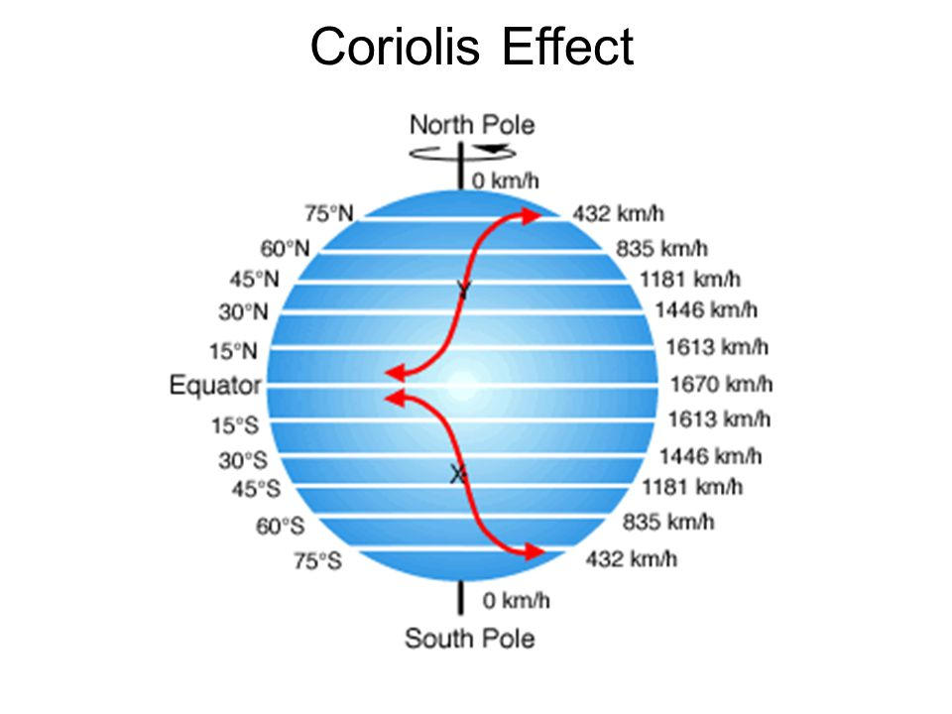
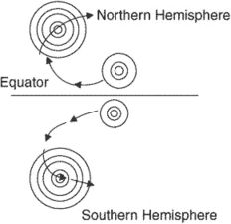
Cyclone and hemispheres
counterclockwise rotation in the Northern Hemisphere
clockwise rotation in the Southern Hemisphere

Slide 20
Cyclones
Effects of Cyclones
  They damage installations, communication systems, trees, etc.
  Results in loss of life and property
  They may cause river floods and submergence of low-lying areas
Management of Cyclones
  Proper construction of houses and Construction of cyclone shelters in the cyclone-prone areas
  Relief tasks
  Development of warning systems
  Community preparedness at all levels to deal with emergency situations

