Slide 1

Current Environmental Problems,
Environmental Legislation

Slide 2
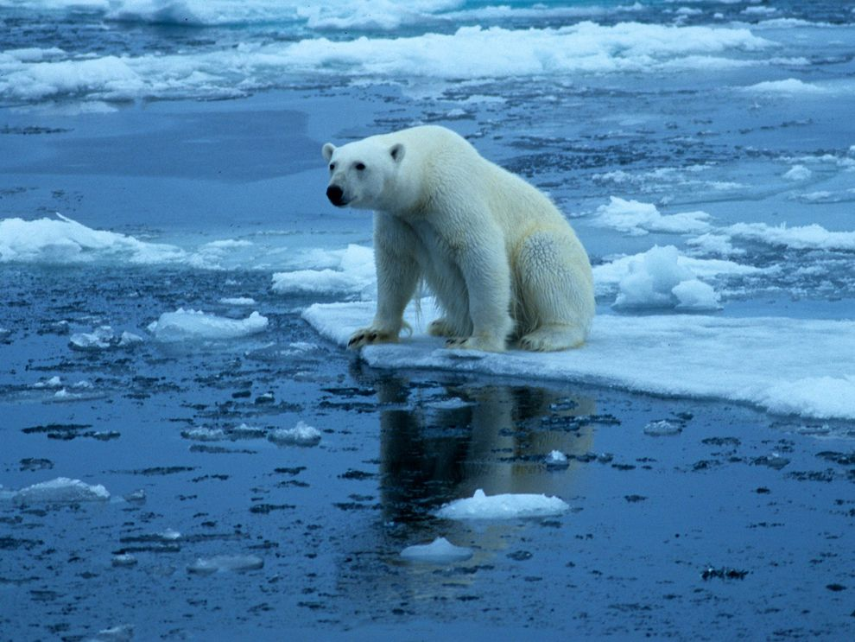
Current Environmental issues
Greenhouse effect and Global Warming
  The term greenhouse effect is used to indicate a heat-trapping process caused by gases such as carbon dioxide, and water vapour which are transparent to incoming solar radiations but re-emit the infrared radiations from Earth's surface.
  Global warming is a long-term rise in the average temperature of Earth as a whole as a result of greenhouse effect.
12/03/19

Slide 3
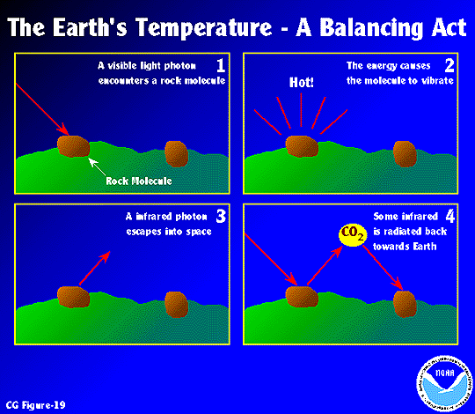
Current Environmental issues
Process
1. High energy wavelengths hit the earths surface
2. Incoming energy is converted to heat
3. Longer, infrared wavelengths hit greenhouse gas molecules in the atmosphere
4. Greenhouse gas molecules in the atmosphere emit infrared radiation back towards earth
12/03/19

Slide 4
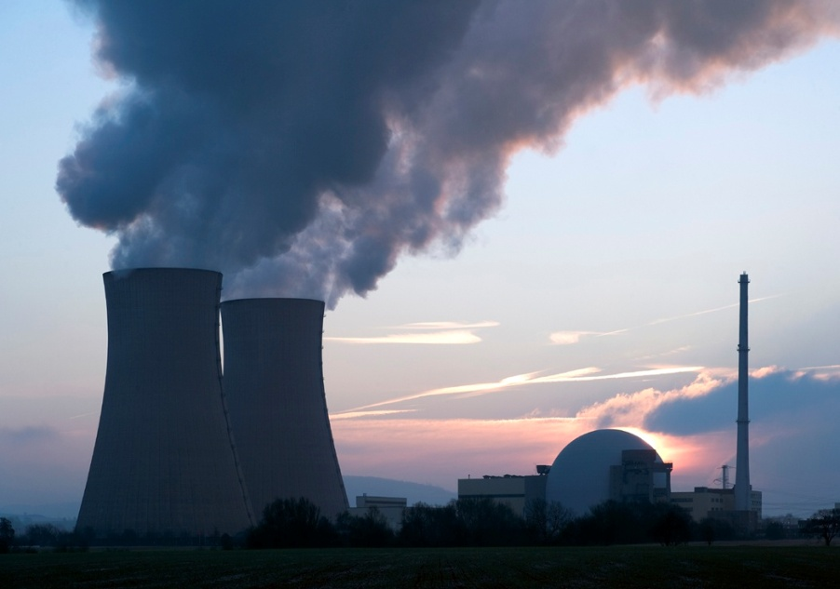
Greenhouses Gases
Some common greenhouse gases
Carbon dioxide
Methane
Nitrous oxide
Chlorofluoro carbons
Causes of greenhouse gases
Fossil-fuel burning
Industrial processes
Deforestation
Livestock
Biomass burning
Coal mining
12/03/19

Slide 5
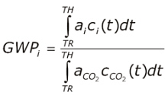
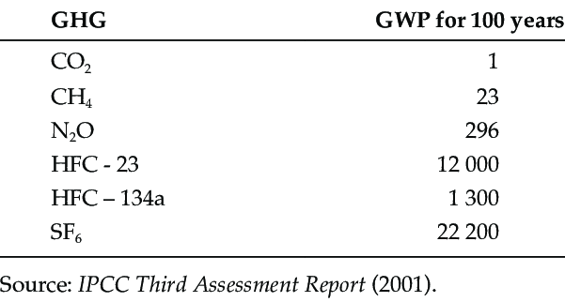
Global Warming Potential (GWP)
Where,
a_{i} is the instantaneous radiative forcing due to the release of a unit mass of trace gas, i, into the atmosphere, at time TR, C_{i} is the amount of that unit mass remaining in the atmosphere at time, t, after its release and TH is TR plus the time horizon over which the calculation is performed

Slide 6
Effects of CO₂ increase
Air and the Earth’s surface may grow warmer.
The stratosphere may become cooler.
Temperate and polar regions may become warmer leading to the reduction in the ice cover of the earth.
Rainfall may be higher than what it is present in the temperate regions.
The greater amount of evaporation due to excess warmth .
12/03/19

Slide 7
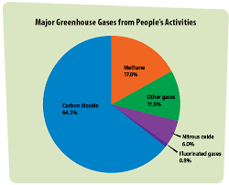
Emission of Greenhouses Gases

Slide 8
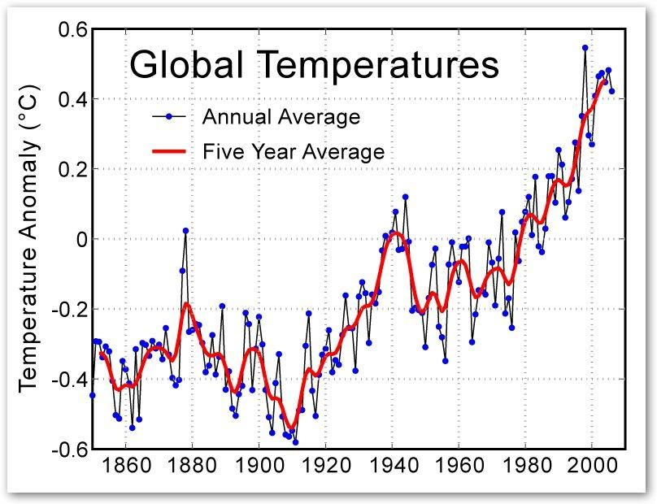
Emission of Greenhouses Gases

Slide 9
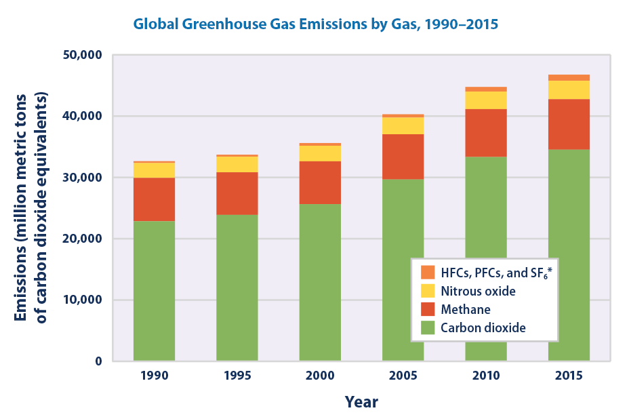

Slide 10
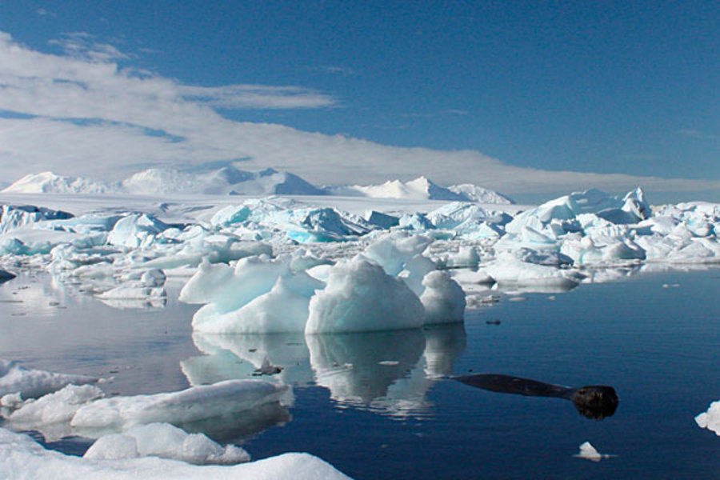
Environmental Effects of Global warming
Climate change
Rise in sea level
Reduced agricultural production
Storms
Adverse effects on human health
Loss of ecosystems and biodiversity
12/03/19

Slide 11
Control measures of Global warming
Reduction in the use of fossil fuels
Shifting to the renewable energy sources that do not emit greenhouse gases
Increasing the use of energy efficient and cleaner production technologies and practices
Reducing deforestation, adopting better forest management practices, and undertaking aforestation to sequester carbon
12/03/19

Slide 12
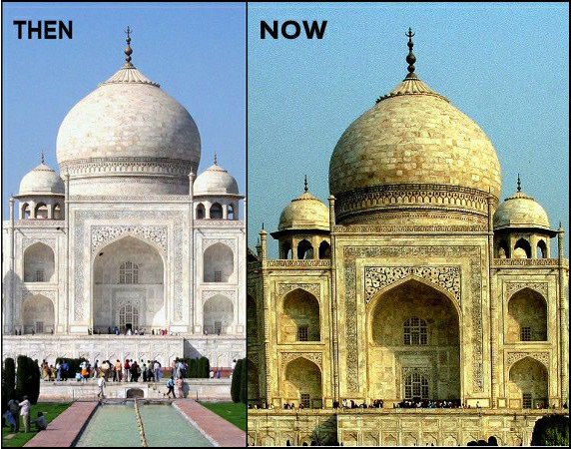
Acid Rain
Acid rain refers to a condition in which natural precipitation becomes acidic after reacting chemically with pollutants in the air.
Causes of Acid Rain
Burning of the fuel as well as the use of nuclear weapons leading to the evolution of large amounts of sulphur dioxide (SO₂) and nitrogen dioxide (NO₂), which get converted to sulphurous acid and nitric acid, respectively.
Effects of Acid rain
Reduction in population of flora and fauna
Damage to terrestrial ecosystems
Corrosion of buildings
Effect on human beings
12/03/19

Slide 13
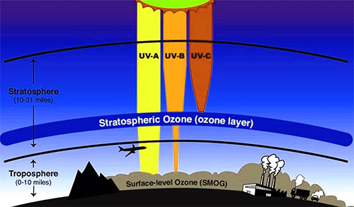

Ozone Layer and Its Depletion
The decrease in the concentration of ozone (O₃) in stratosphere is known as ozone layer depletion.
12/03/19

Slide 14
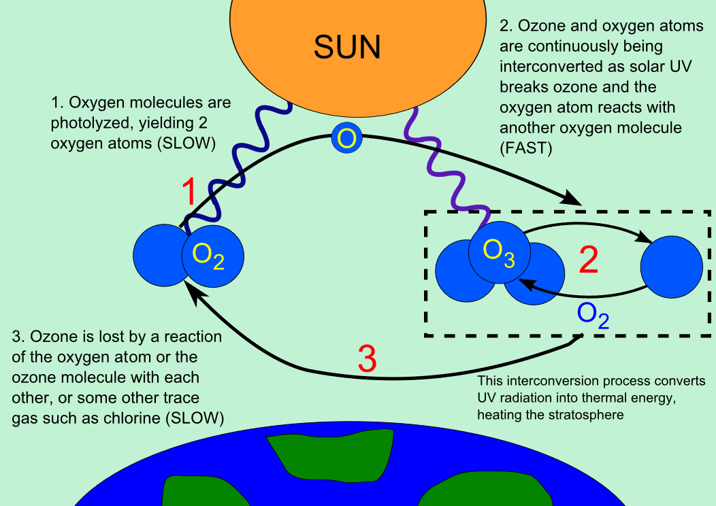

Slide 15
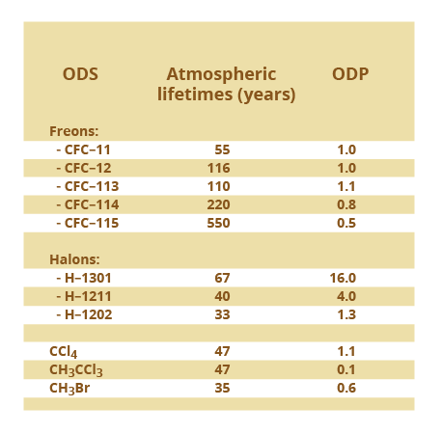
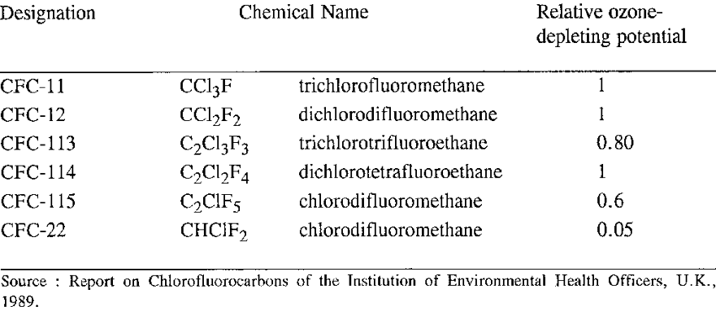
Ozone Depleting Potential (ODP)
Dobson Unit (DU) = 2.6867 x 10²⁰ molecules per meter square

Slide 16
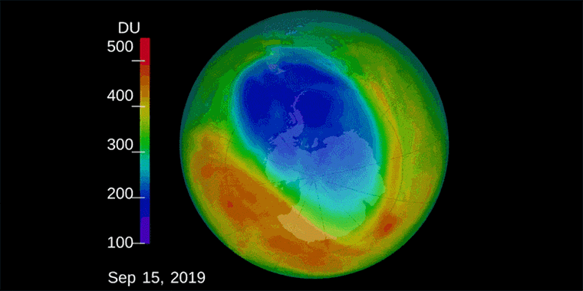
Ozone Hole
The thinning of ozone layer or reduction in concentration of ozone especially over the area of Antarctic continent is known as ozone hole, which covers approximately seven million square kilometer.

Slide 17
The Environment Protection act 1986
Objective- It provides for the protection and conservation of the Environment.
  Enacted in 1986, the Environment Protection Act is an important legislation aimed at protecting the environment and preventing pollution in India.
  The Act provides for the prevention, control, and abatement of environmental pollution, and the protection of the environment overall.
  The Act also empowers the central government to take necessary measures to protect and improve the quality of the environment.

Slide 18
Salient Features of the Environment Protection Act 1986
  The Act provides for the establishment of Central and State Pollution Control Boards, which are responsible for enforcing the provisions of the Act and implementing pollution control measures.
  The Act empowers the government to regulate and restrict industrial activities that may cause pollution, and to impose penalties for non-compliance.
  The Act also provides for the appointment of Environmental Impact Assessment (EIA) authorities, who are responsible for assessing the potential environmental impacts of developmental projects before they are approved.

Slide 19
Impact of the Environment Protection Act 1986
  The Environment Protection Act has had a significant impact on the protection of the environment in India.
  The Act has led to the establishment of pollution control measures, such as the installation of effluent treatment plants, and has helped to reduce the pollution levels in air and water.
  The Act has also led to the promotion of sustainable development practices, and has helped to raise public awareness about the importance of protecting the environment.

Slide 20
Amendments of Environment Protection Act 1986
Amendment | Year | Key Provisions
1st Amendment | 1991 | Introduced the concept of "hazardous substances“ Required certain industries to obtain consent from the State Pollution Control Board (SPCB) before operating
2nd Amendment | 1992 | - Made it mandatory for industries to disclose information related to the discharge of pollutants into the environment
3rd Amendment | 1997 | - Established the National Environment Appellate Authority to hear appeals against decisions made by the central and state pollution control boards
4th Amendment | 2001 | strengthen the provisions for penalizing polluters and introduced the concept of 'polluter pays principle', which makes polluters liable to pay for the environmental damage caused by their activities.
5th Amendment | 2003 | - Increased penalties for offenses under the Act
6th Amendment | 2010 | - Introduced provisions related to the regulation of electronic waste
7th Amendment | 2021 | - Introduced provisions related to the management of air pollution in the National Capital Region (NCR)

Slide 21
Environmental Impact Assessment (EIA)
  EIA is a process of evaluating the potential environmental impacts of a proposed project or development.
    Examples: Construction of a new road or building, Mining and mineral extraction, Large-scale agricultural projects, Oil and gas exploration and production
  Steps in Environmental Impact Assessment:
    Screening
    Scoping
    Assessment
    Mitigation
    Review and Monitoring

Slide 22
Air (Prevention and Control of Pollution) Act of 1981
Air (Prevention and Control of Pollution) Act, 1981 was enacted by the Indian Parliament to provide for the prevention, control, and abatement of air pollution.
The Act aims to protect and improve the quality of air and to prevent and control air pollution in India.
Some of the key features of the Act include the establishment of State Pollution Control Boards, the regulation of industries and vehicles, and the imposition of penalties for non-compliance with the provisions of the Act.

Slide 23
Roles and Responsibilities of Air (Prevention and Control of Pollution) Act of 1981
The Act assigns certain roles and responsibilities to different entities for the prevention and control of air pollution.
The Central Pollution Control Board (CPCB) is responsible for coordinating the activities of State Pollution Control Boards and providing technical assistance and guidance to them.
The State Pollution Control Boards (SPCBs) are responsible for implementing the provisions of the Act within their respective states and monitoring air quality.
Industries and other establishments are required to obtain a consent to operate under the Act and comply with emission standards and other regulations.

Slide 24
Roles and Responsibilities of Air (Prevention and Control of Pollution) Act of 1981
The Act prescribes penalties for various offences related to air pollution. These penalties can range from fines to imprisonment.
Some of the offences under the Act include operating an industrial plant without obtaining a consent to operate, violating emission standards, and failing to comply with the directions of the SPCBs or CPCB.
The Act also provides for the closure of industries or establishments that violate the provisions of the Act and pose a serious threat to public health and the environment.

Slide 25
Amendments of Air (Prevention and Control of Pollution) Act of 1981
Amendment | Year | Key Provisions
1st Amendment | 1987 | Introduced the concept of "hazardous substances" Required certain industries to obtain consent from the State Pollution Control Board (SPCB) before operating
2nd Amendment | 1991 | - Made it mandatory for new industries to obtain a "no objection certificate" (NOC) from the SPCB before starting operations
3rd Amendment | 1993 | Added provisions related to the prevention and control of vehicular pollution. Introduced the concept of "pollution under control" (PUC) certificates for vehicles. Required new vehicles to meet emission standards set by the Central Pollution Control Board (CPCB)
4th Amendment | 1998 | - Made it mandatory for existing industries to obtain a renewal of their consent from the SPCB every five years
5th Amendment | 2018 | Expanded the definition of "air pollutant" to include particulate matter Introduced new emission standards for thermal power plants and cement industries Made it mandatory for construction sites measuring more than 20,000 square meters to obtain environmental clearance from the CPCB

Slide 26
NAAQS (National Ambient Air Quality Standard)
Pollutant | Time Weighted Average | Concentration in Ambient Air
 |  | Industrial, Residential, Rural and Other Areas | Ecologically Sensitive Area (notified by Central Government)
Sulphur Dioxide (SO₂), µg/m³ | Annual* 24 hours** | 50 80 | 20 80
Nitrogen Dioxide (NO₂), µg/m³ | Annual* 24 hours** | 40 80 | 30 80
Particulate Matter (size less than 10 µm) or PM₁₀ µg/m³ | Annual* 24 hours** | 60 100 | 60 100
Particulate Matter (size less than 2.5 µm) or PM_{2.5} µg/m³ | Annual* 24 hours** | 40 60 | 40 60
Ozone (O₃) µg/m³ | 8 hours* 1 hour** | 100 180 | 100 180
Lead (Pb), µg/m³ | Annual* 24 hours** | 0.50 1.0 | 0.50 1.0
Carbon Monoxide (CO) mg/m³ | 8 hours* 1 hour** | 02 04 | 02 04
Ammonia (NH₃) µg/m³ | Annual* 24 hours** | 100 400 | 100 400
Benzene (C₆H₆) µg/m³ | Annual* | 5 | 5
Benzo(a)Pyrene (BaP)- particulate phase only, ng/m³ | Annual* | 1 | 1
Arsenic(As), ng/m³ | Annual* | 6 | 60
Nickel (Ni), ng/m³ | Annual* | 20 | 20

Slide 27
Water (Prevention and Control of Pollution) Act 1974
Water (Prevention and Control of Pollution) Act, 1974 is a legislation enacted by the Indian Parliament to prevent and control water pollution.
The Act aims to maintain and restore the wholesomeness of water and to establish central and state boards for the prevention and control of water pollution.
Some of the key features of the Act include the regulation of discharge of pollutants into water, the establishment of standards for water quality, and the imposition of penalties for non-compliance with the provisions of the Act.

Slide 28
Roles and responsibilities of Water (Prevention and Control of Pollution) Act 1974
The Act assigns certain roles and responsibilities to different entities for the prevention and control of water pollution.
The Central Pollution Control Board (CPCB) is responsible for coordinating the activities of State Pollution Control Boards and providing technical assistance and guidance to them.
The State Pollution Control Boards (SPCBs) are responsible for implementing the provisions of the Act within their respective states and monitoring water quality.
Industries and other establishments are required to obtain a consent to operate under the Act and comply with effluent standards and other regulations.

Slide 29
Roles and responsibilities of Water (Prevention and Control of Pollution) Act 1974
The Act prescribes penalties for various offences related to water pollution. These penalties can range from fines to imprisonment.
Some of the offences under the Act include discharging pollutants into water without obtaining a consent to operate, violating effluent standards, and failing to comply with the directions of the SPCBs or CPCB.
The Act also provides for the closure of industries or establishments that violate the provisions of the Act and pose a serious threat to public health and the environment.

Slide 30
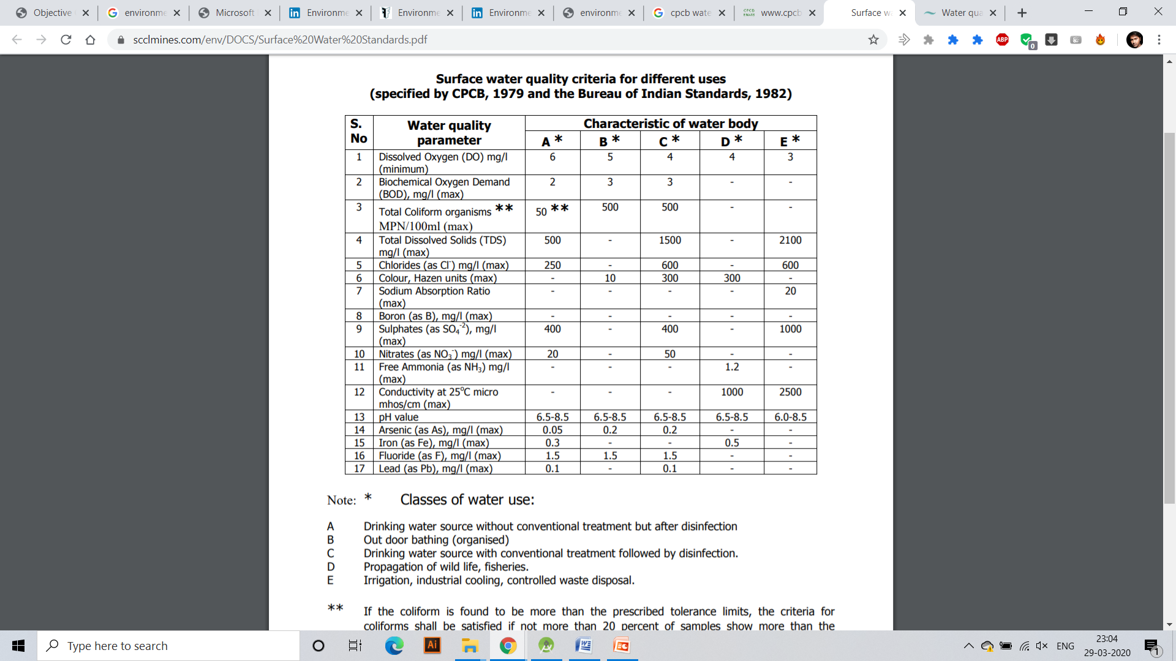

Slide 31
Amendments of Water (Prevention and Control of Pollution) Act 1974
Amendment | Year | Key Provisions
1st Amendment | 1988 | Introduced the concept of "hazardous substances“ Required certain industries to obtain consent from the State Pollution Control Board (SPCB) before discharging effluent
2nd Amendment | 1991 | - Made it mandatory for new industries to obtain a "no objection certificate" (NOC) from the SPCB before starting operations
3rd Amendment | 1994 | - Made it mandatory for all existing industries to obtain a renewal of their consent from the SPCB every five years
4th Amendment | 2003 | - Introduced provisions related to the prevention and control of groundwater pollution
5th Amendment | 2018 | Introduced provisions related to the regulation of groundwater extraction Required industries to obtain a "consent to operate" from the SPCB before extracting groundwater Made it mandatory for all industries to comply with effluent and emission standards set by the CPCB

Slide 32
Wildlife Protection Act of 1972
The Wildlife Protection Act of 1972 is a comprehensive legislation that aims to protect and conserve the wildlife and its habitats in India.
Objective- The objective of the Wildlife Protection Act of 1972 is to protect the wildlife of India and to regulate hunting, poaching, and trade in wildlife and their products..
Functions-
To provide protection to all forms of wild animals, birds, and plants.
To ensure the conservation of wildlife and their habitats.
To regulate hunting, trapping, and poaching of wild animals.
To establish protected areas such as national parks, sanctuaries, and biosphere reserves for the conservation of wildlife.
To prevent the trade of wildlife and their products.
To provide legal framework for the management of captive animals and their welfare.
To promote public awareness about wildlife conservation and their importance.
To encourage research and scientific studies on wildlife and their habitats.
To coordinate with other countries for the protection and conservation of migratory species.
To provide punishment and penalties for violation of the provisions of the Act.

Slide 33
Wildlife Protection Act of 1972
Year | Key Provisions
1982 | Included new species in the list of protected animals Increased penalties for offenses under the Act
1992 | Established the Central Zoo Authority to regulate zoos in the country
1993 | - Introduced provisions related to the protection of plants and their habitats
2003 | Established the National Board for Wildlife to advise the government on wildlife conservation issues
2013 | Increased penalties for offenses under the Act

Slide 34
Forest Conservation Act of 1980
Objective- It provides for the protection and conservation of the forests.
Under the Act, a state government may regulate or prohibit in any forest the clearing of land for cultivation, pasturing of cattle, or clearing the vegetation for any purpose.
Functions-
The Forest Conservation Act was enacted in 1980 to regulate the diversion of forest land for non-forestry purposes such as mining, industries, infrastructure, and other developmental activities.
The act requires prior approval from the central government for any diversion of forest land for non-forestry purposes.
The act provides for compensatory afforestation, which means that an equivalent area of land has to be afforested in lieu of the forest land that was diverted.
The act also mandates the creation of a national committee to oversee the implementation of the act and ensure that the diversion of forest land is kept to a minimum.
The Forest Conservation Act is aimed at protecting the forests and ensuring their sustainable use, as forests are an important part of the country's natural resources and provide a range of ecological, economic, and social benefits.

Slide 35
Amendments of Forest Conservation Act of 1980
Year | Key Provisions
1988 | -National forest policy was introduced
1992 | Established the National Afforestation and Eco-Development Board to promote afforestation and regeneration of degraded forests
1996 | - Introduced provisions related to the participation of local communities in forest conservation and management
2003 | - Made it mandatory for state governments to seek the approval of the central government before diverting forest land for non-forestry purposes
2017 | Exempted bamboo grown in non-forest areas from the definition of "tree" under the Act Allowed for the cultivation and harvesting of bamboo grown in forest areas by tribal communities

Slide 36
Environmental protocols
Kyoto Protocol (1997)
  Aims to reduce greenhouse gas emissions and combat climate change.
  It was adopted in 1997 and came into force in 2005.
  The protocol set binding targets for 37 industrialized countries and the European Union to reduce their greenhouse gas emissions below 1990 levels.
  The goal was to collectively reduce emissions by 5.2% by the end of 2012.
  The protocol created a market-based mechanism known as carbon trading, where countries that exceed their emissions reduction targets can sell excess credits to countries that have not met their targets.
  The protocol also established the Clean Development Mechanism (CDM), which allows industrialized countries to earn credits by funding emission reduction projects in developing countries.
  The Kyoto Protocol has been criticized for not including major emitters such as China and the United States, who later withdrew from the agreement.
  Despite these criticisms, the Kyoto Protocol served as an important precursor to the Paris Agreement, which was adopted in 2015 and set more ambitious emissions reduction targets.
12/03/19

Slide 37
Environmental protocols
Montreal Protocol (1987)
  The Montreal Protocol was adopted in September 1987 and entered into force on January 1, 1989.
  The protocol is an international treaty that aims to protect the ozone layer by phasing out the production and consumption of substances that deplete it, such as chlorofluorocarbons (CFCs) and other ozone-depleting substances (ODS).
  The protocol has been successful in reducing the production and consumption of ODS, and as a result, the ozone layer is slowly recovering.
  The protocol has been amended several times to strengthen its provisions and address new ozone-depleting substances that have been discovered.
  The protocol has been ratified by nearly every country in the world, making it one of the most widely adopted environmental treaties in history.
  The success of the Montreal Protocol has demonstrated that international cooperation and action can be effective in addressing global environmental challenges.
12/03/19

Slide 38
Environmental protocols
Convention on Biological diversity (1992)
  The CBD has been ratified by 196 countries and the European Union, making it one of the most widely recognized international environmental treaties.
  Three main objectives:
    The conservation of biological diversity
    The sustainable use of its components
    The fair and equitable sharing of benefits arising from the use of genetic resources.
  Nagoya Protocol: In 2010, the Nagoya Protocol on Access to Genetic Resources and the Fair and Equitable Sharing of Benefits Arising from their Utilization was adopted as a supplementary agreement to the CBD.
  The CBD has set several targets to protect and conserve biodiversity, including the Aichi Biodiversity Targets, which aim to halt the loss of biodiversity by 2020.
  Despite the efforts of the CBD, the world has not met the biodiversity targets set by the Convention. There are several challenges to the implementation of the CBD, including lack of political will, inadequate financial resources, and insufficient public awareness about the importance of biodiversity conservation.
12/03/19

Slide 39

Issues involved in enforcement of Environmental Laws
Illiteracy
Growing population
Ignorance
Economic reasons
Insufficiency of laws
12/03/19

Slide 40
Thank You

