Slide 1

Environmental Pollution

Slide 2
Soil Pollution
Any change in the physical, chemical, and biological properties of soil due to natural or anthropogenic activities that leads to adverse effects on human health, plants, animals or environment is known as soil pollution.
Major Soil Pollutants and their effects
  1) Heavy Metal (Mercury, Lead, Arsenic, Cadmium)
  2) Chemical waste
  3) Pesticides, fertilizers and other agricultural products
  5) Radioactve waste
12/03/19

Slide 3
Soil Pollution
Causes of Soil Pollution
  Industrial waste
  Mining
  Agricultural waste
  Domestic waste
  Radioactive wastes
Effects of Soil Pollution
  Reduces the fertility of the soil
  Causes an increase in the number of mosquitoes and flies, which are vectors of several deadly diseases
  Reduces the aesthetic value of land
  Radioactive elements present in polluted soil enter human body and cause a number of adverse health effects such as cancer, deformities in bones, etc.
12/03/19

Slide 4
Soil Pollution
Control of Soil Pollution
  Treatment of industrial waste before being disposed to reduce soil pollution.
  Garbage from urban waste should be segregated into biodegradable and non-biodegradable waste products. Biodegradable waste can be used for production of manures and biogas, non-biodegradable waste can be recycled and reused.
  Planting of trees must be encouraged.
  Reduction in the amount of radioactive materials released in the soil
  Reduction in the use of chemical fertilizers and pesticides
  Solid waste can be used for electricity generation.
12/03/19

Slide 5
Solid waste
Solid waste is that material (such as domestic trash, garbage, metal scrap etc.) which arises from various human activities and which is normally discarded as useless or unwanted. It is responsible for land pollution in urban and industrial areas.
Garbage refers to the putrescible solid waste (Solid waste that contains organic matter capable of being decomposed by microorganisms easily) constituents produced during the preparation or storage of meat, vegetables, etc.
Rubbish is the non-putrescible solid waste constituents, either combustible or non combustible. Combustible waste includes paper, wood, wood scrap, rubber, leather, etc. Non-combustible wastes are metals, glass, ceramics etc.
Refuse means all decomposing and non-decomposing combustible and non-combustible solid wastes such as garbage, ashes, paper, cans, wood scraps, plastic etc.
12/03/19

Slide 6
Important source of solid waste
Domestic garbage refers to household wastes such as plastic, paper, glass pieces, metal objects etc.
Pathological wastes include dead animals and human waste.
Industrial wastes generally include chemicals, paints, sand, metal ore processing, fly ash, sewage treatment sludge, etc.
Agricultural wastes contain mainly farm animal manure and crop residues.
Municipal Solid waste (MSW) is commonly known as trash or garbage and consists of everyday items such as product packaging, furniture, bottles etc.
Mining wastes result from mining activities. Eg. Heavy metals.
Radioactive wastes: Nuclear explosions, nuclear testing, use of radioactive substances in medical and scientific research etc.
Hospital wastes (BMW) includes disposable needles, syringes, blades, tissues etc.
E-waste refers to electrical and electronic equipment wastes.
12/03/19

Slide 7
Effects of Solid Waste
Solid waste helps disease-causing organisms such as mosquitoes, flies, etc., to thrive freely and increase in population.
It runs off with rainwater and mixes with the nearby water bodies causing water pollution.
Burning of solid waste leads to air pollution.
Radioactive substances present in solid waste cause a number of diseases in human beings.
Solid waste reduces the aesthetic value of land.
Non-biodegradable solid wastes such as polythene, plastic, rubber, etc., release toxic gases when burnt hence causing air pollution.
12/03/19

Slide 8
Solid waste management
Indiscriminate disposal of solid wastes-especially of hazardous waste causes adverse environment effects.
The main objective of solid waste management is to minimize these adverse effects before it becomes too difficult to rectify in the future.
12/03/19

Slide 9
Solid waste management
Main Functional Elements:
  Waste generation
  Waste management
    Storage
    Collection
    Transfer/transport
    Processing/recovery
    Disposal
12/03/19

Slide 10
Solid waste management
Solid waste management (SWM) is a three-step process:
  Collection of solid waste
  Transportation of solid waste
  Disposal of solid waste
12/03/19

Slide 11
Collection of solid waste
Large number of dustbins must be provided to enable proper collection of solid wastes according to categories.
Door to door collection of domestic garbage, is the most common and popular practice.
Rag pickers contribute to waste management. They segregate recyclable materials from other wastes and hence save the cost and time.
12/03/19

Slide 12
Transportation of solid waste
Transportation of solid wastes from urban areas to the dumping grounds with the help of tractors, trucks etc.
Transfer station
  Reduces
    transportation cost
    vehicular emission
    maintenance cost.
12/03/19

Slide 13
Processing/Recovery of solid waste
Reduction of the use of raw materials
Reuse of waste materials
  Repair
Recycling of materials
  Reformation of old products
  Formation of new products
12/03/19

Slide 14
Disposal of solid waste
Open dumping
Land fill
Ocean dumping
Burning (Incineration)
Composting
Reduction at source
12/03/19

Slide 15
Disposal of solid waste
Sanitary landfill
  Garbage is spread out in thin layers, compacted and covered with clay/plastic foam
  Bottom is covered with impermeable linings to prevent the percolation of leachates.
  When the landfill is full, it is covered with clay, sand and gravels
  Monitoring wells are drilled near the landfill area
  Landfill gas (Methane) is produced.
Composting
  It is done due to the shortage of landfill area
  Decomposed in oxygen-rich medium
  Nutrient rich manure is produced
Incineration
  Burning of waste in very high temperature
  Initial cost is very high
  Dioxin, furan, lead, cadmium etc. can be released. So, battery or plastics should be removed before burning
12/03/19

Slide 16
Noise Pollution
Noise: Unpleasant/ unwanted sound
Noise pollution: The noise propagates through the atmosphere that leads to discomfort and health hazards is known as noise pollution.
Noise measurement is expressed as Sound Pressure Level (SPL)
SPL is a logarithmic ration of sound pressure to a reference pressure.
International reference pressure is 2 X 10 ⁻⁵ Pa. (average threshold of hearing)
Unit of SPL is decibel.
Threshold of pain is 130 dB
Types of noise: Continuous, Intermittent, Impact/Impulsive
12/03/19

Slide 17
Sources of Noise Pollution
Natural phenomena such as violent volcanic eruptions, thunder, fierce storms, etc.
Domestic appliances such as mixers, washing machines, telephones, etc.
Industries such mills and factories
Automobiles –music system n constant honking by drivers, Noise by Trains, ships, and aircrafts
Bursting of crackers and playing loud music during social gatherings and festivals.
Entertainment devices such as radio, television, etc.
12/03/19

Slide 18
Effects of Noise pollution
Auditory effects:
  Temporary or permanent hearing loss
Non-auditory effects:
  Heart problems
  Change in blood pressure
  Loss of working efficiency
  Insomnia
  Emotional and behavioral change
Effects on wildlife
  Habitat loss
  Problems in laying eggs
  Damage in vocal chords
12/03/19

Slide 19
Control of Noise Pollution
Control at source
  Designing, fabricating and using quieter machines to replace the noisy ones
  Proper lubrication and better maintenance of machines
  Installing noisy machine in soundproof chamber
  Using vibration dampener
  Using silencers in automobiles
Control in transmission
  Noise barrier
Control at receptor
  Ear-protection aids like earplugs, noise helmets, headphones etc.
12/03/19

Slide 20
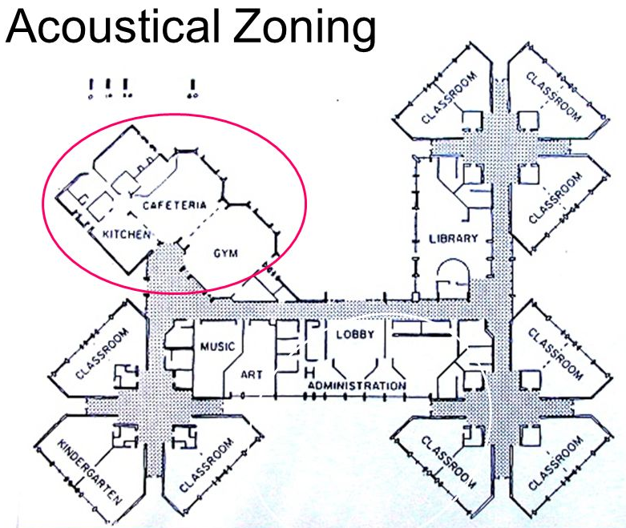
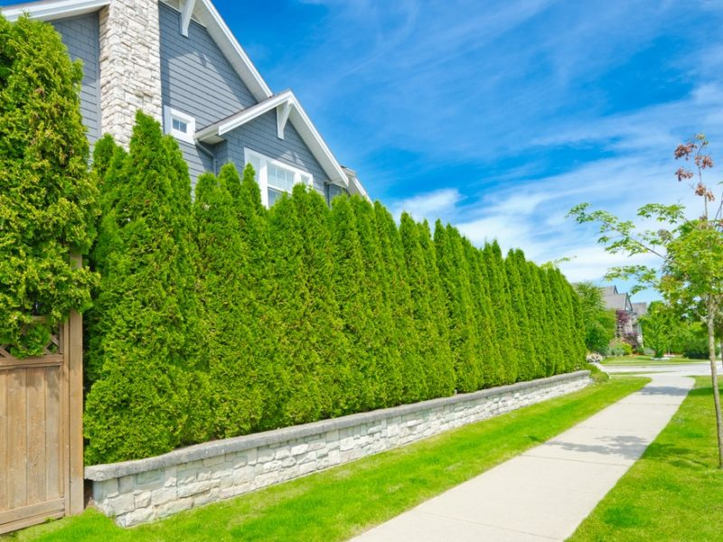
Control of Noise Pollution
Other methods
  Acoustic Zoning
  Planting of Trees
  Legislative measures
12/03/19

Slide 21
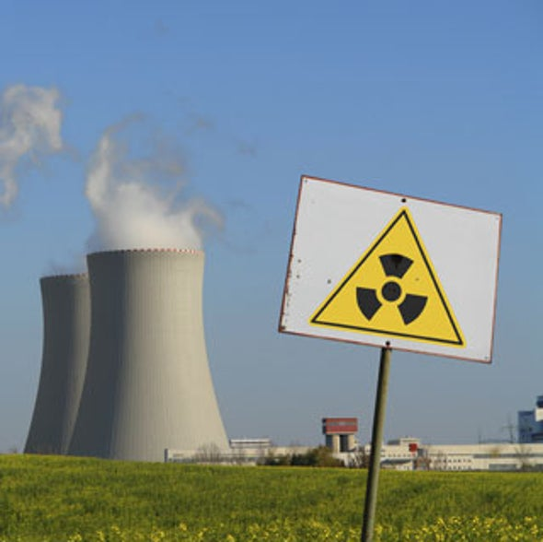
Radiation Pollution
Radiation pollution is the emission of any form of ionizing (alpha and beta) or non-ionizing (gamma) radiation as a result of natural or human activities.
Causes
  Natural
    Cosmic rays from outer space
    Radioactive Radon-222
    Soil, rock, water, air and food
    may contain radioactive materials
  Anthropogenic
    Nuclear power plants
    Nuclear accidents
    Medical X-rays, test laboratories
12/03/19

Slide 22
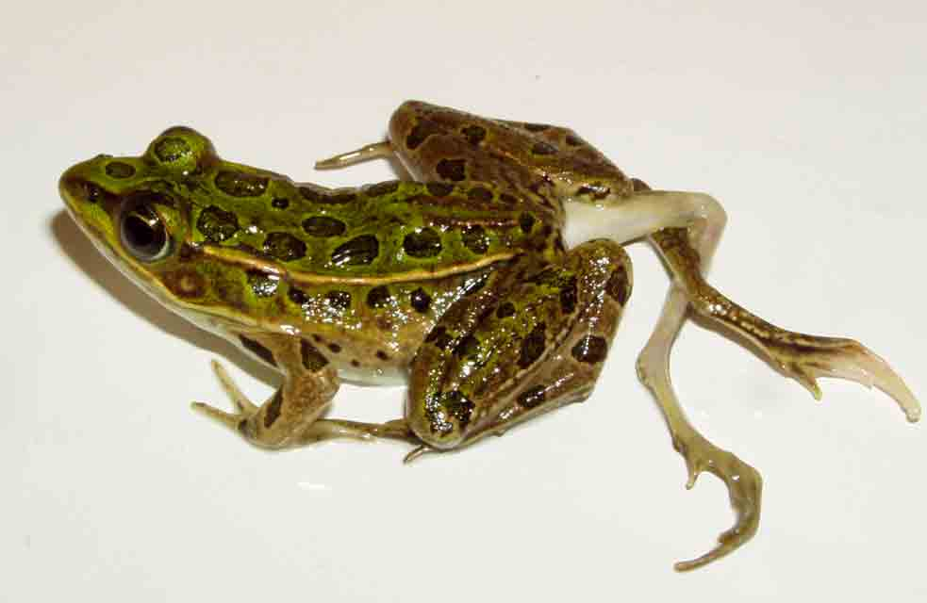
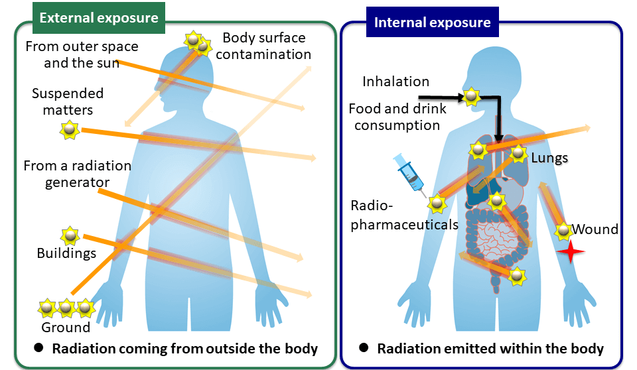
Radiation Pollution
Unit of radioactive exposure
  Rem (Roentgen equivalent man)
Effects of Radiation Pollution
  Somatic Effects (Change in body cells)
    skin cancer
    bone cancer
    reduction of life span
    premature ageing
  Genetic Effects (Change in DNA)
    Defect in child birth
    Infant mortality
12/03/19

Slide 23
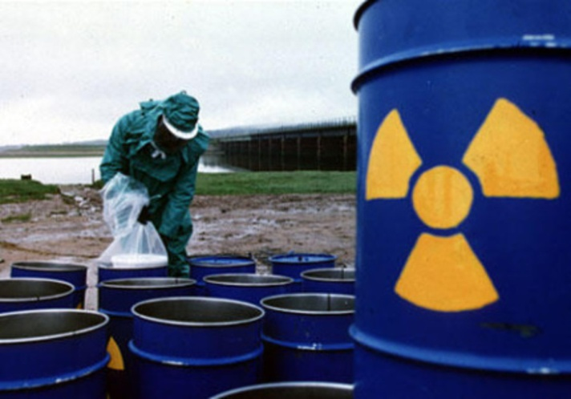
Radiation Pollution
Control of Radiation pollution
  Dense trees should be planted around atomic power plants.
  Proper management of radioactive waste should be ensured.
  Unnecessary X-ray examination should be avoided. Lead shields should be used by workers.
  During nuclear installations, various aspects must be considered
    Site selection
    Design
    Construction process
    Operating conditions
    Precautionary measures and preparedness for disasters
12/03/19

Slide 24
Thank You

